Slide 1
Slide Instructions
General
Font size title: 44
Font size text: 28
Font: Red Hat Display
Font color on white background: Dark Gray (Hex: #333333)
Font color on black background: white (Hex: #FFFFFF)
Font color on white background: Dark Red (Hex: #9B0000)
Extra
UW Branding Information: https://brand.wisc.edu/visual-identity/colors/
Page numbers (Insert > Slide Number)
Slide layout adjustments (View > Slide Master)
Design layouts and logos that will be presented as backgrounds of the slides
Overview │ Methods │ Results

Slide 2
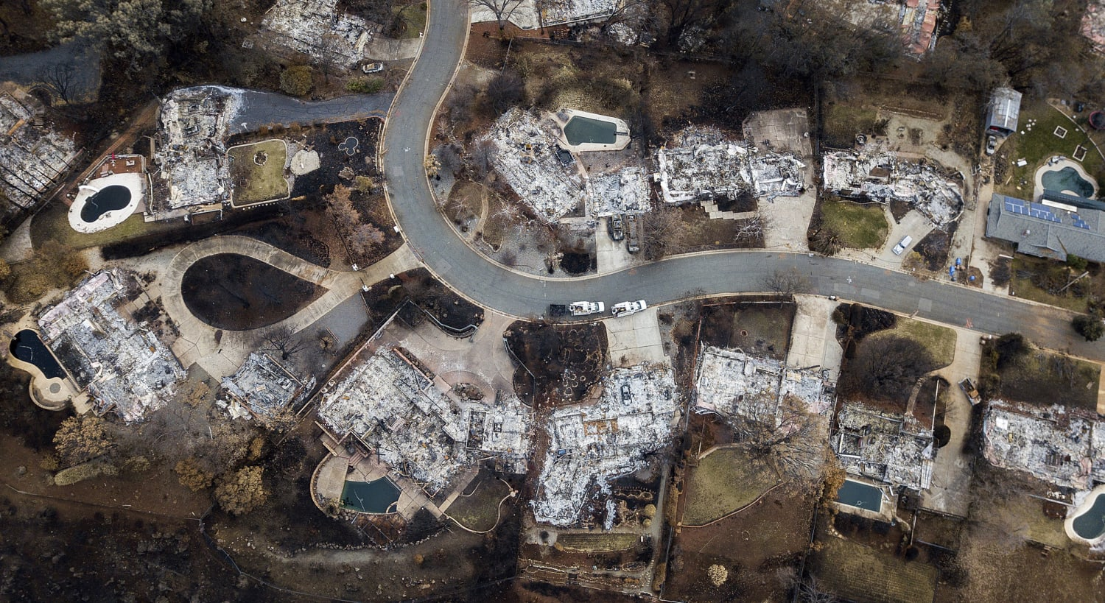
Rapid growth of the United States wildland-urban interface raises wildfire risk
Volker Radeloff and Dave Helmers
Notes:
Image source: https://www.google.com/url?sa=i&url=https%3A%2F%2Fwww.nbcnews.com%2Fnews%2Fus-news%2Fparadise-returned-some-allowed-back-devastated-town-after-deadly-california-n944586&psig=AOvVaw1pbBCGNlv2F7sa-MoQnghJ&ust=1727891514701000&source=images&cd=vfe&opi=89978449&ved=0CBQQjRxqFwoTCLj209Tf7YgDFQAAAAAdAAAAABAE

Slide 3
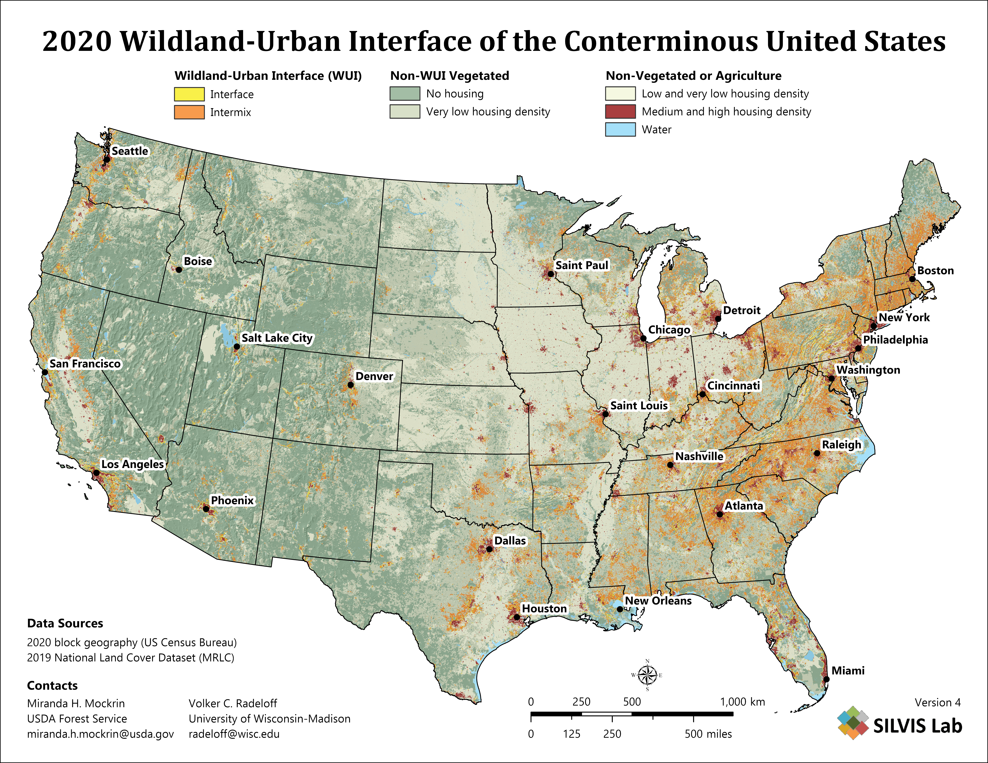
The 2020 WUI in the United States
Wildfire problems are most pronounced in the WUI
41% WUI growth from 1990 to 2010
new WUI areas mainly due to new housing

Slide 4
The 2020 WUI in the United States
Table 1: Table caption….
Region | WUI in 1990 | WUI in 2000 | WUI in 2010
California | 5.6 % | 6 % | 6.6 %
Colorado | 2.2 % | 2.9 % | 3.6 %
Florida | 9.6 % | 11.3 % | 12.9 %
Wisconsin | 6.7 % | 7.8 % | 9.3 %

Slide 10
Rapid growth of the United States wildland-urban interface raises wildfire risk
Volker Radeloff and Dave Helmers
Notes:
Image source: https://www.google.com/url?sa=i&url=https%3A%2F%2Fwww.nbcnews.com%2Fnews%2Fus-news%2Fparadise-returned-some-allowed-back-devastated-town-after-deadly-california-n944586&psig=AOvVaw1pbBCGNlv2F7sa-MoQnghJ&ust=1727891514701000&source=images&cd=vfe&opi=89978449&ved=0CBQQjRxqFwoTCLj209Tf7YgDFQAAAAAdAAAAABAE

Slide 11
The 2020 WUI in the United States
Wildfire problems are most pronounced in the WUI
41% WUI growth from 1990 to 2010
new WUI areas mainly due to new housing

Slide 12
WUI growth in the United States
Table 1: Table caption….
Region | WUI in 1990 | WUI in 2000 | WUI in 2010
California | 5.6 % | 6 % | 6.6 %
Colorado | 2.2 % | 2.9 % | 3.6 %
Florida | 9.6 % | 11.3 % | 12.9 %
Wisconsin | 6.7 % | 7.8 % | 9.3 %

