Slide 1
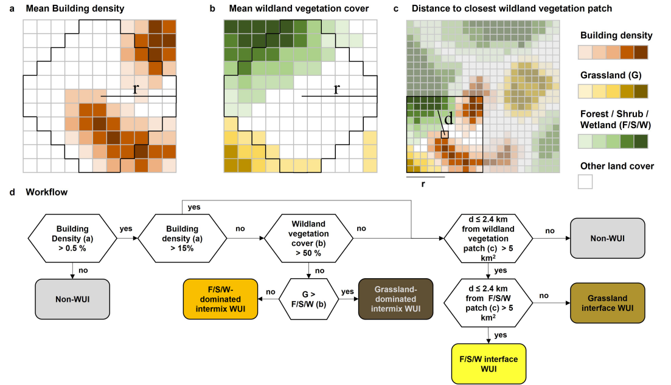
Title
Author¹….
¹ SILVIS Lab, Dep. of Forest and Wildlife Ecology, University of Wisconsin-Madison, ….
Section 1
Section 2
Section 3
Text…..
Text…..
Text…..
Guiding questions for designing your poster
What is the poster narrative and key messages?
What is your target audience?
What are your main results?
General
Font size title: 100
Font size section: 66
Font size text: 32
Font size figure caption: 28
Font: Red Hat Display
Font color: Text Dark Gray (Hex: #333333; RGB: 51, 51, 51)
UW Branding Information Website: https://brand.wisc.edu/visual-identity/colors/
Slide background adjustments (View > Slide Master)
Design background layouts/ in the slide master so that you do not accidentally move frames when designing the poster
Helpful tips
Use boxed to check the spacing of figures, text, etc. to keep a consistent space between each element. Here I use exemplary two dark blue place holders to fit the text nicely in between
“A picture is worth a thousand words” more emphasize on figures, maps, visualizations
Use of bullets, numbering, and headlines make it easy to read. Text is clear and to the point.
A person should fully read your poster in less than 10 min.
Title is short and draws interest.
Map projections:
Local: UTM
Global: Robinson (don’t use the Mercator projection, because it distorts the size of landmasses and areas on maps, especially near the polar regions)
Figure 1: Figure caption….
Table 1: Table caption….
Region | WUI in 1990 | WUI in 2020 | WUI growth
California | 15 % | 30 % | 15 %
Chile | 10 % | 20 % | 10 %
Europe | 13 % | 20 % | 7 %
South Africa | 7 % | 14 % | 7 %
Exemplary box to check spacing
Exemplary box to check spacing

Slide 2
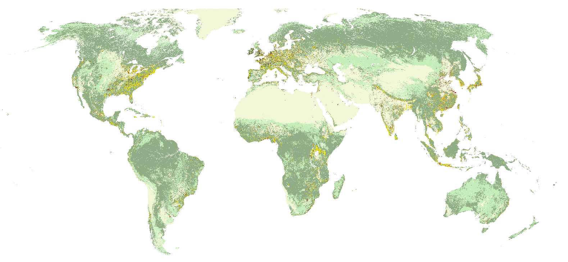
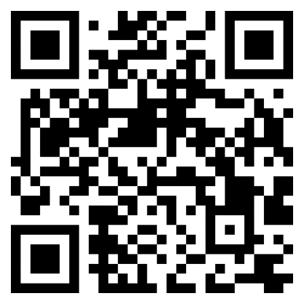
The global Wildland-Urban Interface in 2020
V. Radeloff¹, F. Schug¹, K. Pfoch¹, H. Cox¹, P. Wirth¹, T. Hawbaker²
¹ SILVIS Lab, Dep. of Forest and Wildlife Ecology, University of Wisconsin-Madison, ²USGS, Geoscience and Env. Change Science Center, Denver
Introduction
Results
The wildland-urban interface (WUI) is where buildings and wildland vegetation meet or intermingle.
It is where human-environmental conflicts and risks are concentrated, including the loss of houses and lives to wildfire, habitat loss and fragmentation, and the spread of zoonotic diseases.
Goal
To map the WUI globally for 2020 and assess wildfire risk
Methods
Dataset:
ESA World Cover data 2020 (10 m resolution)
JRC Building Footprint from 2018
Methods:
The wildland-urban interface (WUI) is where buildings and wildland vegetation meet or intermingle.
It is where human-environmental conflicts and risks are concentrated, including the loss of houses and lives to wildfire, habitat loss and fragmentation, and the spread of zoonotic diseases.
Figure 2: The global Wildland–Urban Interface. Here, we present a global map of the 2020 WUI at 10 m resolution using a globally consistent and validated approach based on remote sensing-derived datasets of building area, and wildland vegetation. The WUI is a global phenomenon and WUI covers only 4.7% of the land surface but is home to nearly half its population (3.5 billion).
Figure 3: WUI area, population and biomass by world region, Share of the WUI area in the total land area (a), share of population within the WUI (b) and share of biomass within the WUI per world region
The WUI is especially widespread in Europe (15% of the land area) and the temperate broadleaf and mixed forests biome (18%).
2/3 of all people have their home in the WUI and near a wildfire between 2003–2020 (0.4 billion)
The WUI is a global phenomenon and WUI covers only 4.7% of the land surface but is home to nearly half its population.
We identify many previously undocumented WUI hotspots and highlight the wide range of population density, land cover types and biomass levels in different parts of the global WUI.
Discussion and Conclusion
Figure 1: The Wildland–Urban Interface mapping workflow. Classifying the Wildland–Urban Interface based on a, moving window mean building density and b, wildland vegetation in a circular kernel (r = radius = 500 m, black outline) and c, distance to the closest large wildland vegetation patch (d = distance = 2,400 m). G = grassland, F/S/W = forest/shrubland/wetland. d, Combining building density and wildland vegetation to map the Wildland–Urban Interface.
Given that wildfire activity is predicted to increase because of climate change in many regions, there is a need to understand housing growth and vegetation patterns as drivers of WUI change
Radeloff et al., 2018: Rapid growth of the US wildland-urban interface raises wildfire risk
Carlson et al., 2022: The wildland–urban interface in the United States based on 125 million building locations
Volker Radeloff
Department of Forest and Wildlife Ecology
University of Wisconsin-Madison
E-mail: radeloff@wisc.edu
https://silvis.forest.wisc.edu/
Acknowledgements
We gratefully acknowledge support by:
NSF’s Dimensions of Biodiversity program,
NASA’s Biodiversity and Ecological Forecasting program.

Slide 3
The global Wildland-Urban Interface in 2020
V. Radeloff¹, F. Schug¹, K. Pfoch¹, H. Cox¹, P. Wirth¹, T. Hawbaker²
¹ SILVIS Lab, Dep. of Forest and Wildlife Ecology, University of Wisconsin-Madison, ²USGS, Geoscience and Env. Change Science Center, Denver
Introduction
Results
The wildland-urban interface (WUI) is where buildings and wildland vegetation meet or intermingle.
It is where human-environmental conflicts and risks are concentrated, including the loss of houses and lives to wildfire, habitat loss and fragmentation, and the spread of zoonotic diseases.
Goal
To map the WUI globally for 2020 and assess wildfire risk
Methods
Dataset:
ESA World Cover data 2020 (10 m resolution)
JRC Building Footprint from 2018
Methods:
The wildland-urban interface (WUI) is where buildings and wildland vegetation meet or intermingle.
It is where human-environmental conflicts and risks are concentrated, including the loss of houses and lives to wildfire, habitat loss and fragmentation, and the spread of zoonotic diseases.
Figure 2: The global Wildland–Urban Interface. Here, we present a global map of the 2020 WUI at 10 m resolution using a globally consistent and validated approach based on remote sensing-derived datasets of building area, and wildland vegetation. The WUI is a global phenomenon and WUI covers only 4.7% of the land surface but is home to nearly half its population (3.5 billion).
Figure 3: WUI area, population and biomass by world region, Share of the WUI area in the total land area (a), share of population within the WUI (b) and share of biomass within the WUI per world region
The WUI is especially widespread in Europe (15% of the land area) and the temperate broadleaf and mixed forests biome (18%).
2/3 of all people have their home in the WUI and near a wildfire between 2003–2020 (0.4 billion)
The WUI is a global phenomenon and WUI covers only 4.7% of the land surface but is home to nearly half its population.
We identify many previously undocumented WUI hotspots and highlight the wide range of population density, land cover types and biomass levels in different parts of the global WUI.
Discussion and Conclusion
Figure 1: The Wildland–Urban Interface mapping workflow. Classifying the Wildland–Urban Interface based on a, moving window mean building density and b, wildland vegetation in a circular kernel (r = radius = 500 m, black outline) and c, distance to the closest large wildland vegetation patch (d = distance = 2,400 m). G = grassland, F/S/W = forest/shrubland/wetland. d, Combining building density and wildland vegetation to map the Wildland–Urban Interface.
Given that wildfire activity is predicted to increase because of climate change in many regions, there is a need to understand housing growth and vegetation patterns as drivers of WUI change
Radeloff et al., 2018: Rapid growth of the US wildland-urban interface raises wildfire risk
Carlson et al., 2022: The wildland–urban interface in the United States based on 125 million building locations
Volker Radeloff
Department of Forest and Wildlife Ecology
University of Wisconsin-Madison
E-mail: radeloff@wisc.edu
https://silvis.forest.wisc.edu/
Acknowledgements
We gratefully acknowledge support by:
NSF’s Dimensions of Biodiversity program,
NASA’s Biodiversity and Ecological Forecasting program.

Slide 4
The global Wildland-Urban Interface in 2020
V. Radeloff¹, F. Schug¹, K. Pfoch¹, H. Cox¹, P. Wirth¹, T. Hawbaker²
¹ SILVIS Lab, Dep. of Forest and Wildlife Ecology, University of Wisconsin-Madison, ²USGS, Geoscience and Env. Change Science Center, Denver
Introduction
Results
The wildland-urban interface (WUI) is where buildings and wildland vegetation meet or intermingle.
It is where human-environmental conflicts and risks are concentrated, including the loss of houses and lives to wildfire, habitat loss and fragmentation, and the spread of zoonotic diseases.
Goal
To map the WUI globally for 2020 and assess wildfire risk
Methods
Dataset:
ESA World Cover data 2020 (10 m resolution)
JRC Building Footprint from 2018
Methods:
The wildland-urban interface (WUI) is where buildings and wildland vegetation meet or intermingle.
It is where human-environmental conflicts and risks are concentrated, including the loss of houses and lives to wildfire, habitat loss and fragmentation, and the spread of zoonotic diseases.
Figure 2: The global Wildland–Urban Interface. Here, we present a global map of the 2020 WUI at 10 m resolution using a globally consistent and validated approach based on remote sensing-derived datasets of building area, and wildland vegetation. The WUI is a global phenomenon and WUI covers only 4.7% of the land surface but is home to nearly half its population (3.5 billion).
Figure 3: WUI area, population and biomass by world region, Share of the WUI area in the total land area (a), share of population within the WUI (b) and share of biomass within the WUI per world region
The WUI is especially widespread in Europe (15% of the land area) and the temperate broadleaf and mixed forests biome (18%).
2/3 of all people have their home in the WUI and near a wildfire between 2003–2020 (0.4 billion)
The WUI is a global phenomenon and WUI covers only 4.7% of the land surface but is home to nearly half its population.
We identify many previously undocumented WUI hotspots and highlight the wide range of population density, land cover types and biomass levels in different parts of the global WUI.
Discussion and Conclusion
Figure 1: The Wildland–Urban Interface mapping workflow. Classifying the Wildland–Urban Interface based on a, moving window mean building density and b, wildland vegetation in a circular kernel (r = radius = 500 m, black outline) and c, distance to the closest large wildland vegetation patch (d = distance = 2,400 m). G = grassland, F/S/W = forest/shrubland/wetland. d, Combining building density and wildland vegetation to map the Wildland–Urban Interface.
Given that wildfire activity is predicted to increase because of climate change in many regions, there is a need to understand housing growth and vegetation patterns as drivers of WUI change
Radeloff et al., 2018: Rapid growth of the US wildland-urban interface raises wildfire risk
Carlson et al., 2022: The wildland–urban interface in the United States based on 125 million building locations
Volker Radeloff
Department of Forest and Wildlife Ecology
University of Wisconsin-Madison
E-mail: radeloff@wisc.edu
https://silvis.forest.wisc.edu/
Acknowledgements
We gratefully acknowledge support by:
NSF’s Dimensions of Biodiversity program,
NASA’s Biodiversity and Ecological Forecasting program.

Slide 5
The global Wildland-Urban Interface in 2020
V. Radeloff¹, F. Schug¹, K. Pfoch¹, H. Cox¹, P. Wirth¹, T. Hawbaker²
¹ SILVIS Lab, Dep. of Forest and Wildlife Ecology, University of Wisconsin-Madison, ²USGS, Geoscience and Env. Change Science Center, Denver
Introduction
Results
The wildland-urban interface (WUI) is where buildings and wildland vegetation meet or intermingle.
It is where human-environmental conflicts and risks are concentrated, including the loss of houses and lives to wildfire, habitat loss and fragmentation, and the spread of zoonotic diseases.
Goal
To map the WUI globally for 2020 and assess wildfire risk
Methods
Dataset:
ESA World Cover data 2020 (10 m resolution)
JRC Building Footprint from 2018
Methods:
The wildland-urban interface (WUI) is where buildings and wildland vegetation meet or intermingle.
It is where human-environmental conflicts and risks are concentrated, including the loss of houses and lives to wildfire, habitat loss and fragmentation, and the spread of zoonotic diseases.
Figure 2: The global Wildland–Urban Interface. Here, we present a global map of the 2020 WUI at 10 m resolution using a globally consistent and validated approach based on remote sensing-derived datasets of building area, and wildland vegetation. The WUI is a global phenomenon and WUI covers only 4.7% of the land surface but is home to nearly half its population (3.5 billion).
Figure 3: WUI area, population and biomass by world region, Share of the WUI area in the total land area (a), share of population within the WUI (b) and share of biomass within the WUI per world region
The WUI is especially widespread in Europe (15% of the land area) and the temperate broadleaf and mixed forests biome (18%).
2/3 of all people have their home in the WUI and near a wildfire between 2003–2020 (0.4 billion)
The WUI is a global phenomenon and WUI covers only 4.7% of the land surface but is home to nearly half its population.
We identify many previously undocumented WUI hotspots and highlight the wide range of population density, land cover types and biomass levels in different parts of the global WUI.
Discussion and Conclusion
Figure 1: The Wildland–Urban Interface mapping workflow. Classifying the Wildland–Urban Interface based on a, moving window mean building density and b, wildland vegetation in a circular kernel (r = radius = 500 m, black outline) and c, distance to the closest large wildland vegetation patch (d = distance = 2,400 m). G = grassland, F/S/W = forest/shrubland/wetland. d, Combining building density and wildland vegetation to map the Wildland–Urban Interface.
Given that wildfire activity is predicted to increase because of climate change in many regions, there is a need to understand housing growth and vegetation patterns as drivers of WUI change
Radeloff et al., 2018: Rapid growth of the US wildland-urban interface raises wildfire risk
Carlson et al., 2022: The wildland–urban interface in the United States based on 125 million building locations
Volker Radeloff
Department of Forest and Wildlife Ecology
University of Wisconsin-Madison
E-mail: radeloff@wisc.edu
https://silvis.forest.wisc.edu/
Acknowledgements
We gratefully acknowledge support by:
NSF’s Dimensions of Biodiversity program,
NASA’s Biodiversity and Ecological Forecasting program.

Slide 6
The global Wildland-Urban Interface in 2020
V. Radeloff¹, F. Schug¹, K. Pfoch¹, H. Cox¹, P. Wirth¹, T. Hawbaker²
¹ SILVIS Lab, Dep. of Forest and Wildlife Ecology, University of Wisconsin-Madison, ²USGS, Geoscience and Env. Change Science Center, Denver
Introduction
Results
The wildland-urban interface (WUI) is where buildings and wildland vegetation meet or intermingle.
It is where human-environmental conflicts and risks are concentrated, including the loss of houses and lives to wildfire, habitat loss and fragmentation, and the spread of zoonotic diseases.
Goal
To map the WUI globally for 2020 and assess wildfire risk
Methods
Dataset:
ESA World Cover data 2020 (10 m resolution)
JRC Building Footprint from 2018
Methods:
The wildland-urban interface (WUI) is where buildings and wildland vegetation meet or intermingle.
It is where human-environmental conflicts and risks are concentrated, including the loss of houses and lives to wildfire, habitat loss and fragmentation, and the spread of zoonotic diseases.
Figure 2: The global Wildland–Urban Interface. Here, we present a global map of the 2020 WUI at 10 m resolution using a globally consistent and validated approach based on remote sensing-derived datasets of building area, and wildland vegetation. The WUI is a global phenomenon and WUI covers only 4.7% of the land surface but is home to nearly half its population (3.5 billion).
Figure 3: WUI area, population and biomass by world region, Share of the WUI area in the total land area (a), share of population within the WUI (b) and share of biomass within the WUI per world region
The WUI is especially widespread in Europe (15% of the land area) and the temperate broadleaf and mixed forests biome (18%).
2/3 of all people have their home in the WUI and near a wildfire between 2003–2020 (0.4 billion)
The WUI is a global phenomenon and WUI covers only 4.7% of the land surface but is home to nearly half its population.
We identify many previously undocumented WUI hotspots and highlight the wide range of population density, land cover types and biomass levels in different parts of the global WUI.
Discussion and Conclusion
Figure 1: The Wildland–Urban Interface mapping workflow. Classifying the Wildland–Urban Interface based on a, moving window mean building density and b, wildland vegetation in a circular kernel (r = radius = 500 m, black outline) and c, distance to the closest large wildland vegetation patch (d = distance = 2,400 m). G = grassland, F/S/W = forest/shrubland/wetland. d, Combining building density and wildland vegetation to map the Wildland–Urban Interface.
Given that wildfire activity is predicted to increase because of climate change in many regions, there is a need to understand housing growth and vegetation patterns as drivers of WUI change
Radeloff et al., 2018: Rapid growth of the US wildland-urban interface raises wildfire risk
Carlson et al., 2022: The wildland–urban interface in the United States based on 125 million building locations
Volker Radeloff
Department of Forest and Wildlife Ecology
University of Wisconsin-Madison
E-mail: radeloff@wisc.edu
https://silvis.forest.wisc.edu/
Acknowledgements
We gratefully acknowledge support by:
NSF’s Dimensions of Biodiversity program,
NASA’s Biodiversity and Ecological Forecasting program.

Slide 7
The global Wildland-Urban Interface in 2020
V. Radeloff¹, F. Schug¹, K. Pfoch¹, H. Cox¹, P. Wirth¹, T. Hawbaker²
¹ SILVIS Lab, Dep. of Forest and Wildlife Ecology, University of Wisconsin-Madison, ²USGS, Geoscience and Env. Change Science Center, Denver
Introduction
Results
The wildland-urban interface (WUI) is where buildings and wildland vegetation meet or intermingle.
It is where human-environmental conflicts and risks are concentrated, including the loss of houses and lives to wildfire, habitat loss and fragmentation, and the spread of zoonotic diseases.
Goal
To map the WUI globally for 2020 and assess wildfire risk
Methods
Dataset:
ESA World Cover data 2020 (10 m resolution)
JRC Building Footprint from 2018
Methods:
The wildland-urban interface (WUI) is where buildings and wildland vegetation meet or intermingle.
It is where human-environmental conflicts and risks are concentrated, including the loss of houses and lives to wildfire, habitat loss and fragmentation, and the spread of zoonotic diseases.
Figure 2: The global Wildland–Urban Interface. Here, we present a global map of the 2020 WUI at 10 m resolution using a globally consistent and validated approach based on remote sensing-derived datasets of building area, and wildland vegetation. The WUI is a global phenomenon and WUI covers only 4.7% of the land surface but is home to nearly half its population (3.5 billion).
Figure 3: WUI area, population and biomass by world region, Share of the WUI area in the total land area (a), share of population within the WUI (b) and share of biomass within the WUI per world region
The WUI is especially widespread in Europe (15% of the land area) and the temperate broadleaf and mixed forests biome (18%).
2/3 of all people have their home in the WUI and near a wildfire between 2003–2020 (0.4 billion)
The WUI is a global phenomenon and WUI covers only 4.7% of the land surface but is home to nearly half its population.
We identify many previously undocumented WUI hotspots and highlight the wide range of population density, land cover types and biomass levels in different parts of the global WUI.
Discussion and Conclusion
Figure 1: The Wildland–Urban Interface mapping workflow. Classifying the Wildland–Urban Interface based on a, moving window mean building density and b, wildland vegetation in a circular kernel (r = radius = 500 m, black outline) and c, distance to the closest large wildland vegetation patch (d = distance = 2,400 m). G = grassland, F/S/W = forest/shrubland/wetland. d, Combining building density and wildland vegetation to map the Wildland–Urban Interface.
Given that wildfire activity is predicted to increase because of climate change in many regions, there is a need to understand housing growth and vegetation patterns as drivers of WUI change
Radeloff et al., 2018: Rapid growth of the US wildland-urban interface raises wildfire risk
Carlson et al., 2022: The wildland–urban interface in the United States based on 125 million building locations
Volker Radeloff
Department of Forest and Wildlife Ecology
University of Wisconsin-Madison
E-mail: radeloff@wisc.edu
https://silvis.forest.wisc.edu/
Acknowledgements
We gratefully acknowledge support by:
NSF’s Dimensions of Biodiversity program,
NASA’s Biodiversity and Ecological Forecasting program.

