Slide 1
WUI Growth and Vegetation Changes in the Mediterranean Basin
Kira Pfoch & Volker Radeloff

Slide 2
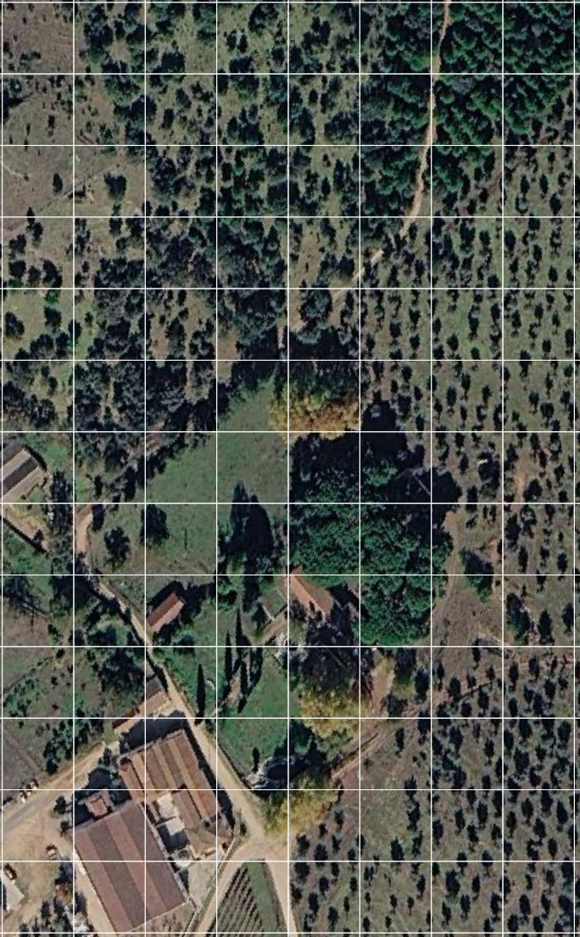
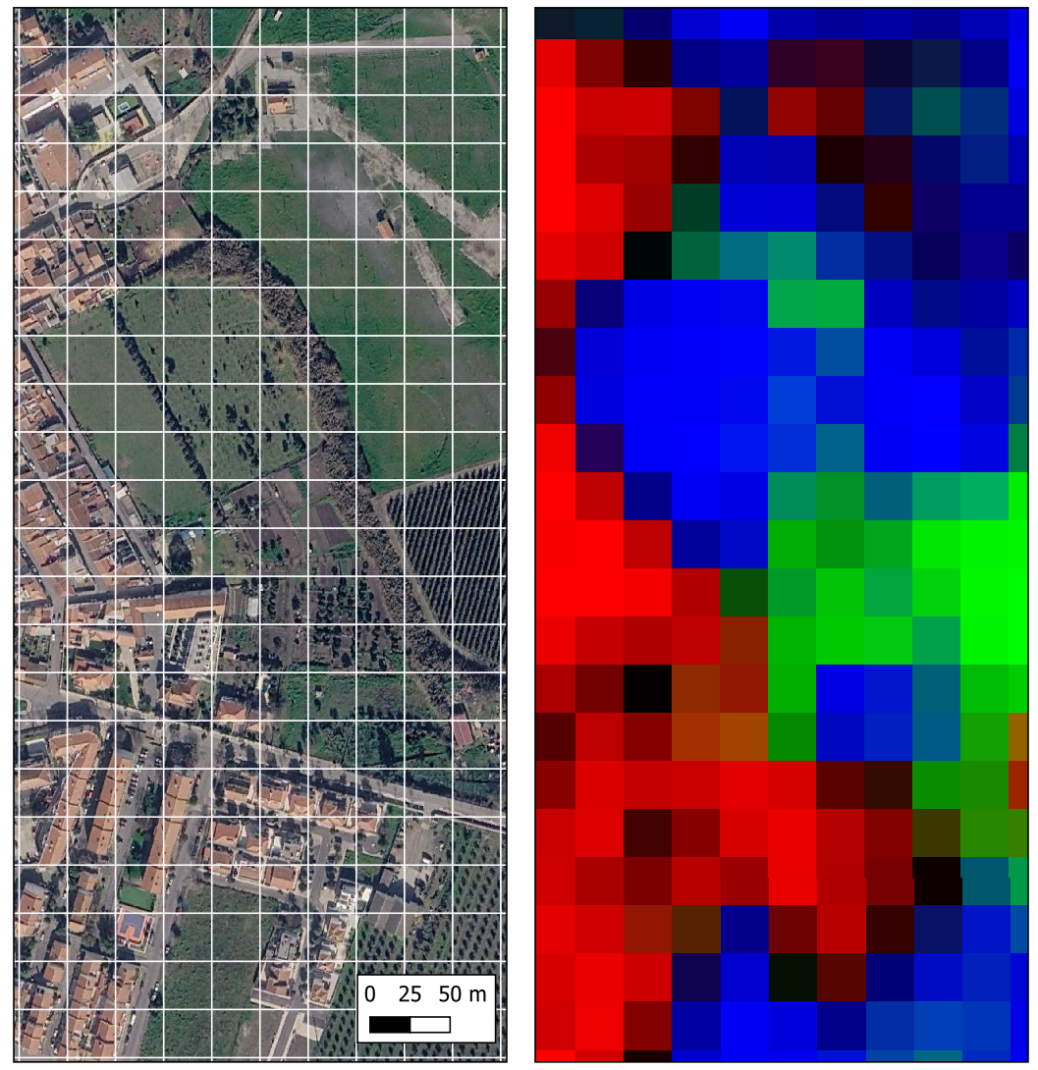

Land Cover Fractions
Pure Pixel: 100% woody vegetation
Mixed Pixel: 80% woody vegetation &
10% non-woody vegetation &
10% bare soil
Mixed Pixel: 35% woody vegetation &
65% non-woody vegetation
Pure Pixel: 100% non-woody vegetation
non-woody
impervious
woody
b)
Pure Pixel: 100% imperviousness
a)
c)

Slide 3
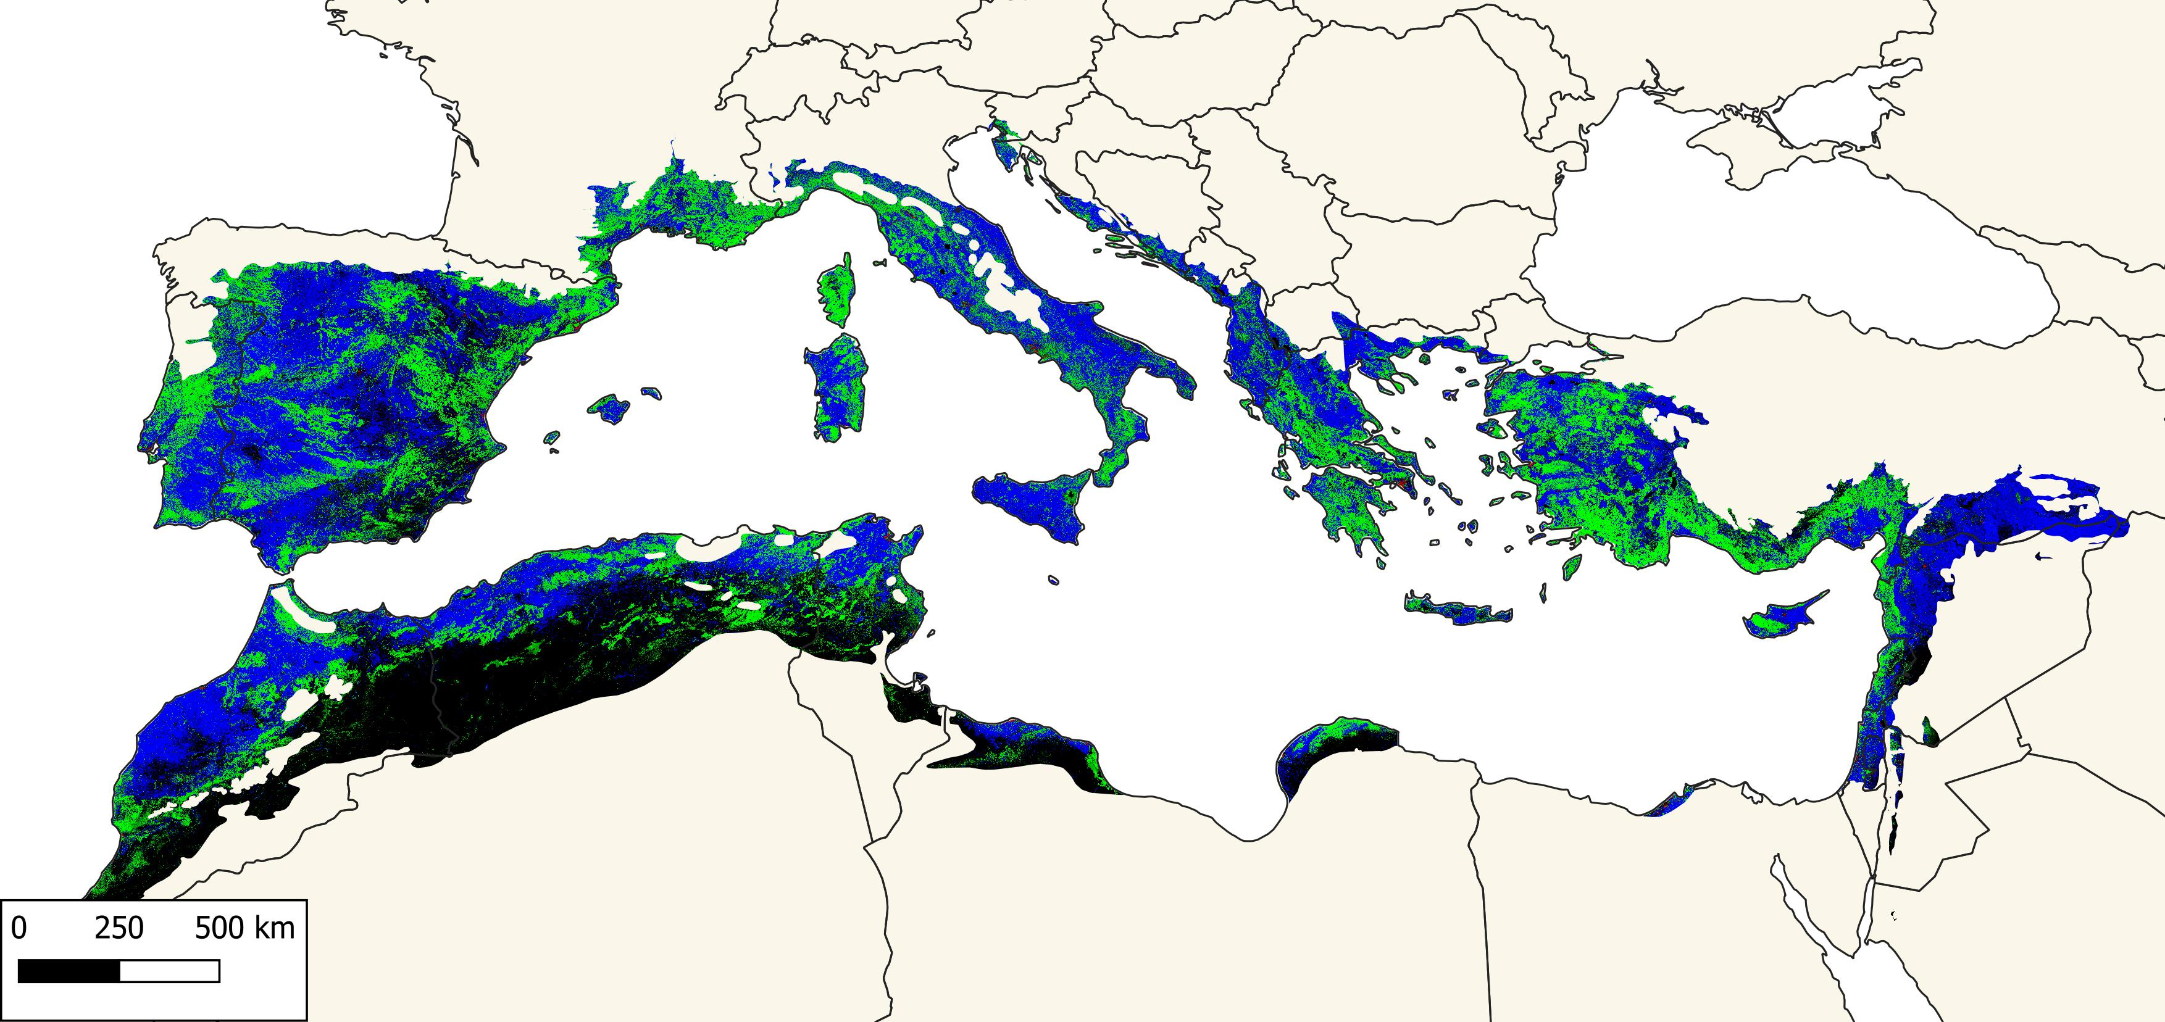
Land Cover Fractions 2000
non-woody
Impervious
woody
b)
a)
c)

Slide 4
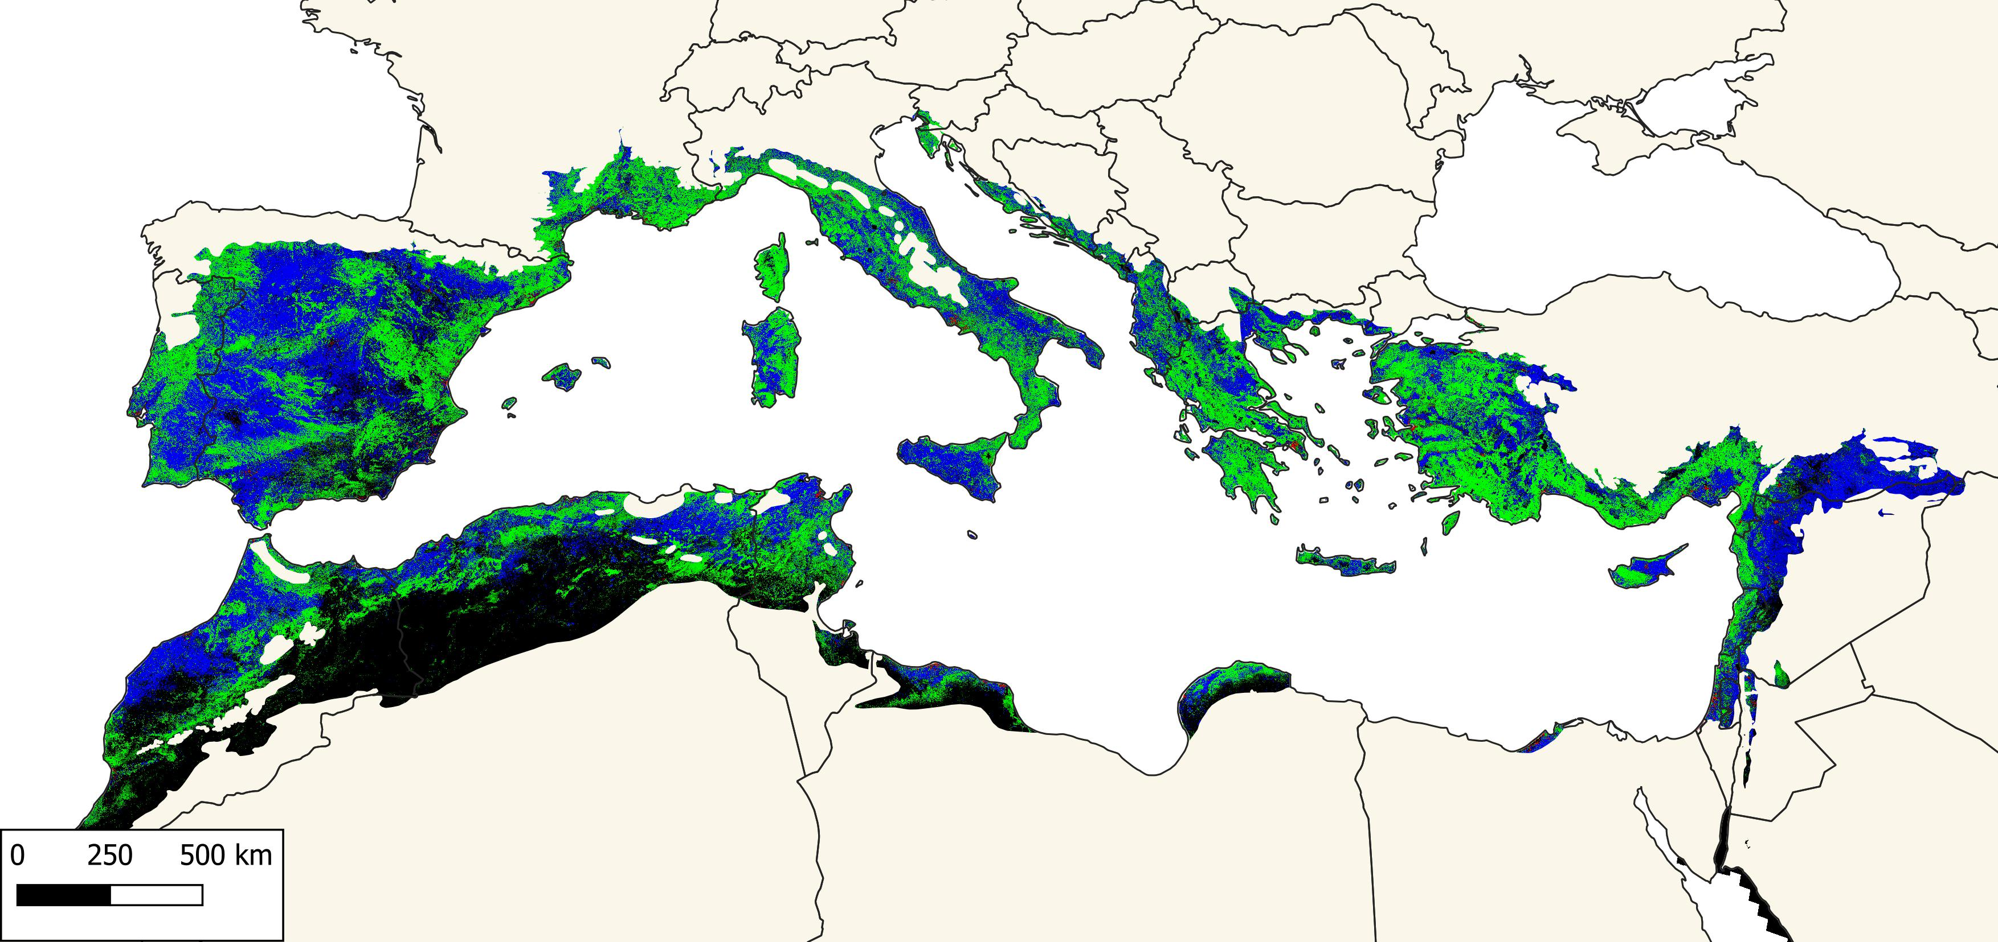
Land Cover Fractions 2020
non-woody
Impervious
woody
b)
a)
c)

Slide 5
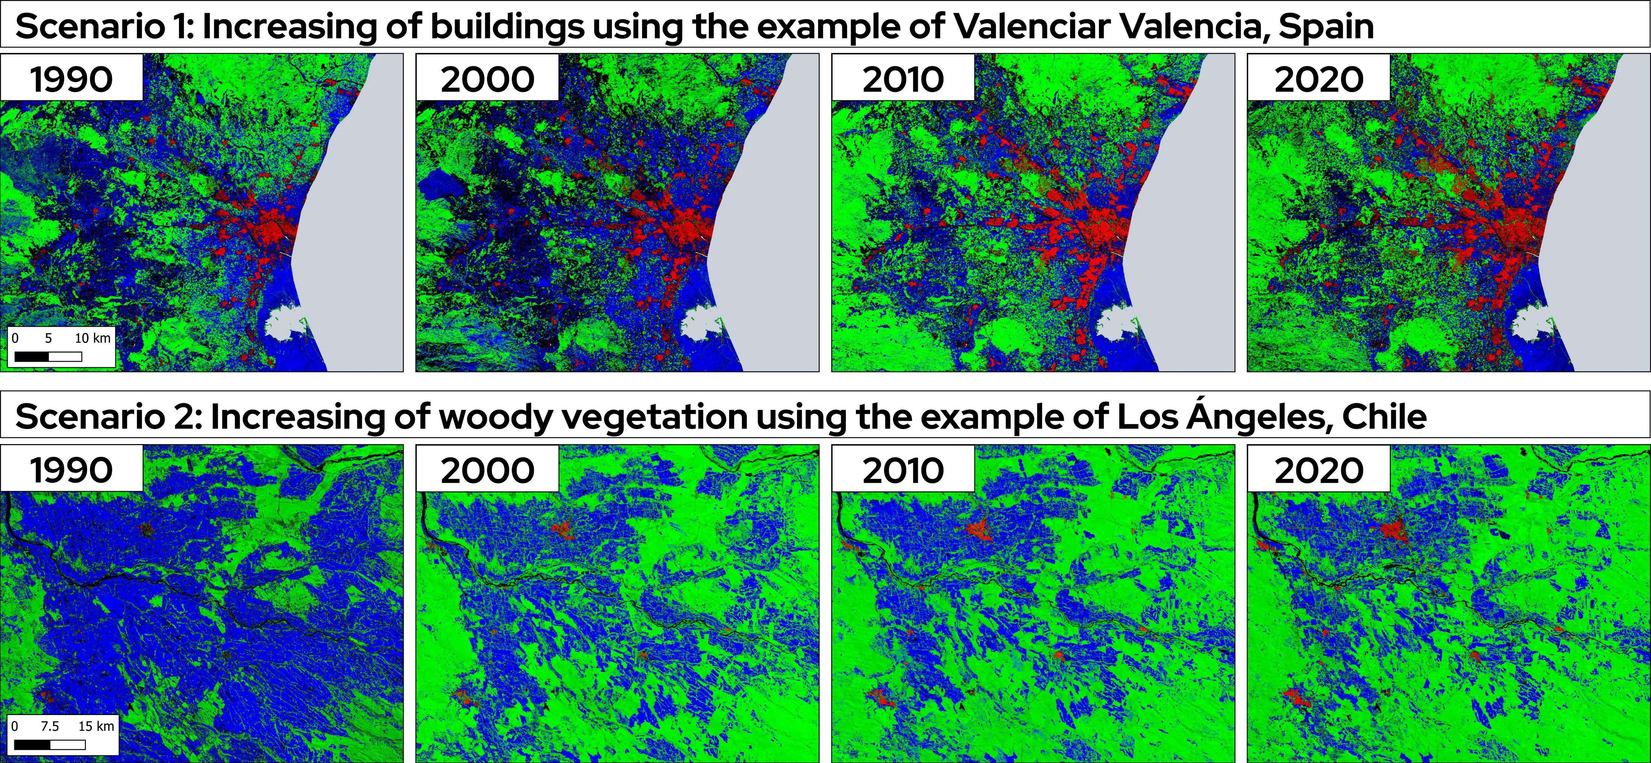
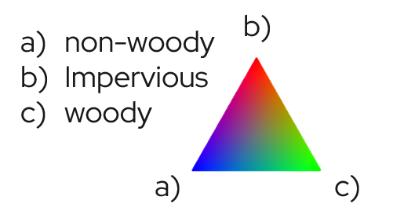
WUI growth & woody vegetation increase

Slide 6
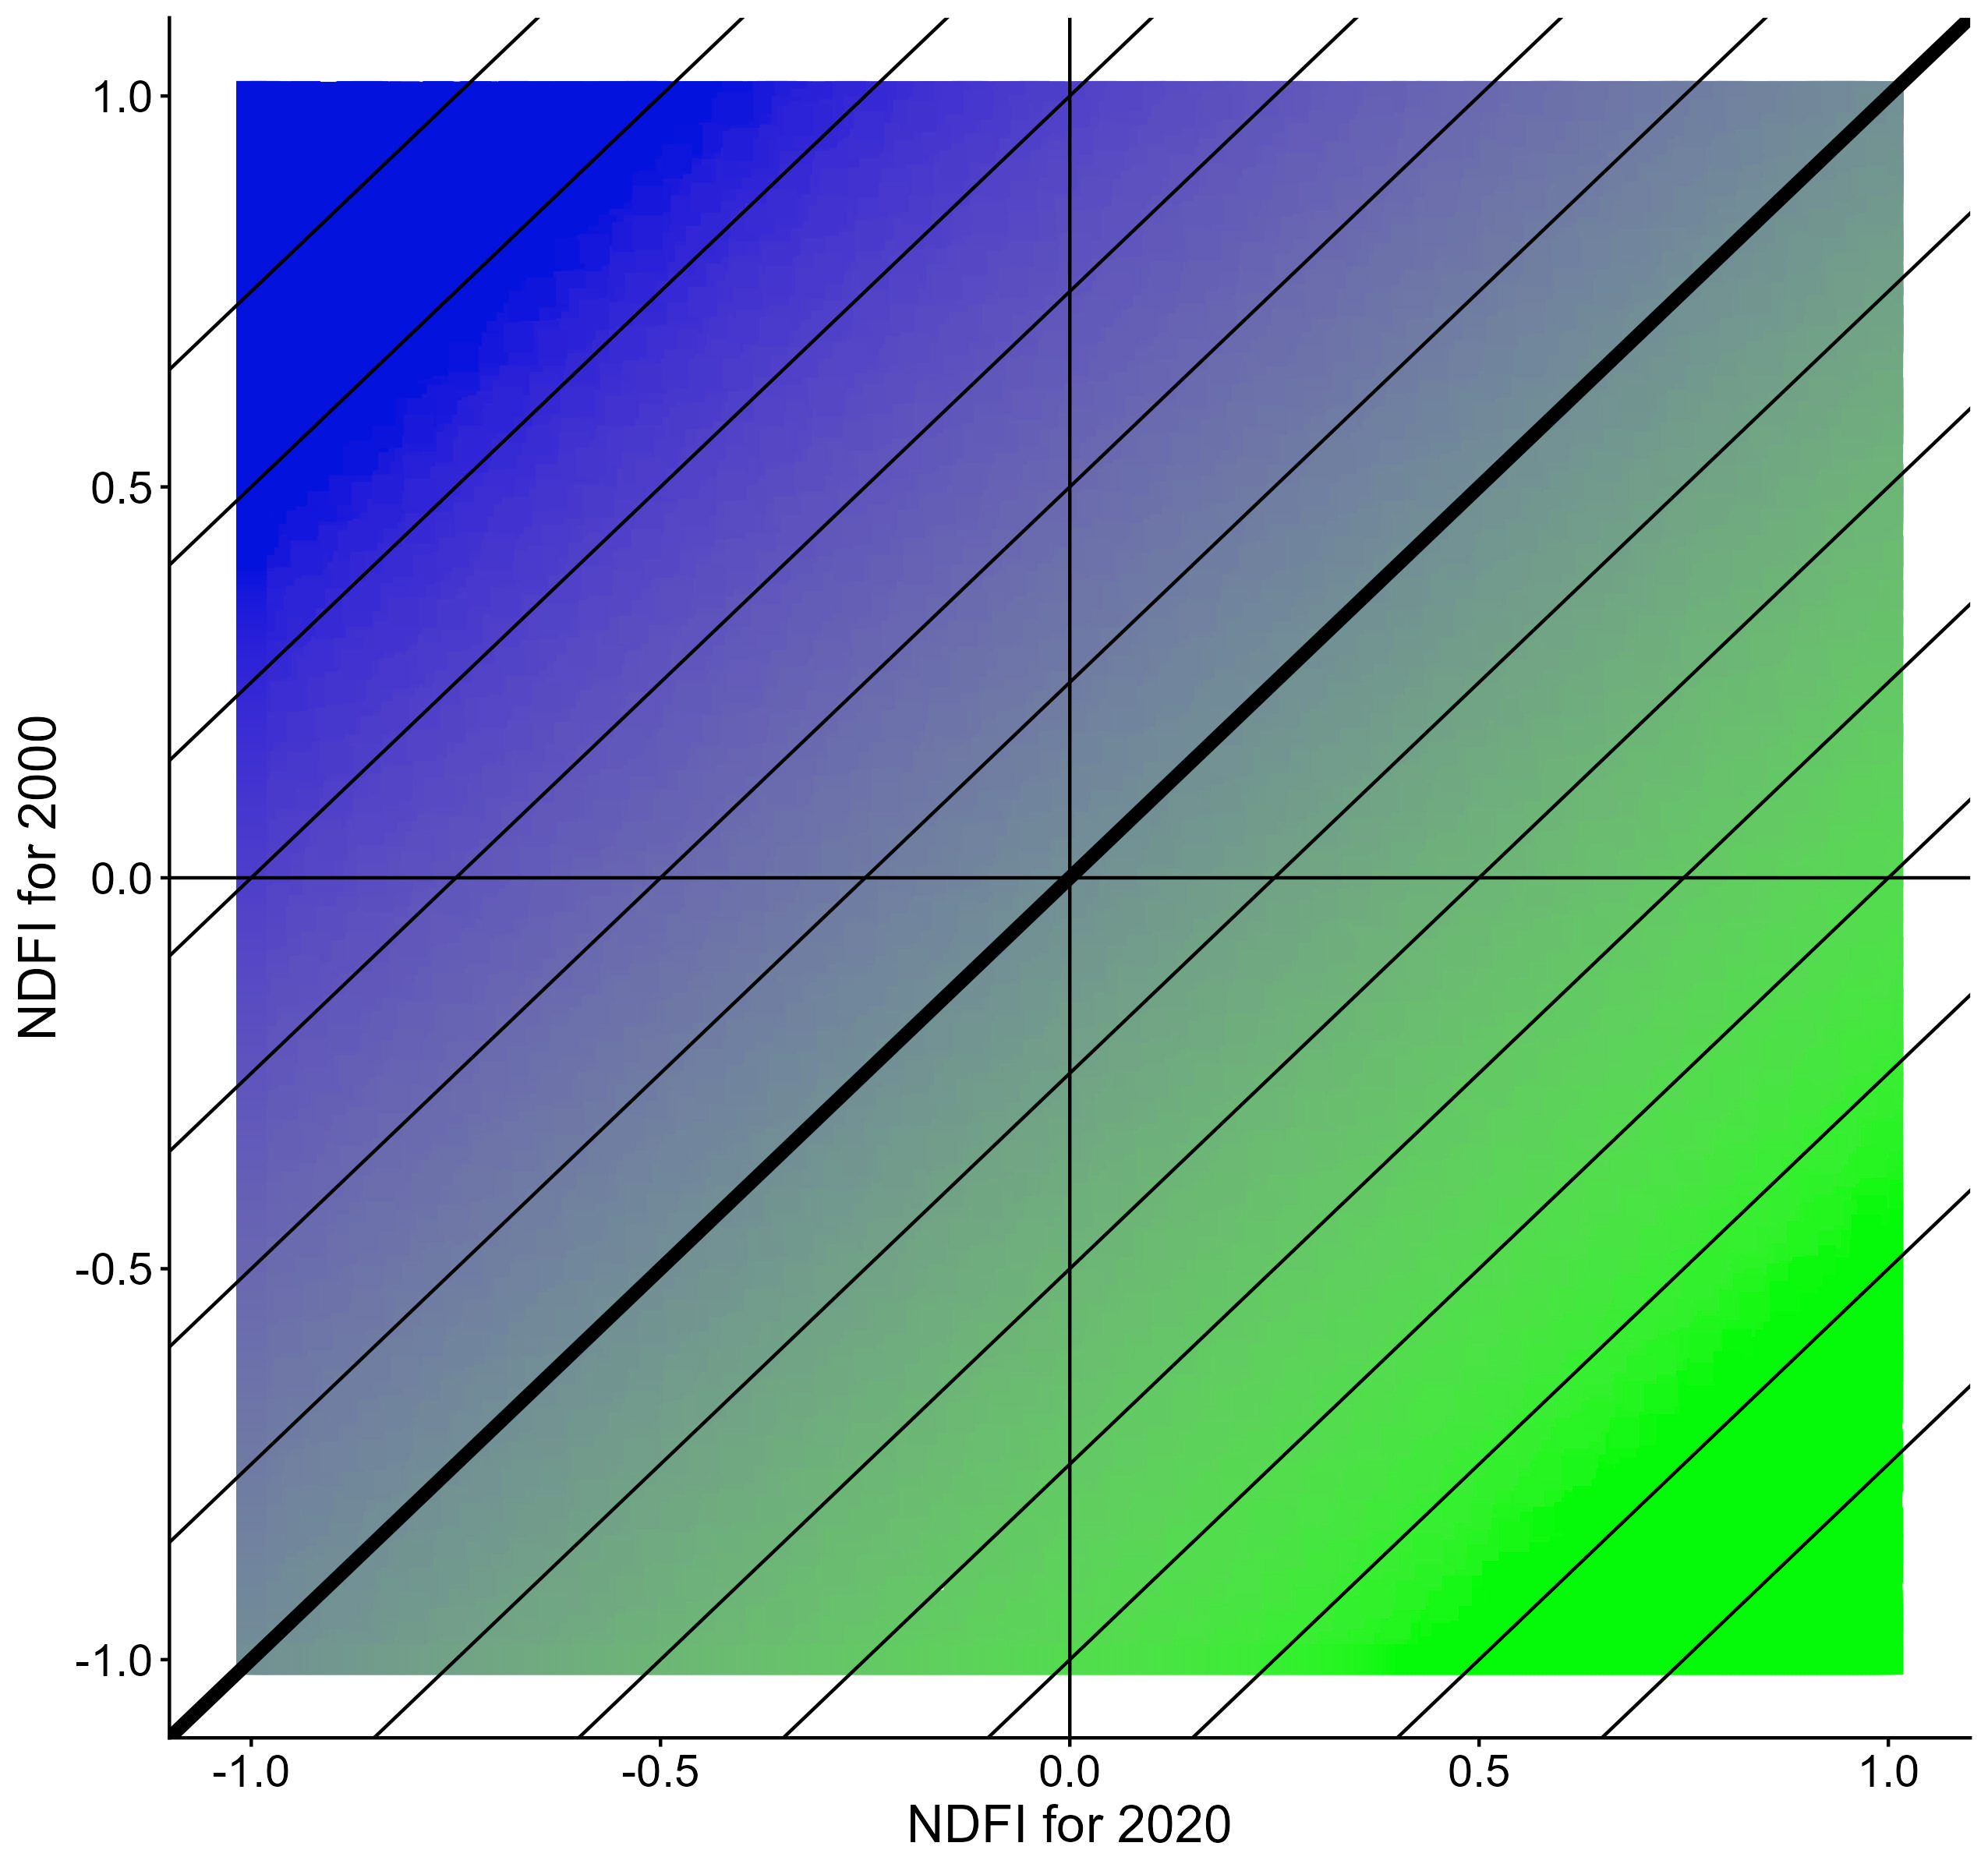
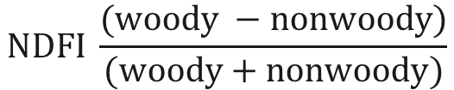
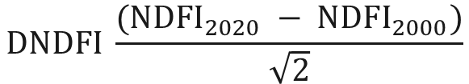
Normalized Difference Fraction Index (NDFI)
Normalize Difference Fraction Index (NDFI)
$$NDFI \frac{(woody −nonwoody)}{(woody+nonwoody)}$$
Distance to 1:1 line for NDFI for 2000 to 2020
$$DNDFI \frac{({NDFI}_{2020} − {NDFI}_{2000})}{\sqrt{2}}$$

Slide 7
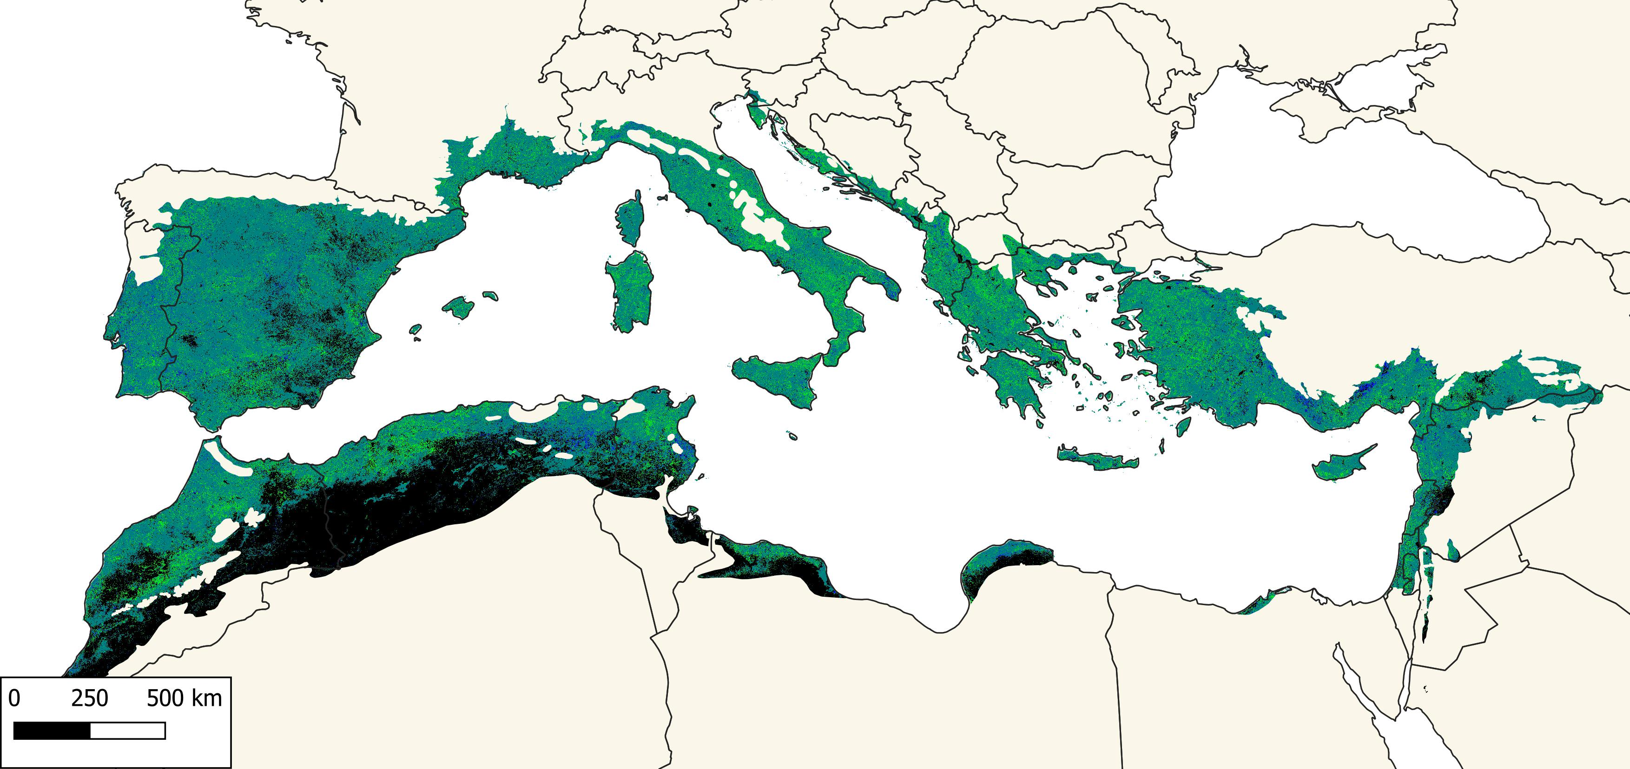
DNDFI 2000-2020
more non-woody
more woody
more non-woody

Slide 8
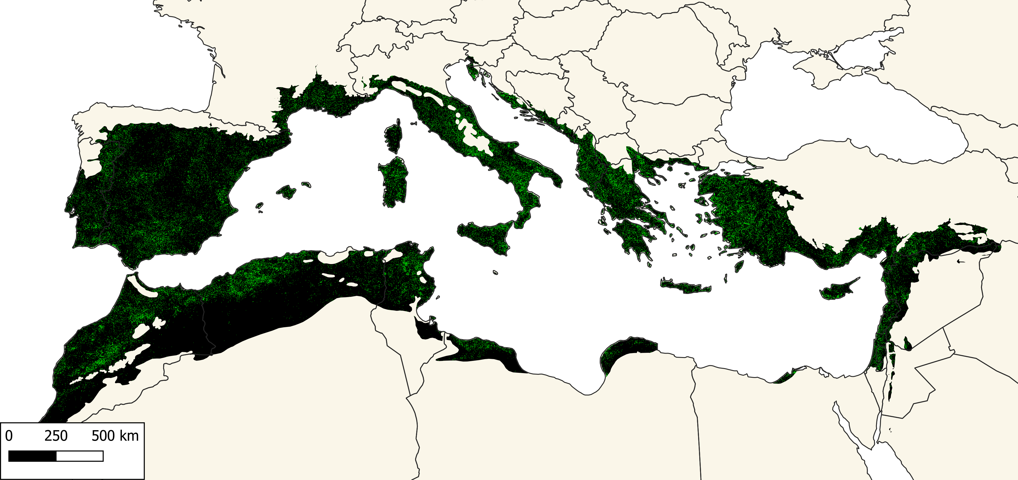
DNDFI > 0.7 (woody increase) | 2000-2020
more non-woody
woody increase

Slide 9
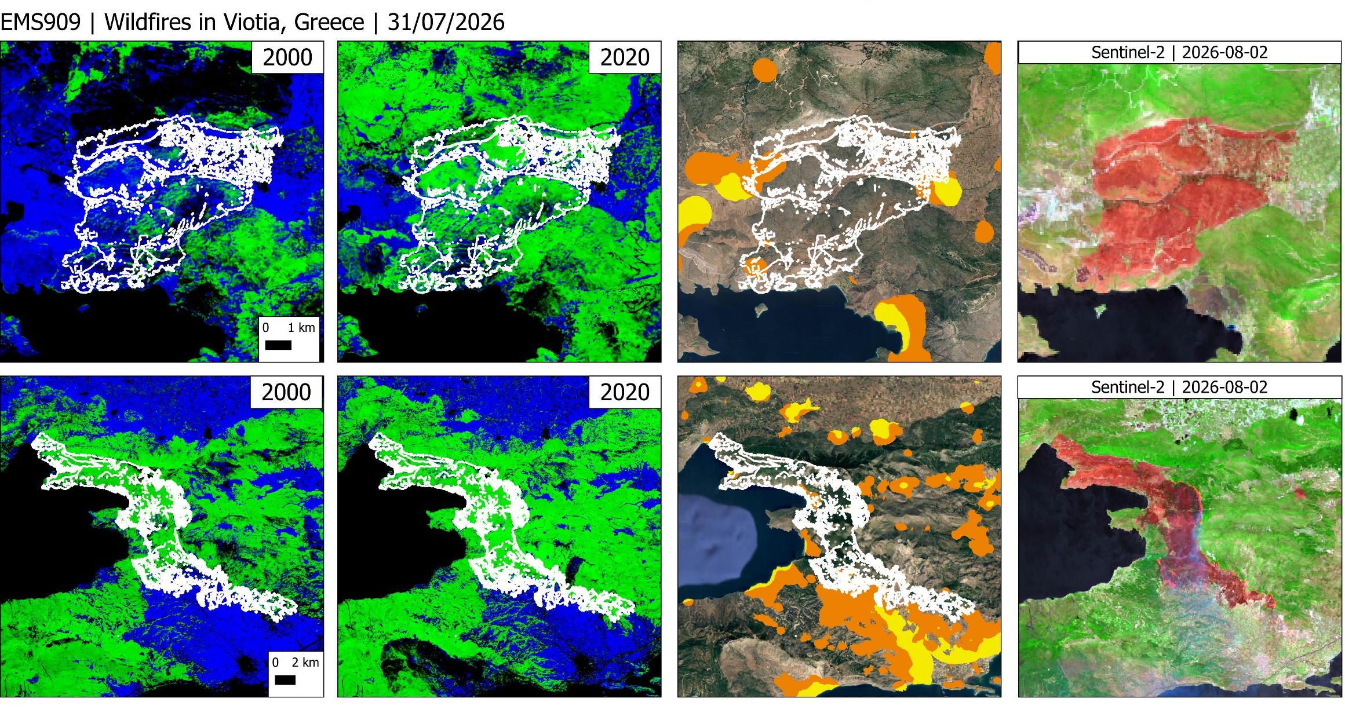
Burned Area in Greece
woody veg.
non-woody veg.
Intermix WUI
Interface WUI

Slide 10

Burned Area in Greece
woody veg.
non-woody veg.
Intermix WUI
Interface WUI

Slide 11
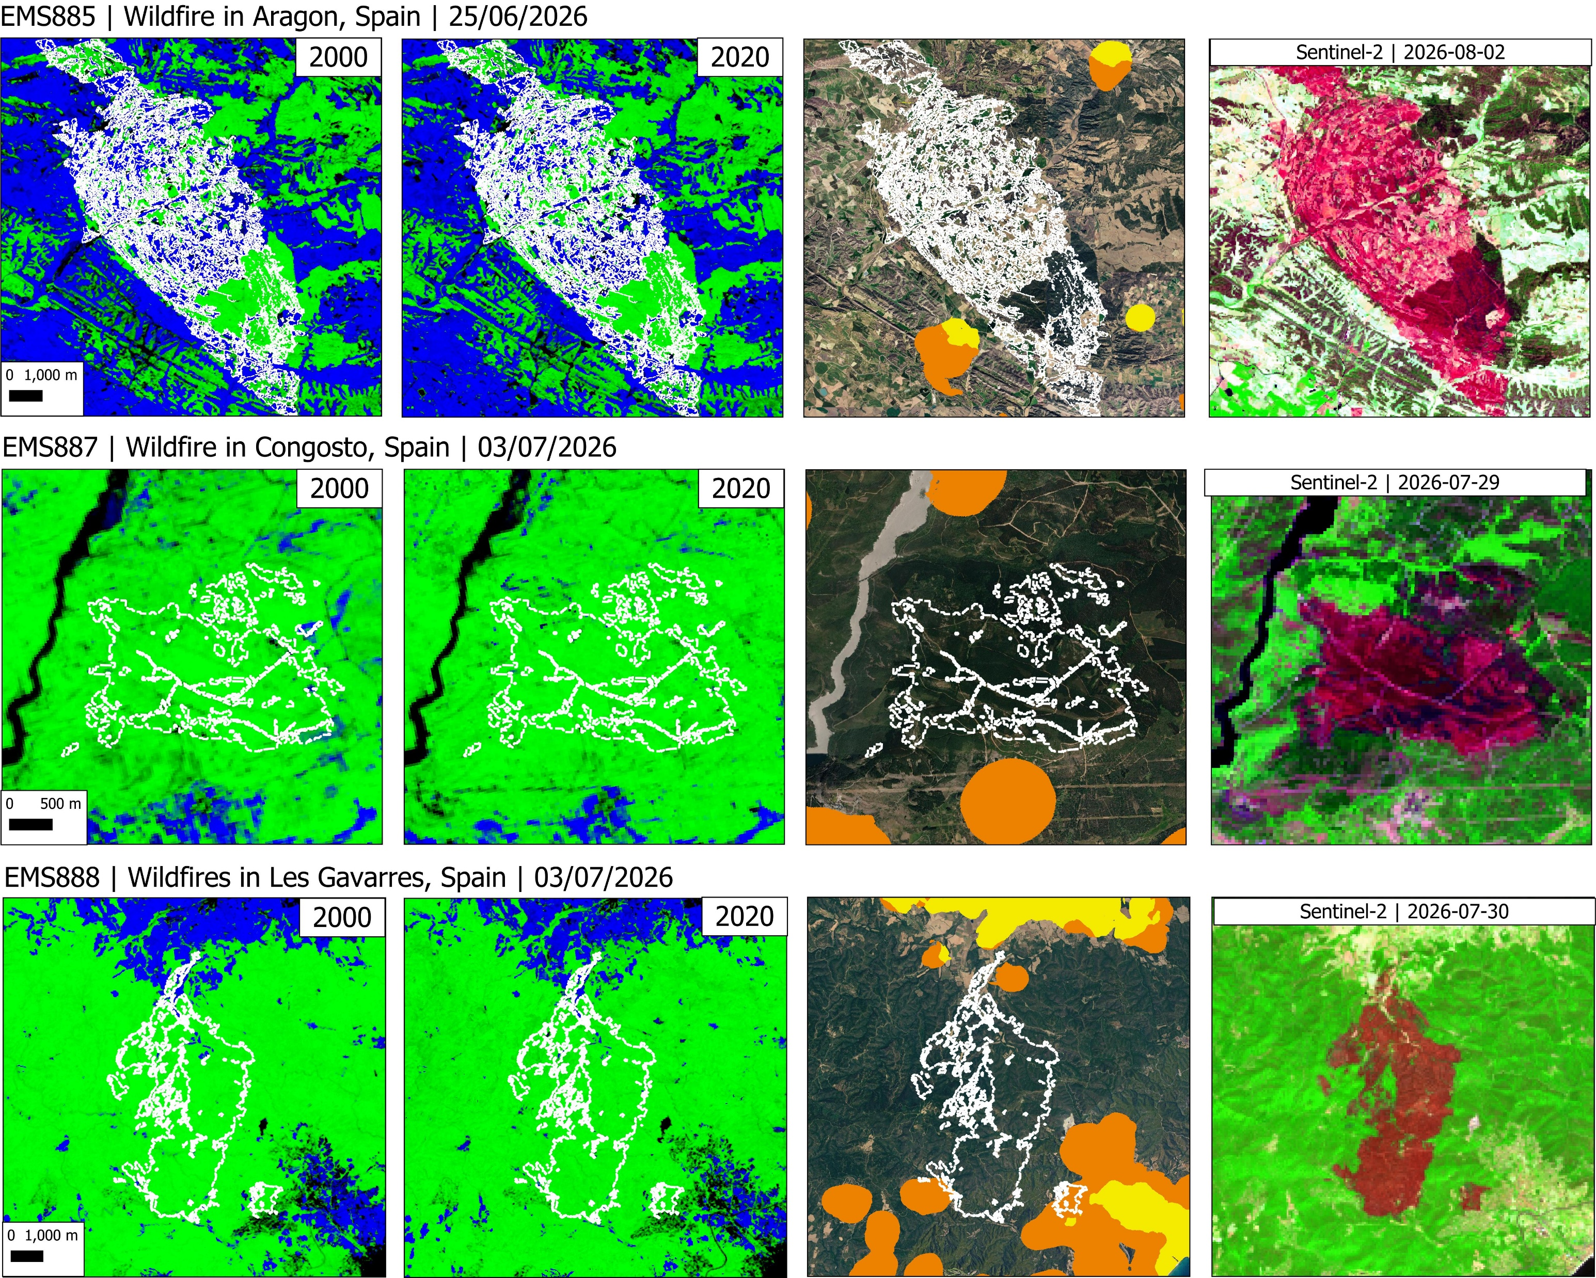
Burned Area in Spain
woody veg.
non-woody veg.
Intermix WUI
Interface WUI

Slide 12
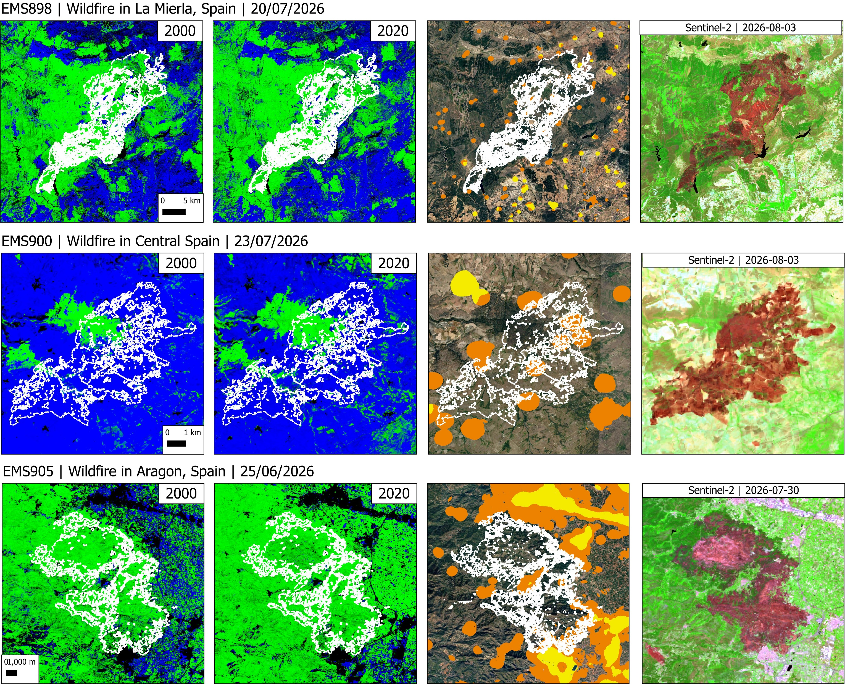
Burned Area in Spain
woody veg.
non-woody veg.
Intermix WUI
Interface WUI

Slide 13
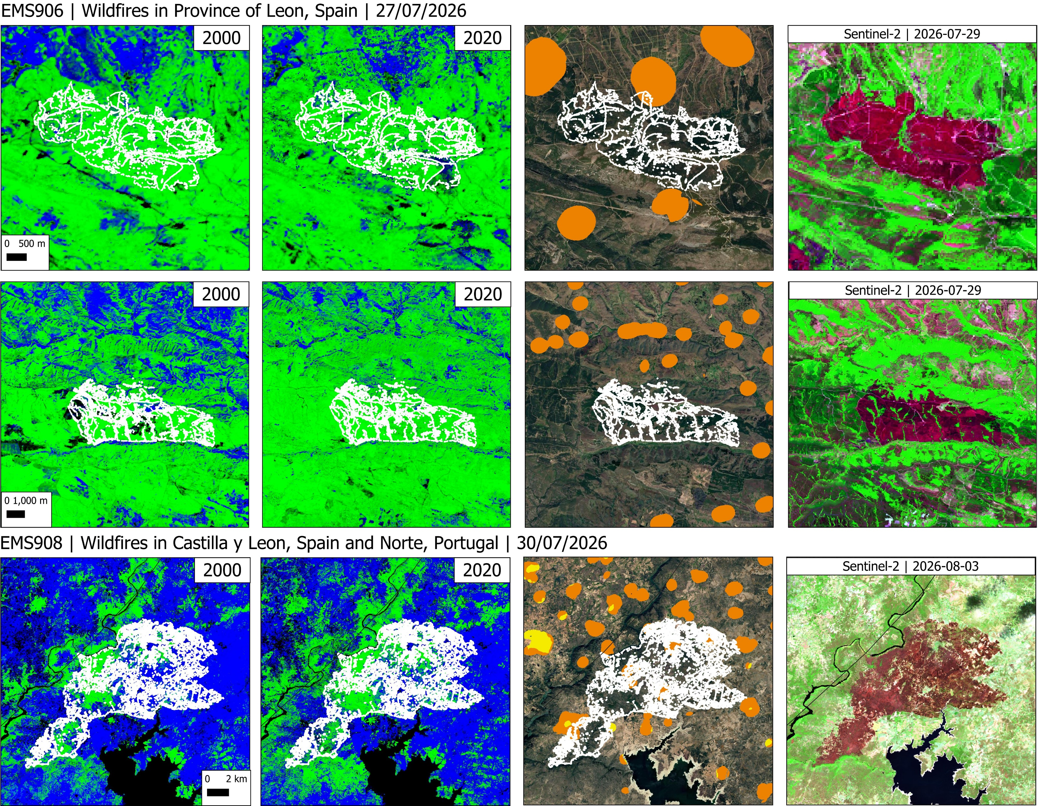
Burned Area in Spain
woody veg.
non-woody veg.
Intermix WUI
Interface WUI

Slide 14
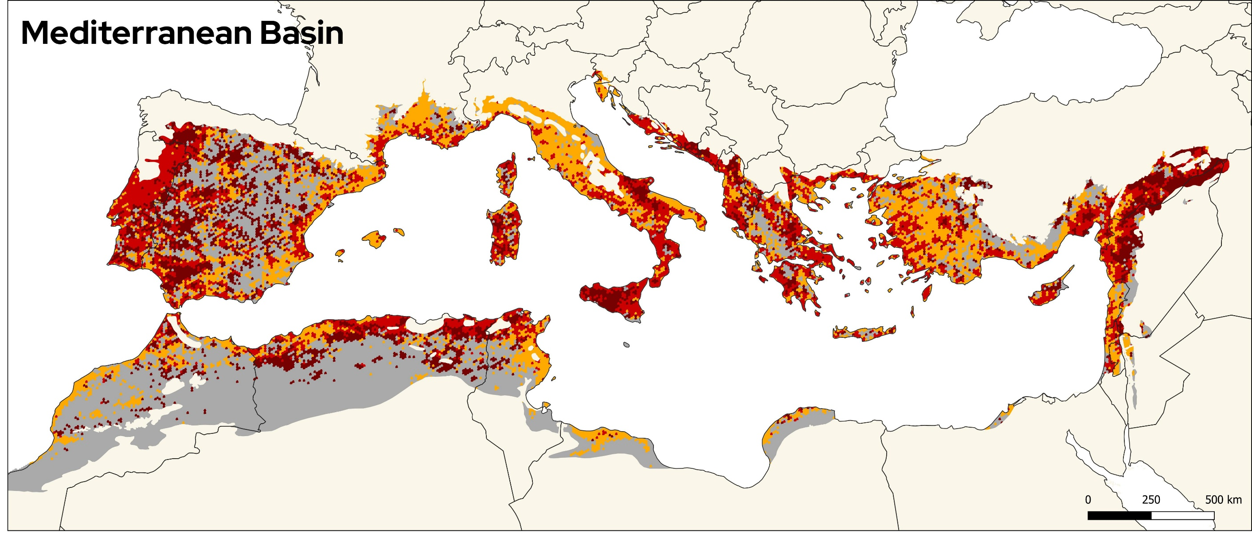
Results: WUI-Fire Relationship at 10km Hexagons
a) Annual Burned Area from 2001-2025 for the global Mediterranean Ecosystems
WUI (>5%) and Wildfire (2001-2025)
Wildfire (2001-2025)
WUI (>5%)
No fire and no WUI (> 5%)
8

Slide 15
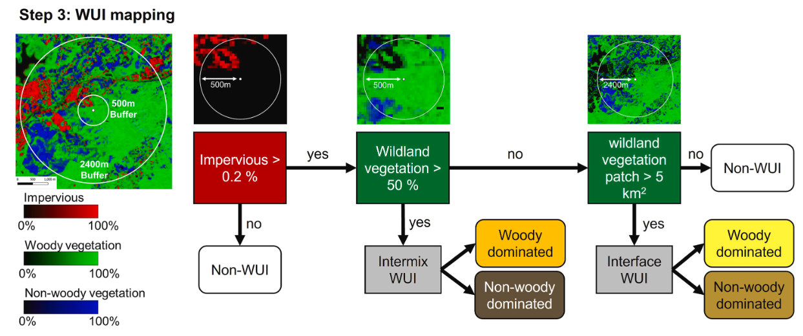
Landsat-based WUI mapping method

Slide 16
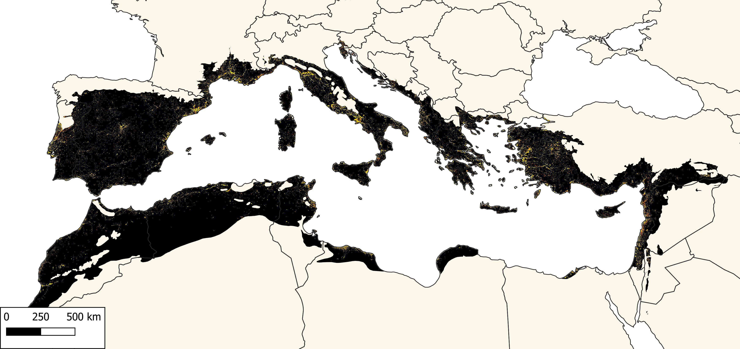
WUI in 2000
Intermix WUI (woody)
Interface WUI (woody)
Intermix WUI (non-woody)
Interface WUI (non-woody)

Slide 17
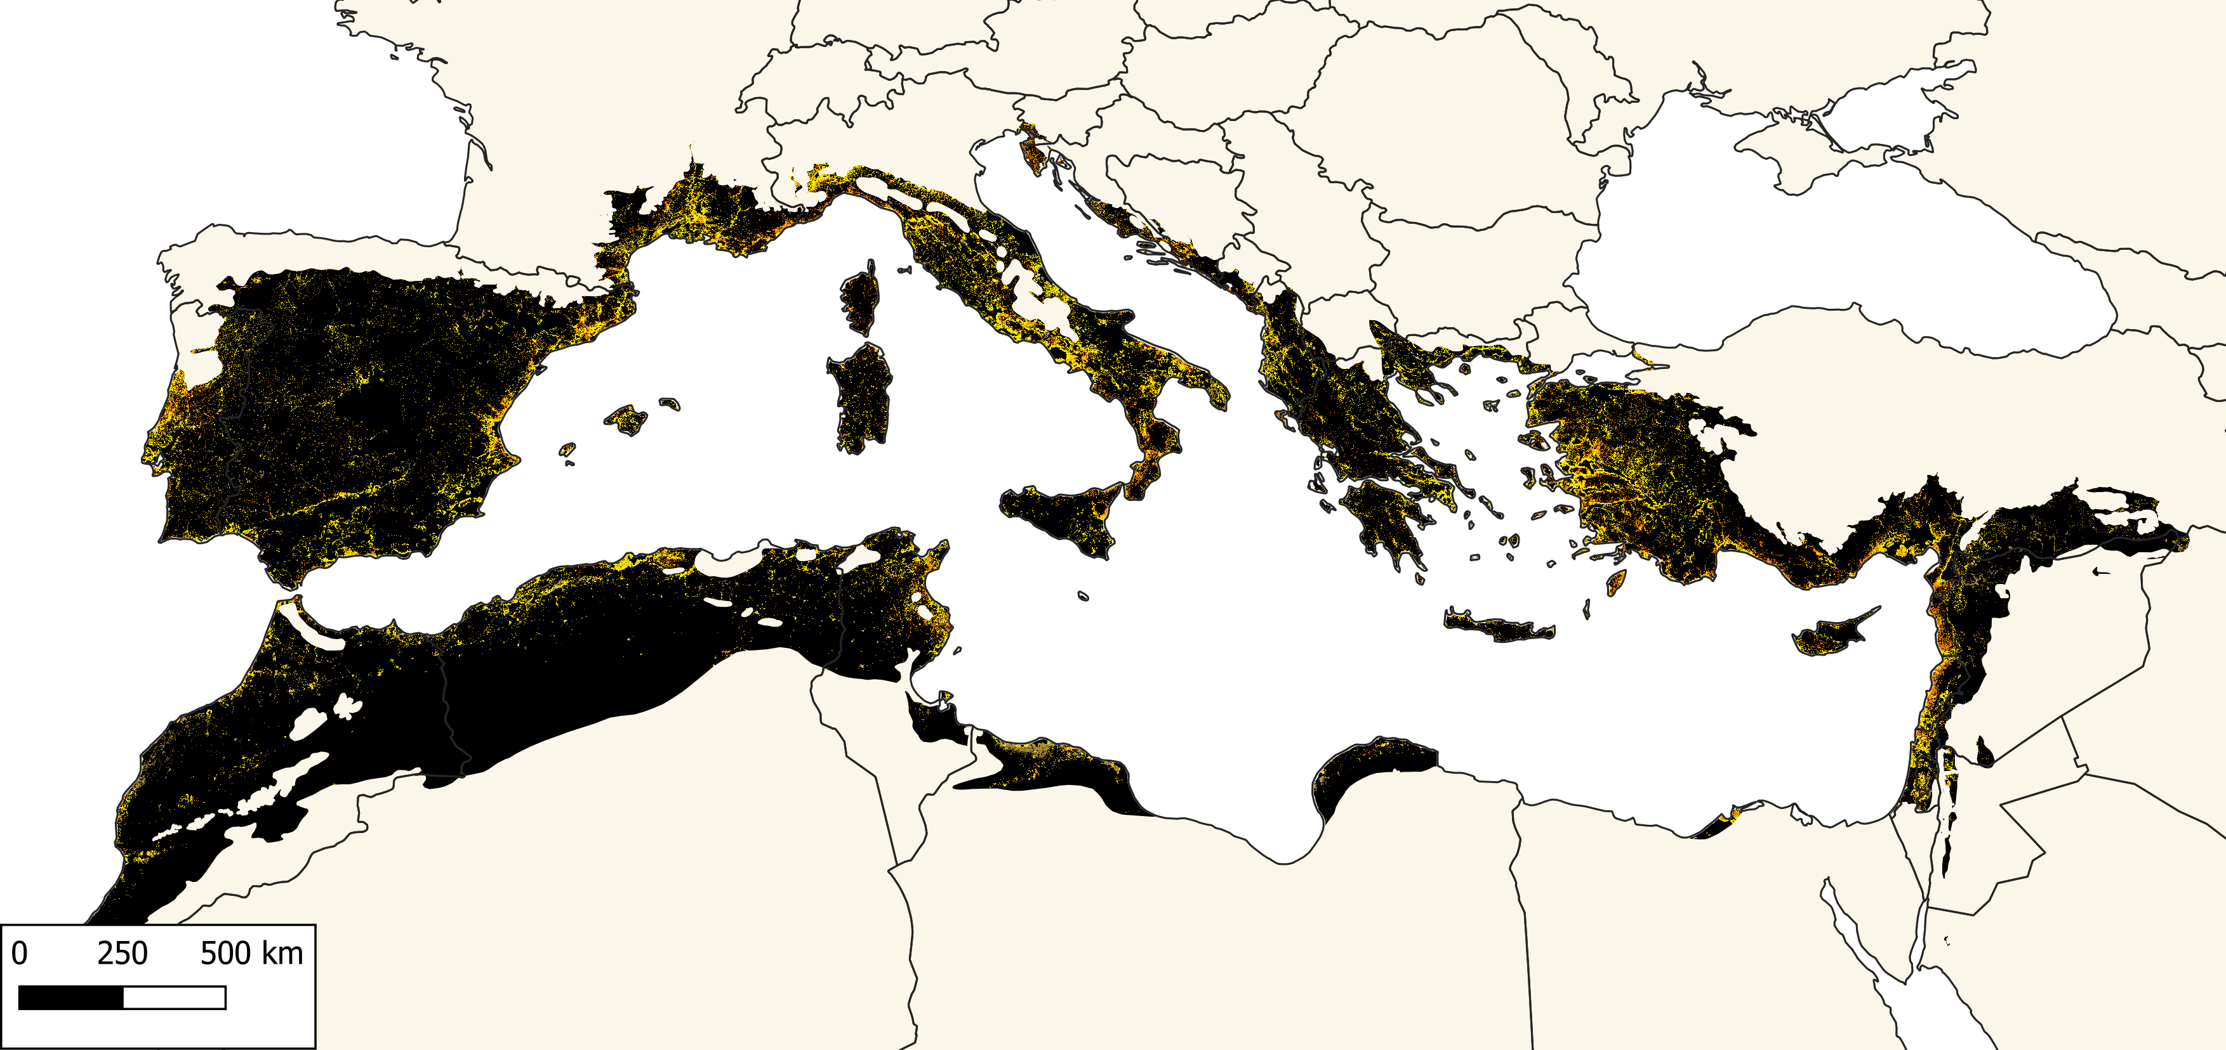
WUI in 2020
Intermix WUI (woody)
Interface WUI (woody)
Intermix WUI (non-woody)
Interface WUI (non-woody)

Slide 18
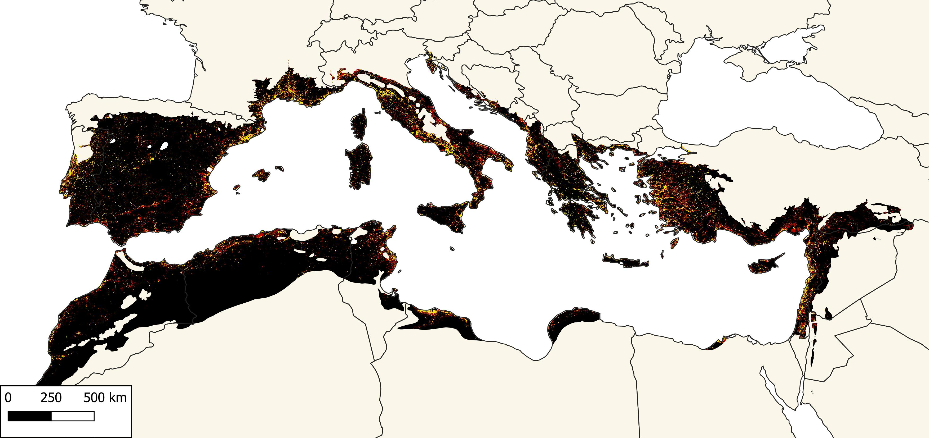
WUI Growth (2000-2020)
Persistent WUI
New WUI

Slide 19
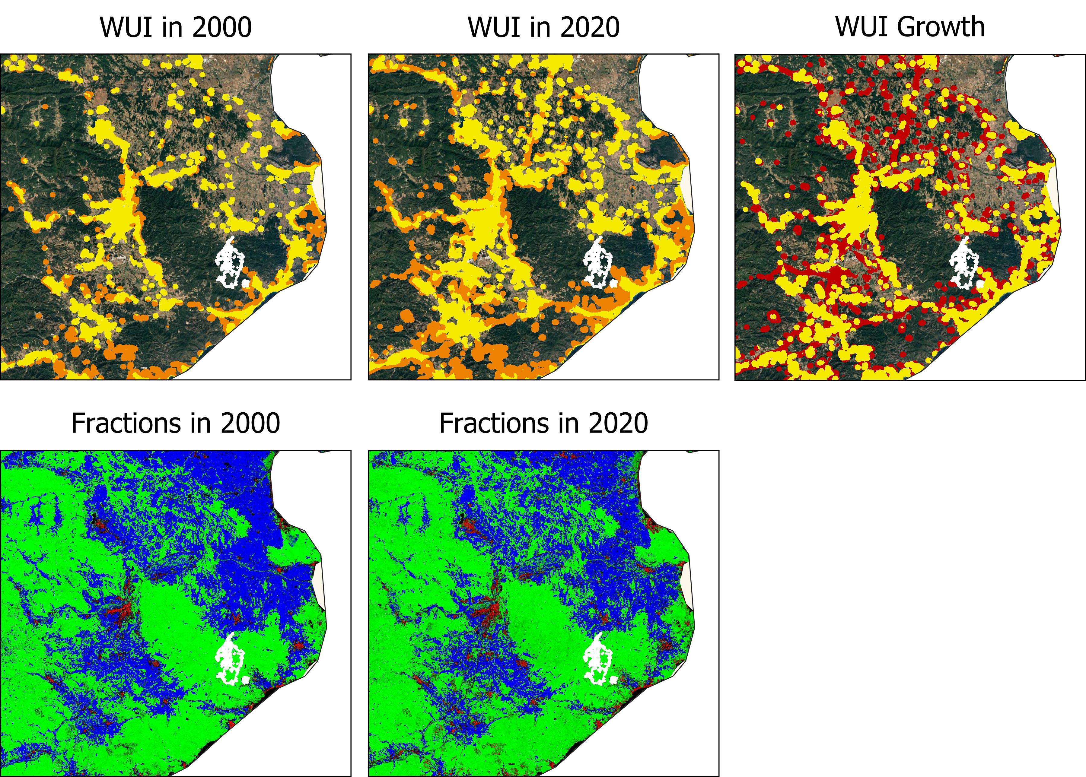
WUI Growth (2000-2020) in Spain
WUI Classes in 2000 & 2020
Intermix WUI (woody)
Interface WUI (woody)
Intermix WUI (non-woody)
Interface WUI (non-woody)
WUI Growth
Persistent WUI
New WUI
Fractions
non-woody
Impervious
woody

Slide 20
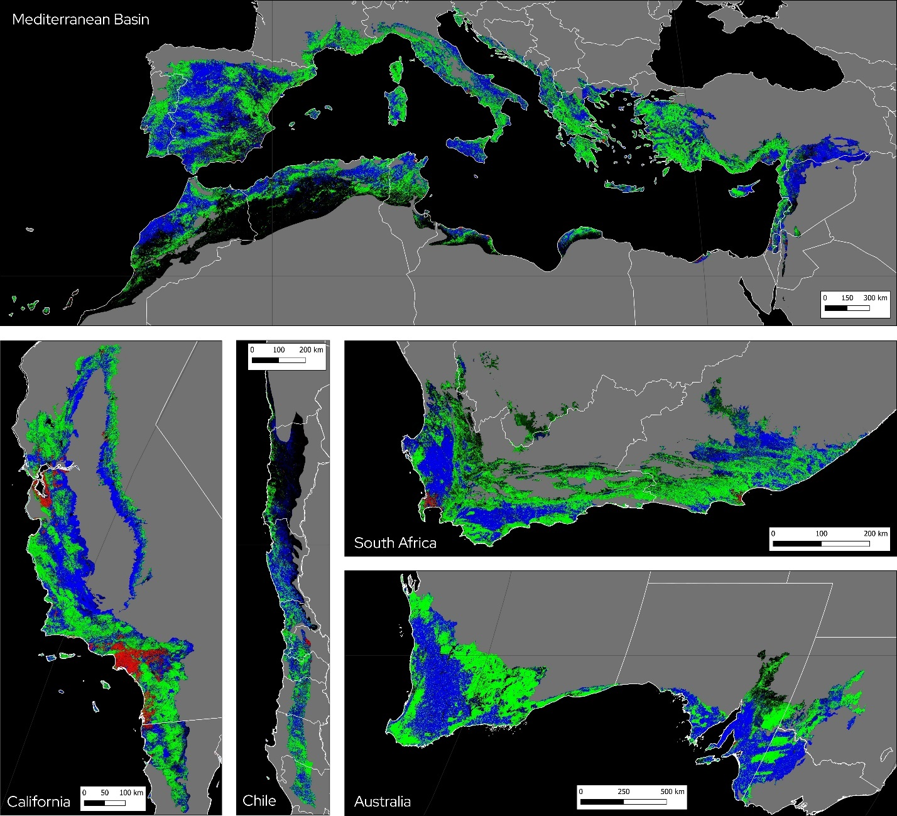
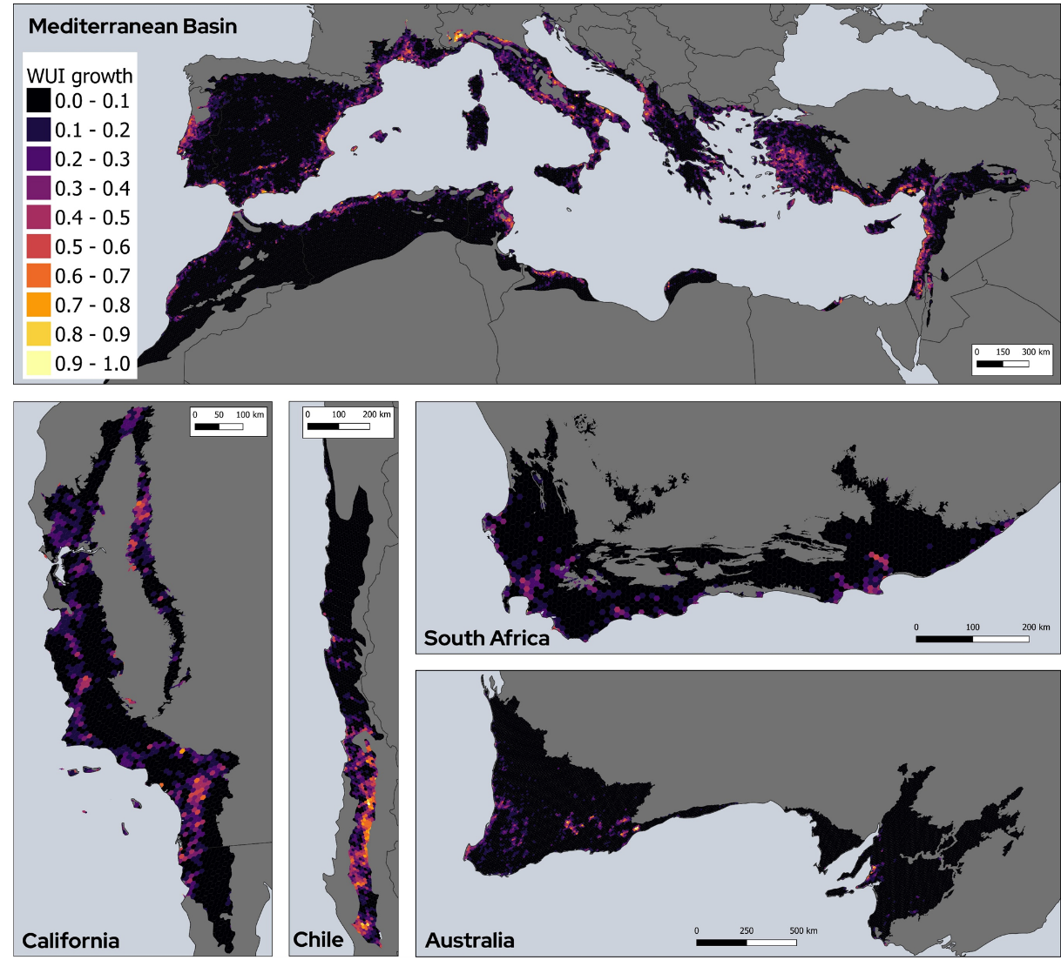
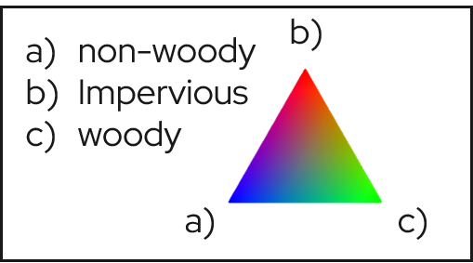
Global Mediterranean Ecosystems
A) Land Cover Fractions for 2020
B) WUI Growth (10km hexagons)

Slide 21
Conclusion
WUI growth increases ignitions and exposes people and houses to wildfires.​
Land-use change cause fuel to build up, exacerbating wildfire risk. ​
Drought and climate change contribute to landscape flammability and thereby to larger, more intense wildfires.​
Wildfire risk is due to WUI growth and increased ignitions, more fuels and climate change.​

