Slide 1
It’s all red
IGERT Writer’s Guild
11/15/2013

Slide 2
Postdoc, 5+ papers, 1st draft

Slide 3
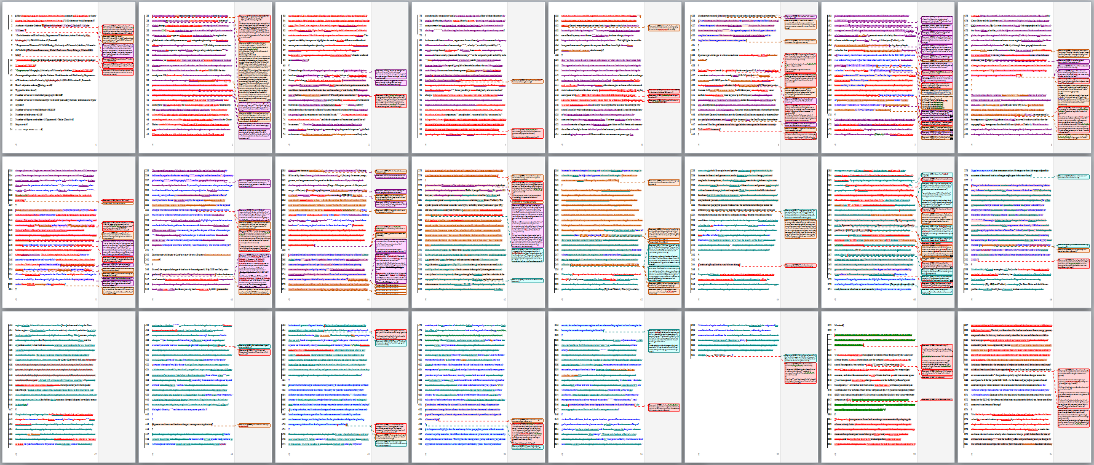
Postdoc, 5+ papers, round 1

Slide 4
Postdoc, 10+ papers, 1st draft

Slide 5
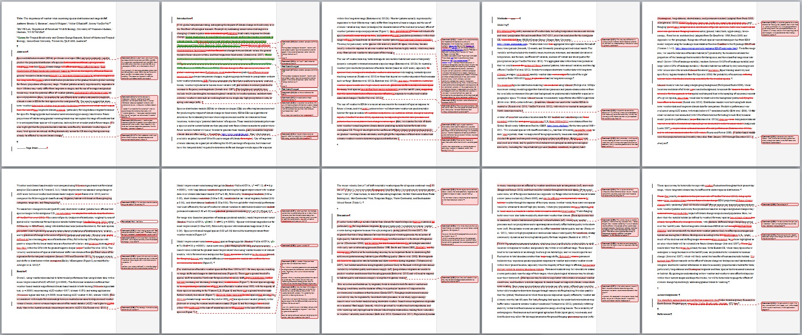
Postdoc, 10+ papers, 1st draft

Slide 6
Postdoc, 5+ papers, round 1

Slide 7
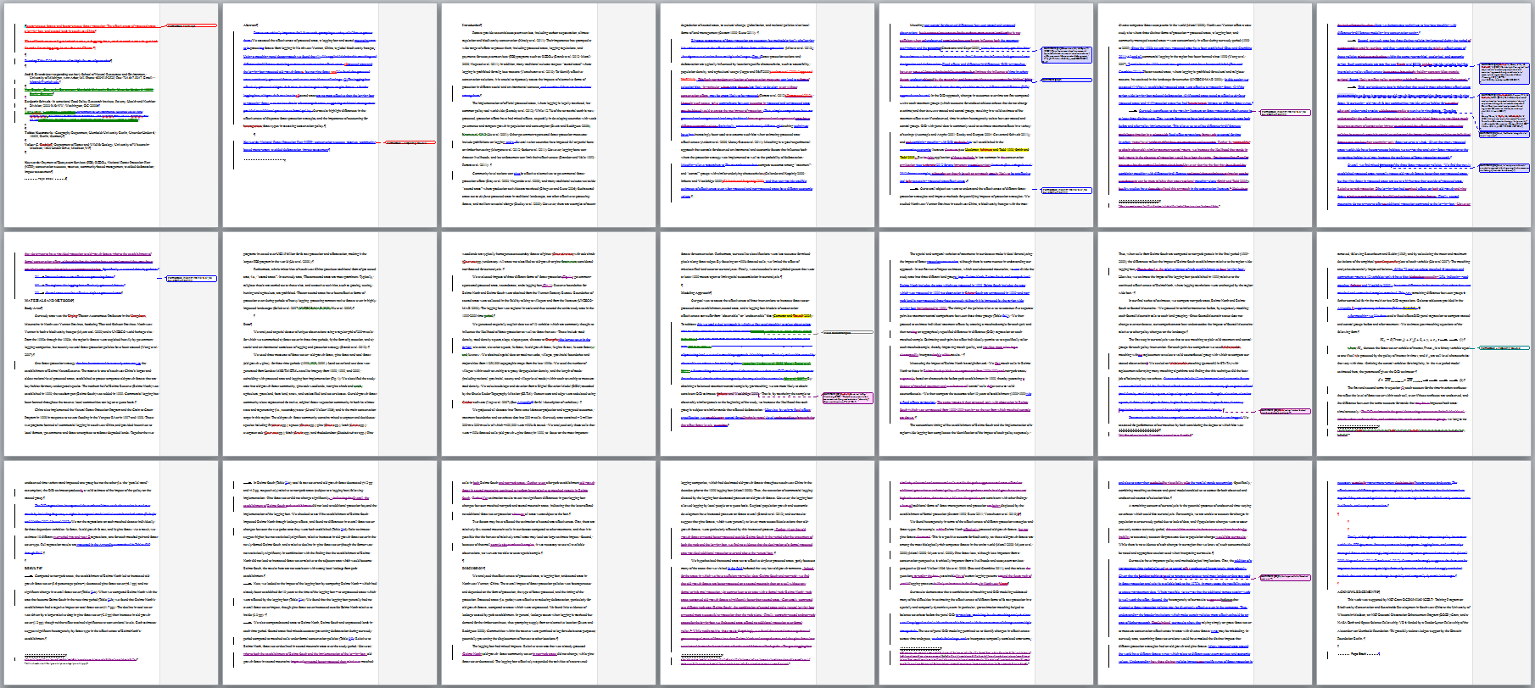
Postdoc, 5+ papers, round 1

Slide 8
PhD student, 3rd paper

Slide 9
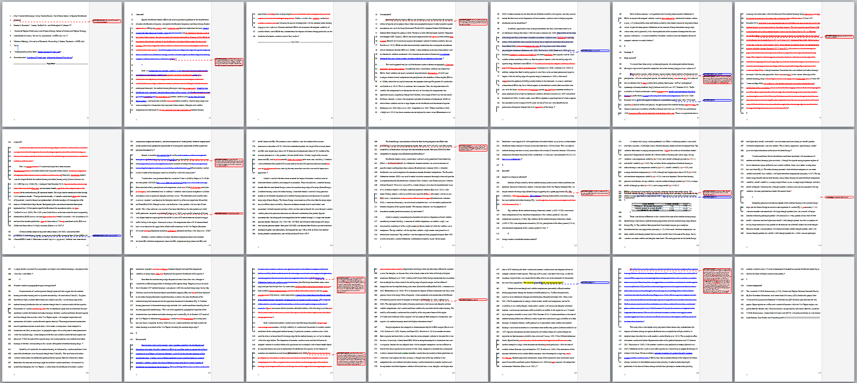
PhD student, 3rd paper

Slide 10
MS student, 1st manuscript, round 1

Slide 11
MS student, 1st manuscript, round 1

Slide 12
MS student, 1st manuscript, round 2

Slide 13
MS student, 1st manuscript, round 2

Slide 14
MS student, 1st manuscript, round 3

Slide 15
MS student, 1st manuscript, round 3

Slide 16
PhD student, 1st paper, 1st draft

Slide 17
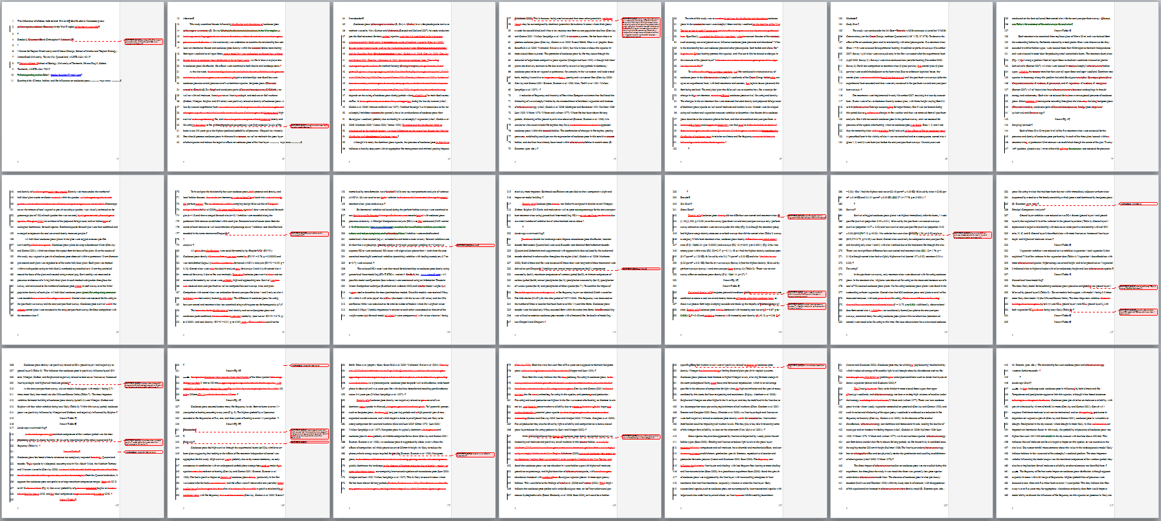
PhD student, 1st paper, 1st draft

Slide 18
PhD student, 2nd manuscript, round 1

Slide 19
PhD student, 2nd manuscript, round 1

Slide 20
PhD student, 1st paper, round 2

Slide 21
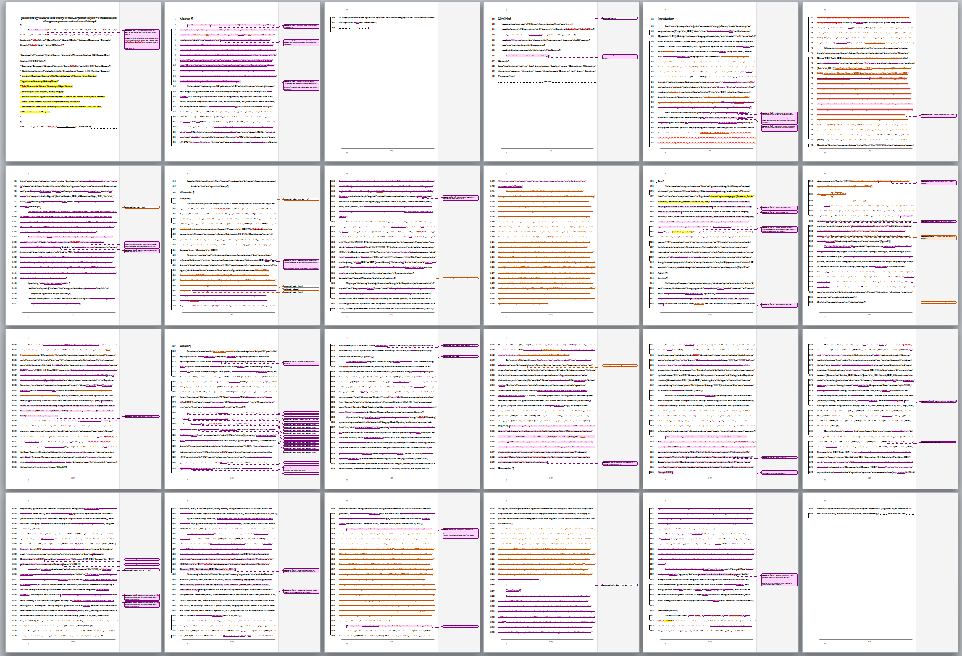
PhD student, 1st paper, round 2

Slide 22
PhD student, 5th manuscript, revisions of a dissertation chapter

Slide 23
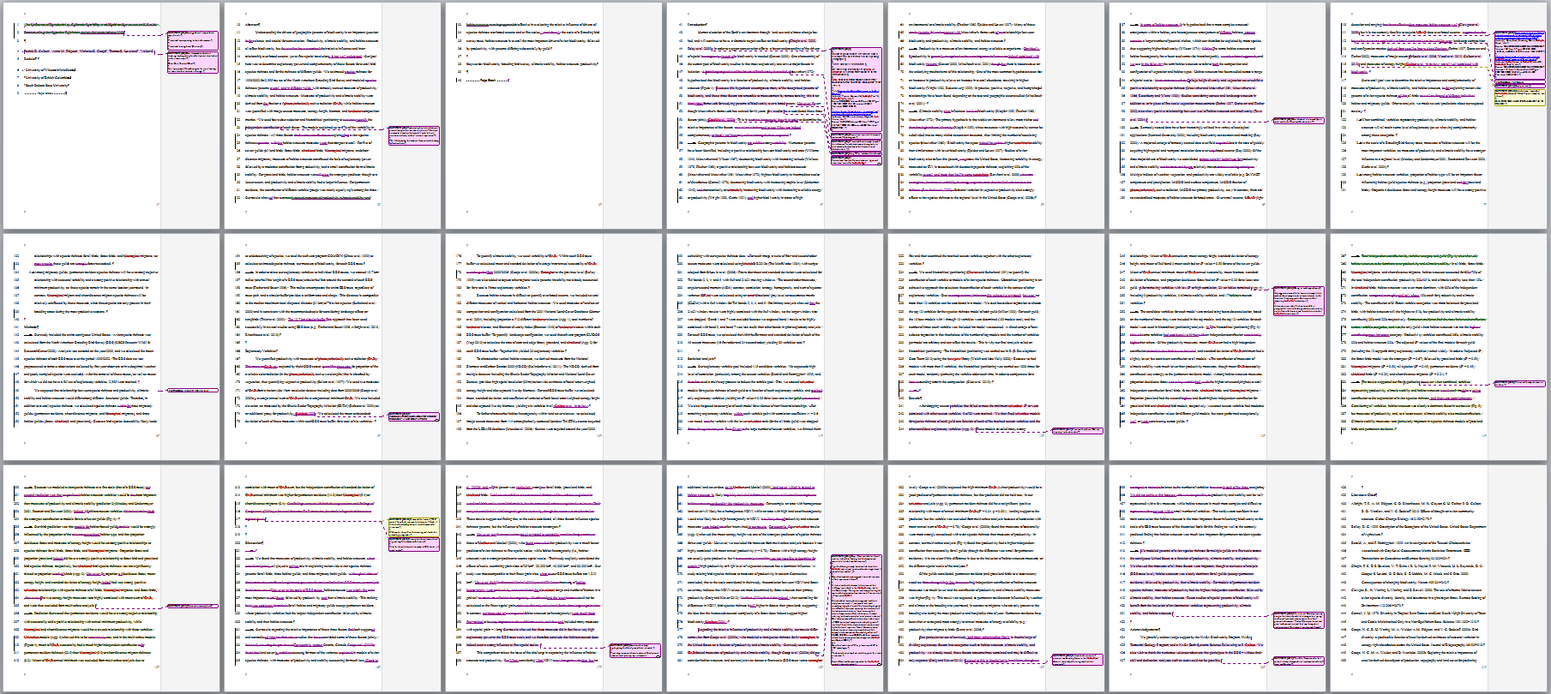
PhD student, 5th manuscript, revisions of a dissertation chapter

Slide 24
Postdoc, 10+ papers, 3 co-authors

Slide 25
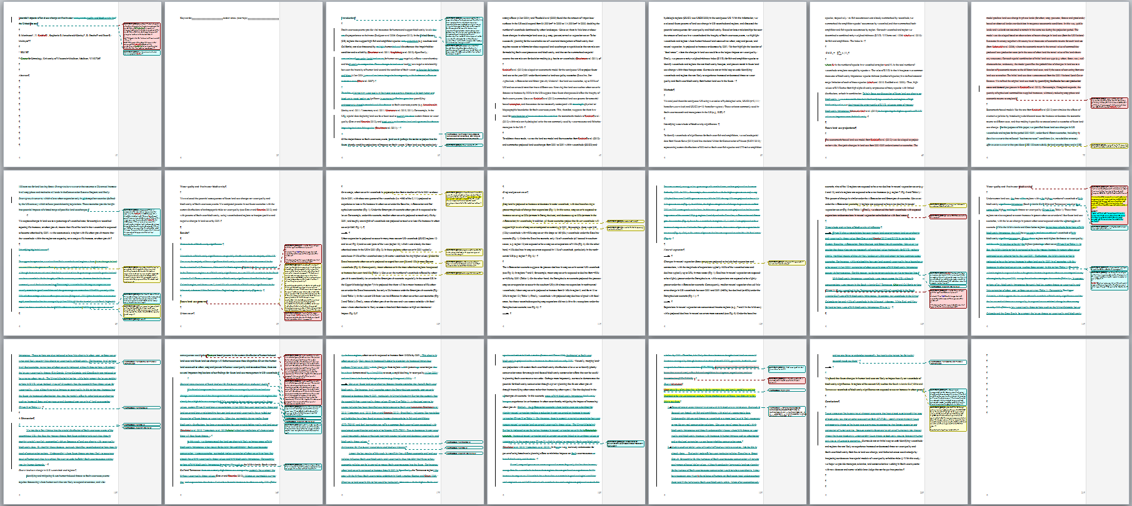
Postdoc, 10+ papers, 3 co-authors

Slide 26
PhD student, 1st paper, round 1

Slide 27
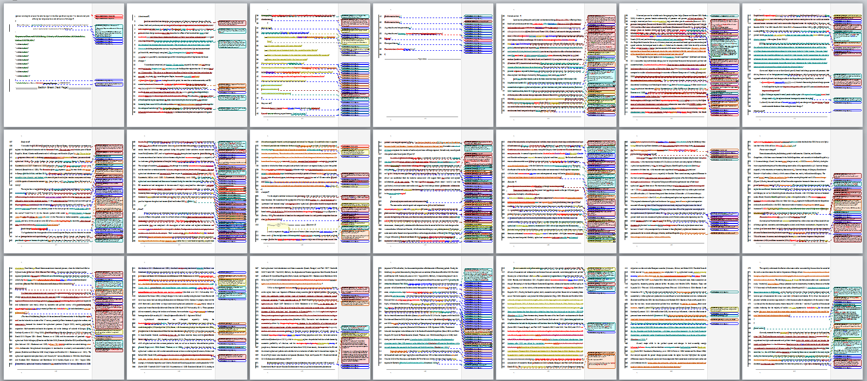
PhD student, 1st paper, round 1

Slide 28
PhD student, 1st paper, round 2

Slide 29
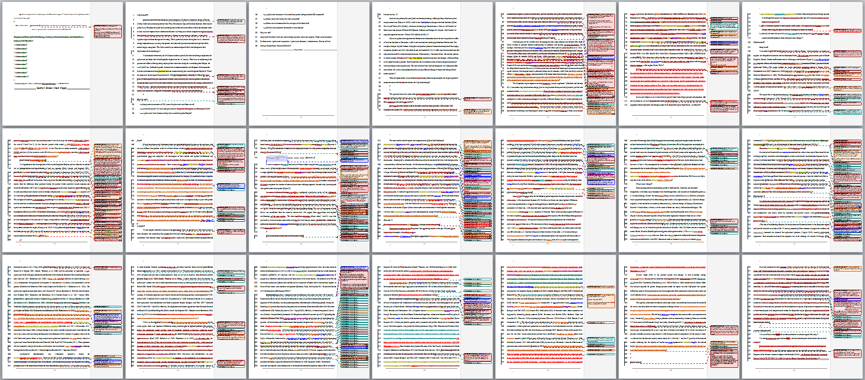
PhD student, 1st paper, round 2

Slide 30
The End

