Slide 1
IGERT Writer’s Guild UW-Madison

Slide 2
Top ten horrors of horrors!!!
10/11/2013
V. C. Radeloff, et al.

Slide 3
Grammar and Style

Slide 4
Grammar and Style
Passive voice

Slide 6
Grammar and Style
Passive voice
Lacks information on who did what
If you can add 'by zombies' to the end of your sentence then you are writing in passive voice
“Data on habitat use was collected by zombies.”

Slide 7
Grammar and Style
Unclear pronouns

Slide 8
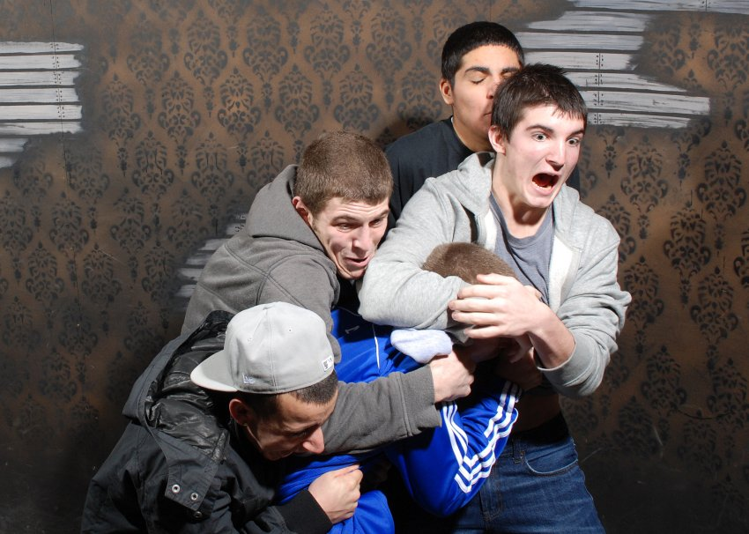

Slide 9
Grammar and Style
Unclear pronouns
“this”, “it”, etc.
Easily causes confusion when the antecedent is not clear
Never start a paragraph with a pronoun

Slide 10
Grammar and Style
Terminology slippage

Slide 12
Grammar and Style
Terminology slippage
Do not use multiple words to refer to the same concept
Readers will assume that different words differ in meaning
Do not be imprecise for fear of being repetitive

Slide 13
Grammar and Style
Jargon and abbreviations

Slide 15
Grammar and Style
Jargon and abbreviations
If you have to use jargon, define it
Do not make up abbreviations, only use commonly known abbreviations
“GIS” is fine, hardly anything else is

Slide 16
Grammar and Style
Sentences that start with a reference

Slide 18
Grammar and Style
Sentences that start with a reference
Focus on WHAT, not WHO
Reference belong at the end of sentences to support your statement
The history of science is a poor justification for your work

Slide 19
Structure

Slide 20
Structure
Poor topic sentences

Slide 21
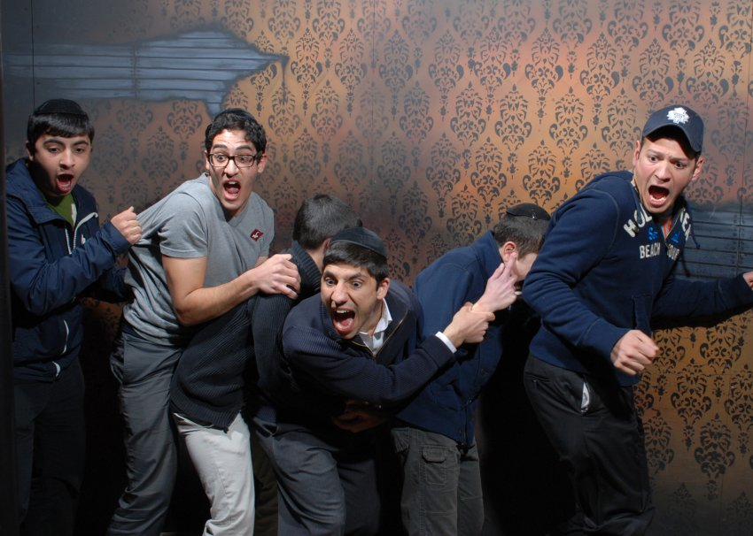

Slide 22
Structure
Poor topic sentences
What is the paragraph about?
That should come out pretty early in the paragraph (1st or 2nd sentence at the latest)

Slide 23
Structure
Paragraphs that try to say too much

Slide 24
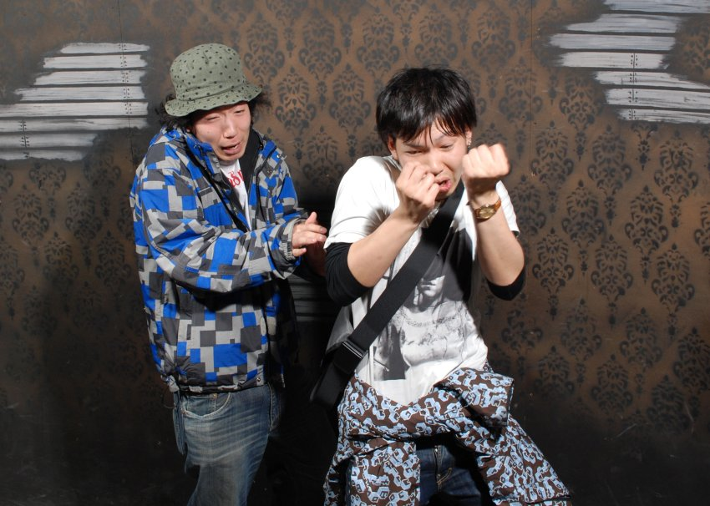

Slide 25
Paragraphs
Paragraphs that try to say too much
Stick to one coherent point per paragraph
Most paragraphs that go awry have 2-3+ important points in them
Keep like things in the same paragraph

Slide 26
Structure
Hidden North Star

Slide 27
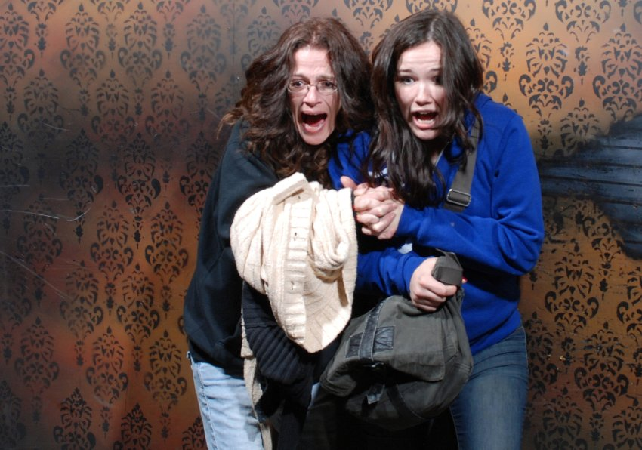

Slide 28
Structure
Hidden North Star
Taking too long to divulge what the paper is about
You should get to the point quickly
If your study is about X, X (usually) should be mentioned in the first paragraph

Slide 29
Structure
No goal, no plan

Slide 31
Structure
No goal, no plan
The last paragraph of the Intro needs to state the overall goal or question, and the specific objectives or hypotheses
Do not report what was done – who cares!
Use your list of objectives to structure Intro, Methods, Results and Discussion. 1-2 paragraphs in each for each objective

Slide 32
Structure
No closure

Slide 34
Structure
No closure
Results and discussion cannot leave loose ends
Each question needs to be answered
Each hypothesis needs to be tested
Each objective needs to be addressed

Slide 35
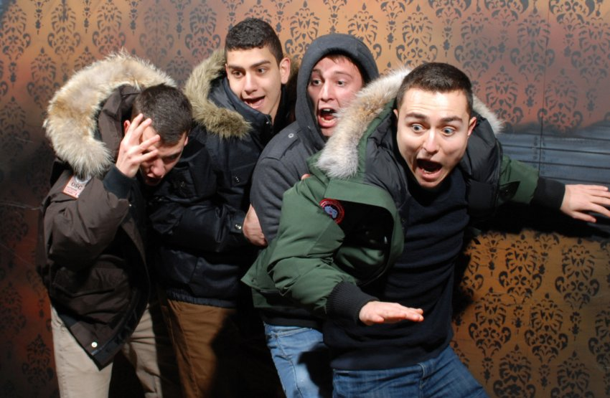

Slide 36
Top Ten Writing Errors
Grammar and Style
Passive voice
Unclear pronouns
Terminology slippage
Jargon and abbreviations
Sentence starting with a reference
Structure
Poor topic sentences
Too many points in one paragraph
Hidden North Star
No goal, no plan
No closure

