Slide 1
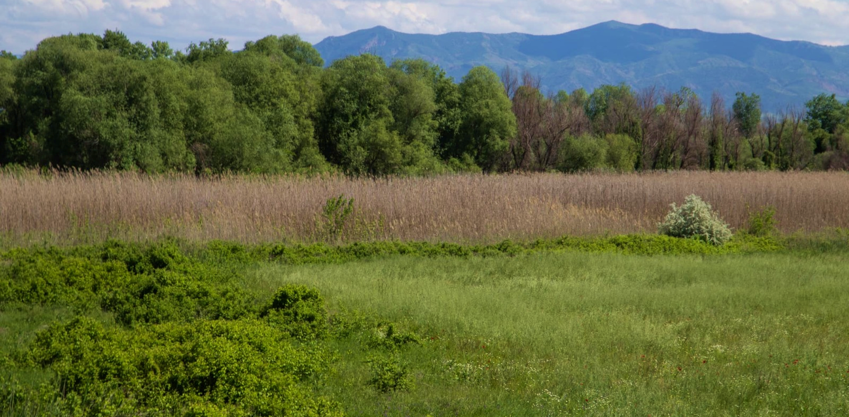
Please follow the link below to access my talk:
https://youtu.be/6tQa5lAuEAs
© Ali Rza

Slide 2
PhD defense December 6th 2023
Afag Rizayeva
Advisor: Volker Radeloff
Committee members: Annemarie Schneider Benjamin Zuckerberg Holly Gibbs Mihai Nita
© Ali Rza

Slide 3
Introduction
Introduction
Historical land cover mapping
Quantifying long-term land cover changes
Assessing habitat changes

Slide 4
Introduction
Introduction
© Ali Rza

Slide 5
Introduction
Human population growth
© UN DESA; History Database of the Global Environment

Slide 6
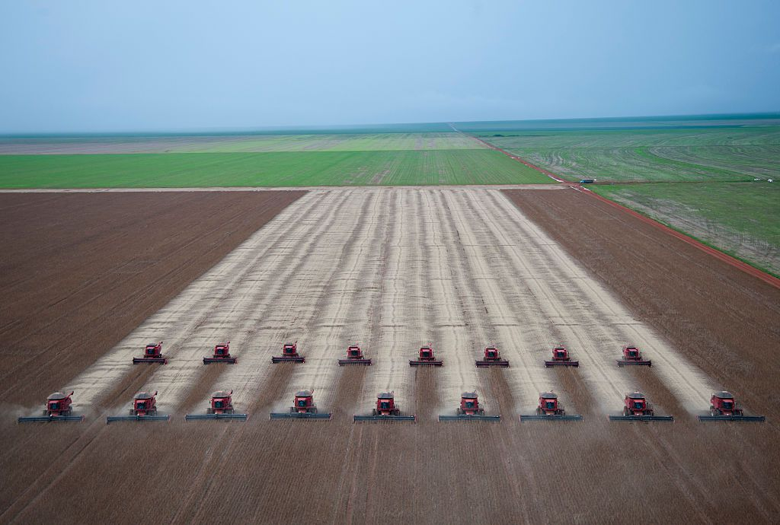
Introduction
Human population growth
The “Green Revolution”

Slide 7
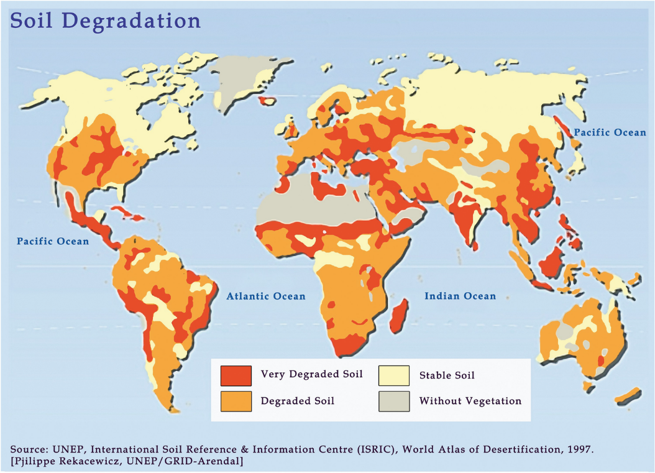
Introduction
Environmental degradation

Slide 8
Introduction
US vs SU

Slide 9
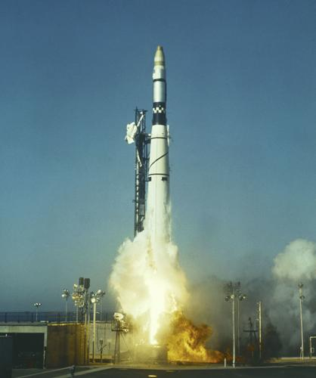
Introduction
Corona satellites
Corona KH-1 spy satellite launched from Vandenberg Air Force base in 1959

Slide 10
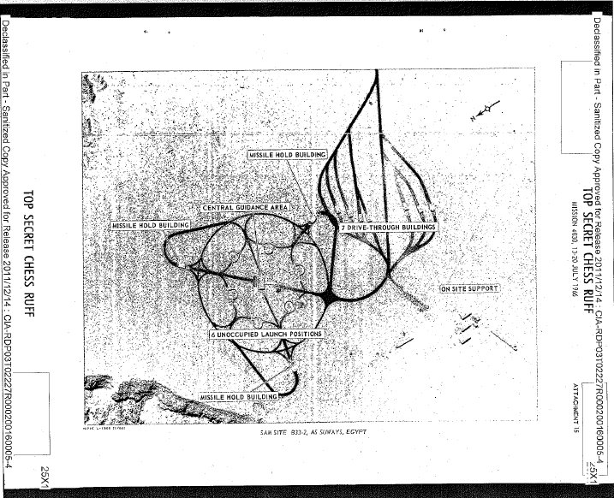
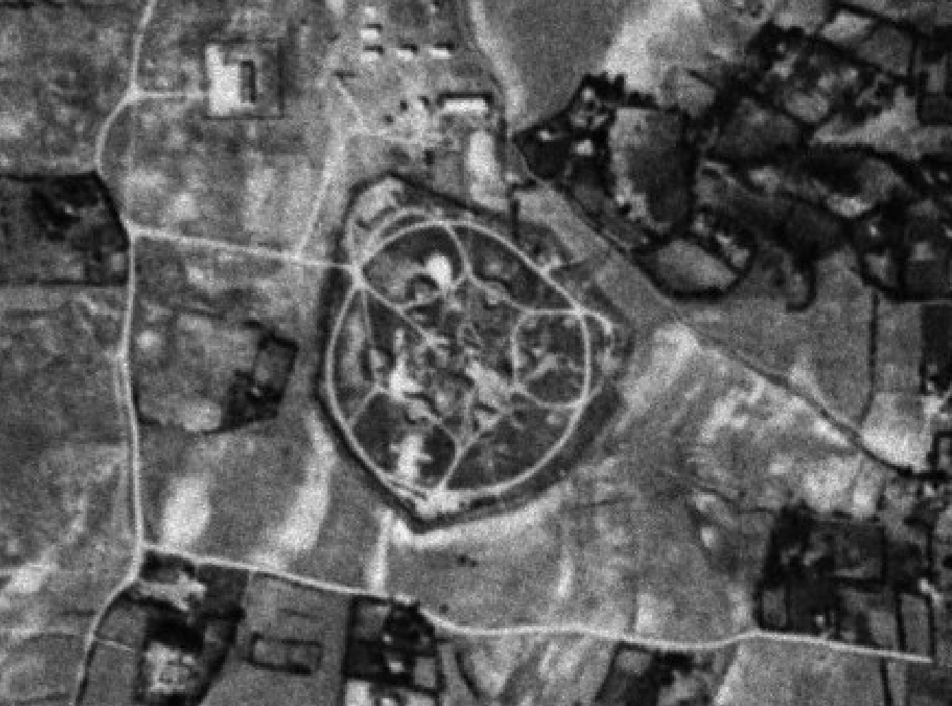
Introduction
Corona satellites
Corona image, Georgia, 1964

Slide 11
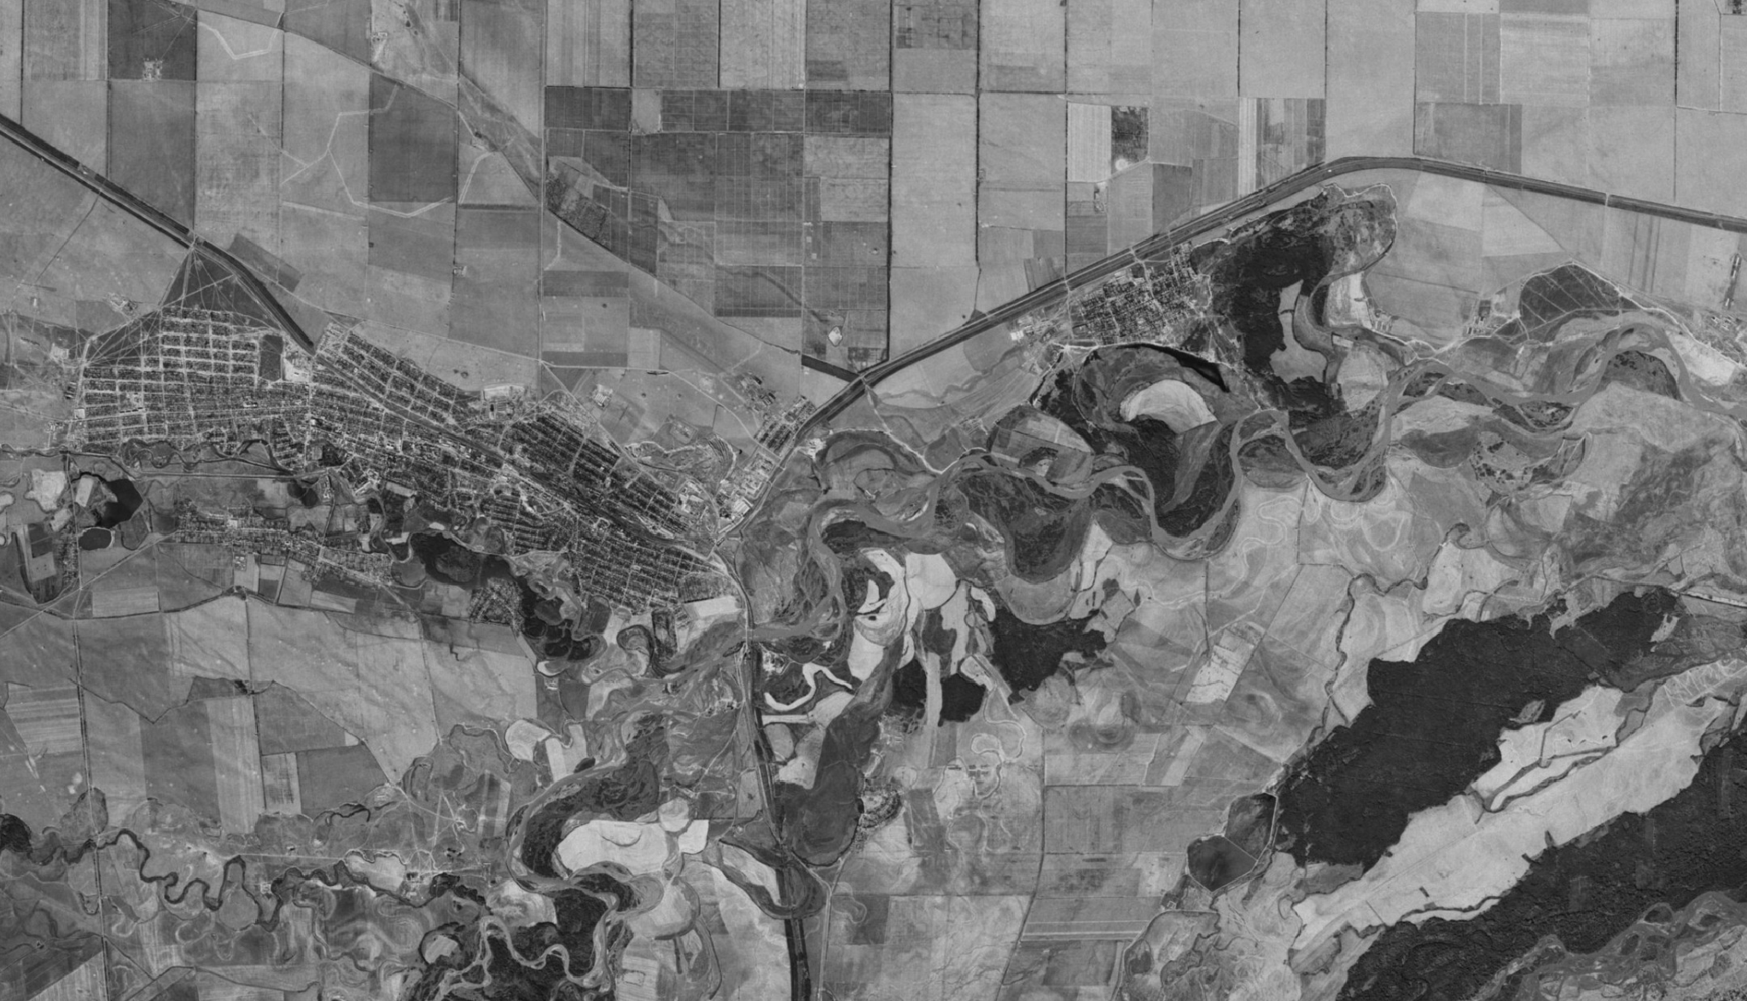
Introduction
Corona satellites
Corona image, near Prokhladniy, Kabardino-Balkaria, Soviet Russia, 1964

Slide 12
Introduction
Corona satellites
Корона

Slide 13
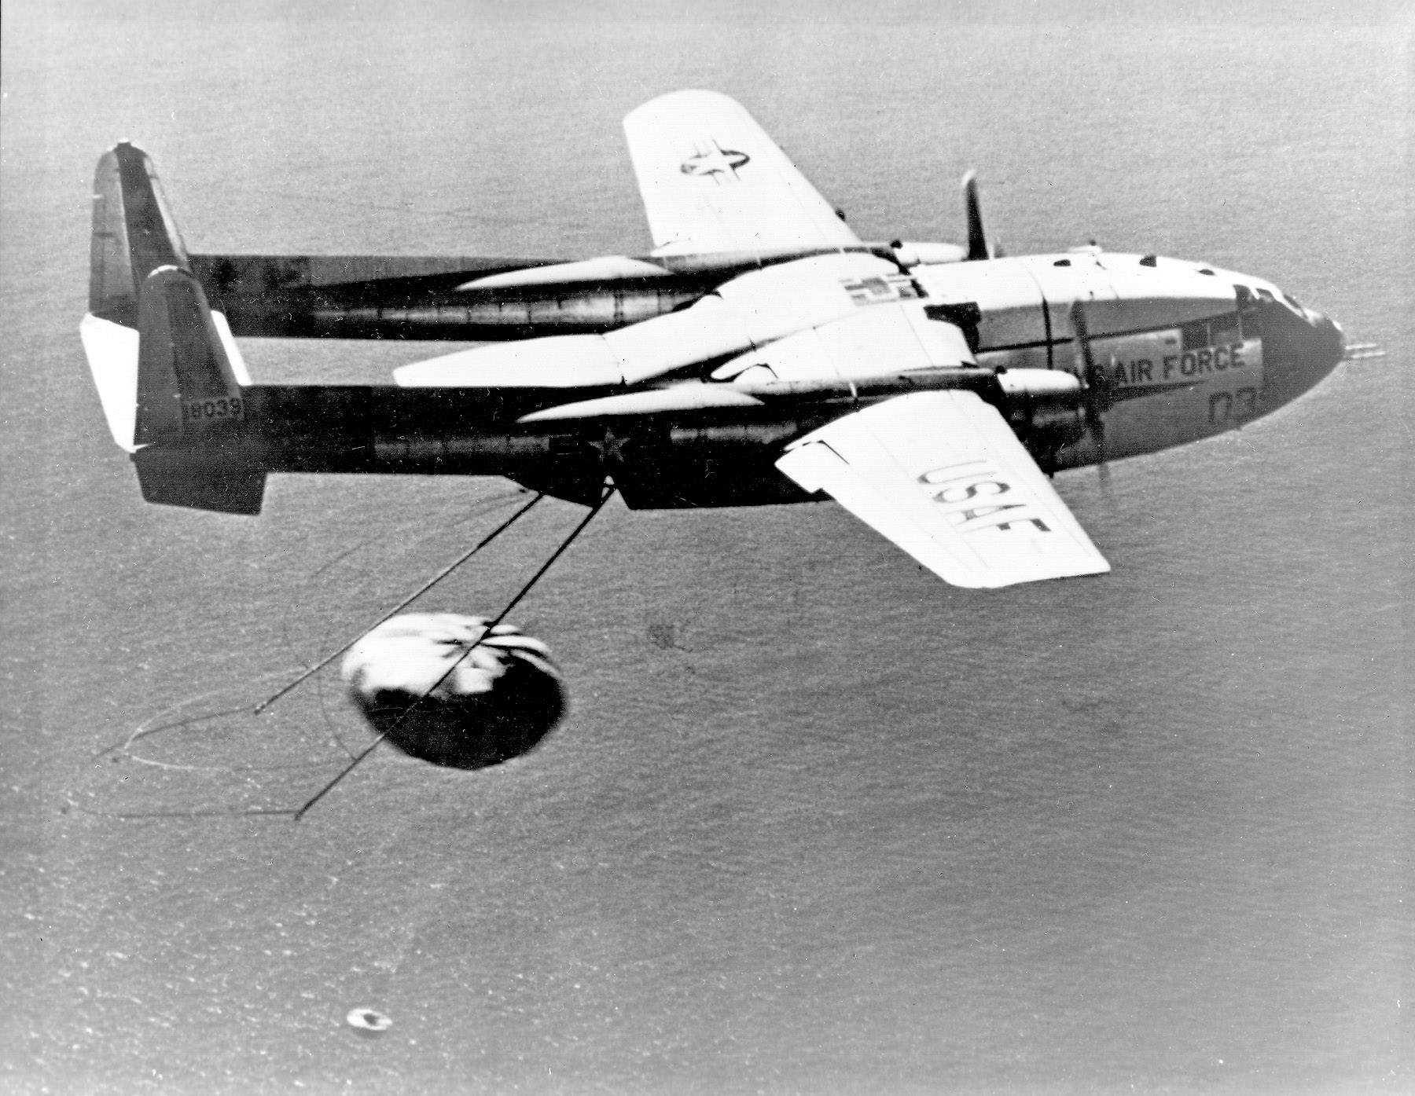
Introduction
Corona data
Corona star catchers

Slide 14
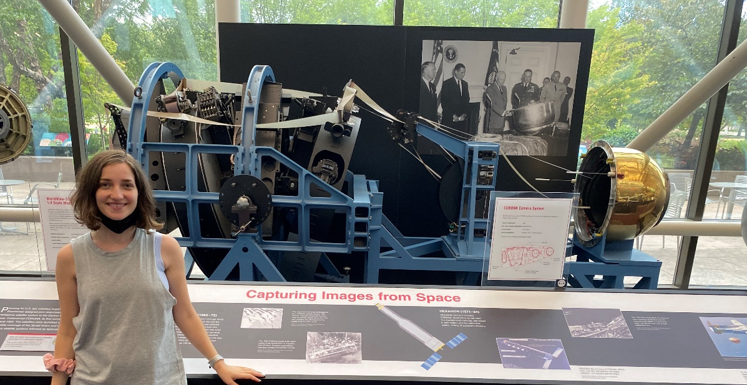
Introduction
Corona data
Corona at the Smithsonian National Air and Space Museum in Washington, DC

Slide 15
Introduction
Corona data

Slide 16
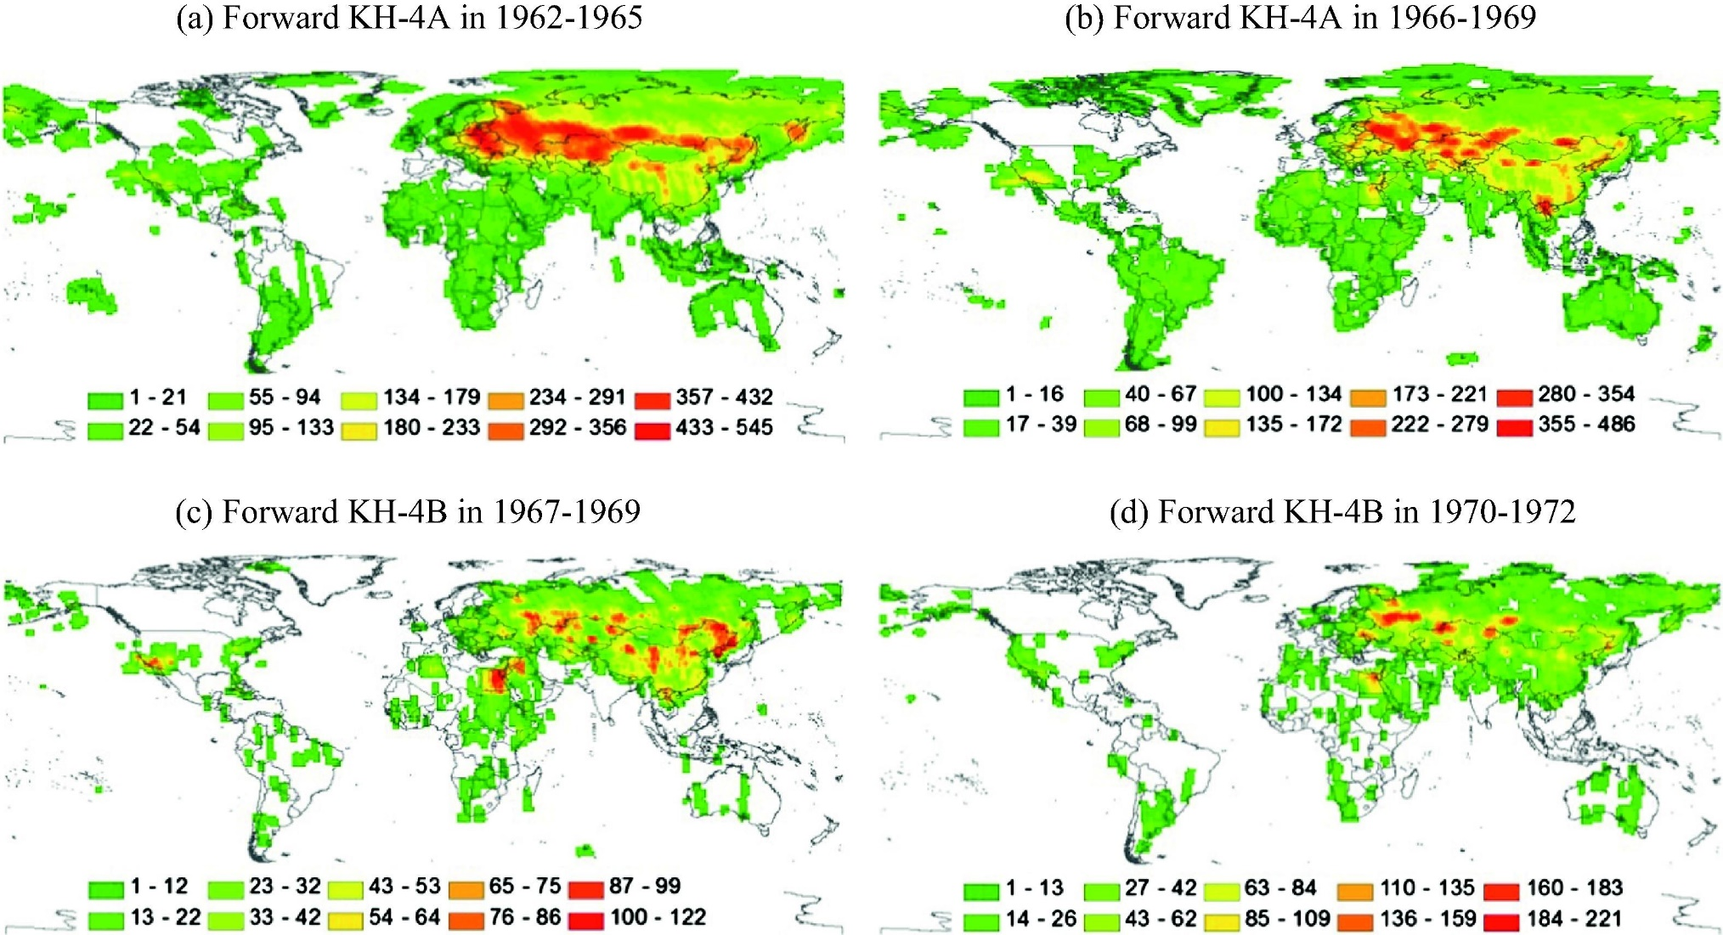
Introduction
Corona data
KH-4A in 1962-1965
KH-4A in 1966-1969
KH-4B in 1967-1969
KH-4B in 1970-1972
Global coverage by Corona satellites during 1962-1972 and the number of available images
(Song et al., 2015)

Slide 17
Introduction
Corona data
M. Gorbachev, general secretary of the Communist Party
the last leader of the Soviet Union

Slide 18
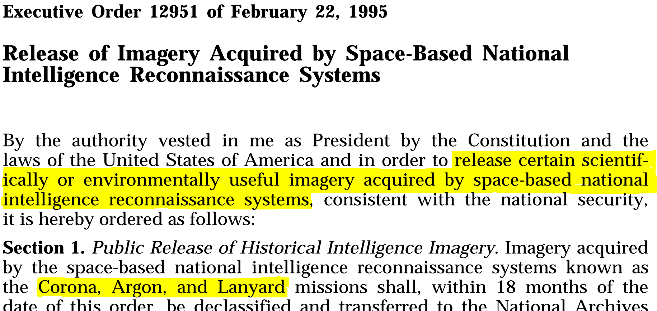
Introduction
Corona data

Slide 19
Introduction
Potential of Corona data
forest
grassland
cropland
lake
barren
wetland
urban
river
snow-and-ice

Slide 20
Introduction
Research questions
Overarching goal – advance remote sensing, long-term land change science,
and habitat modeling
Research questions:
How to automatically map the land cover using high-resolution panchromatic historical spy satellite imagery?
How to quantify long-term land cover changes using multi-resolution satellite images?
How to assess habitat changes of wild ungulates, and evaluate how successful the protected areas were using Corona satellite data?

Slide 21
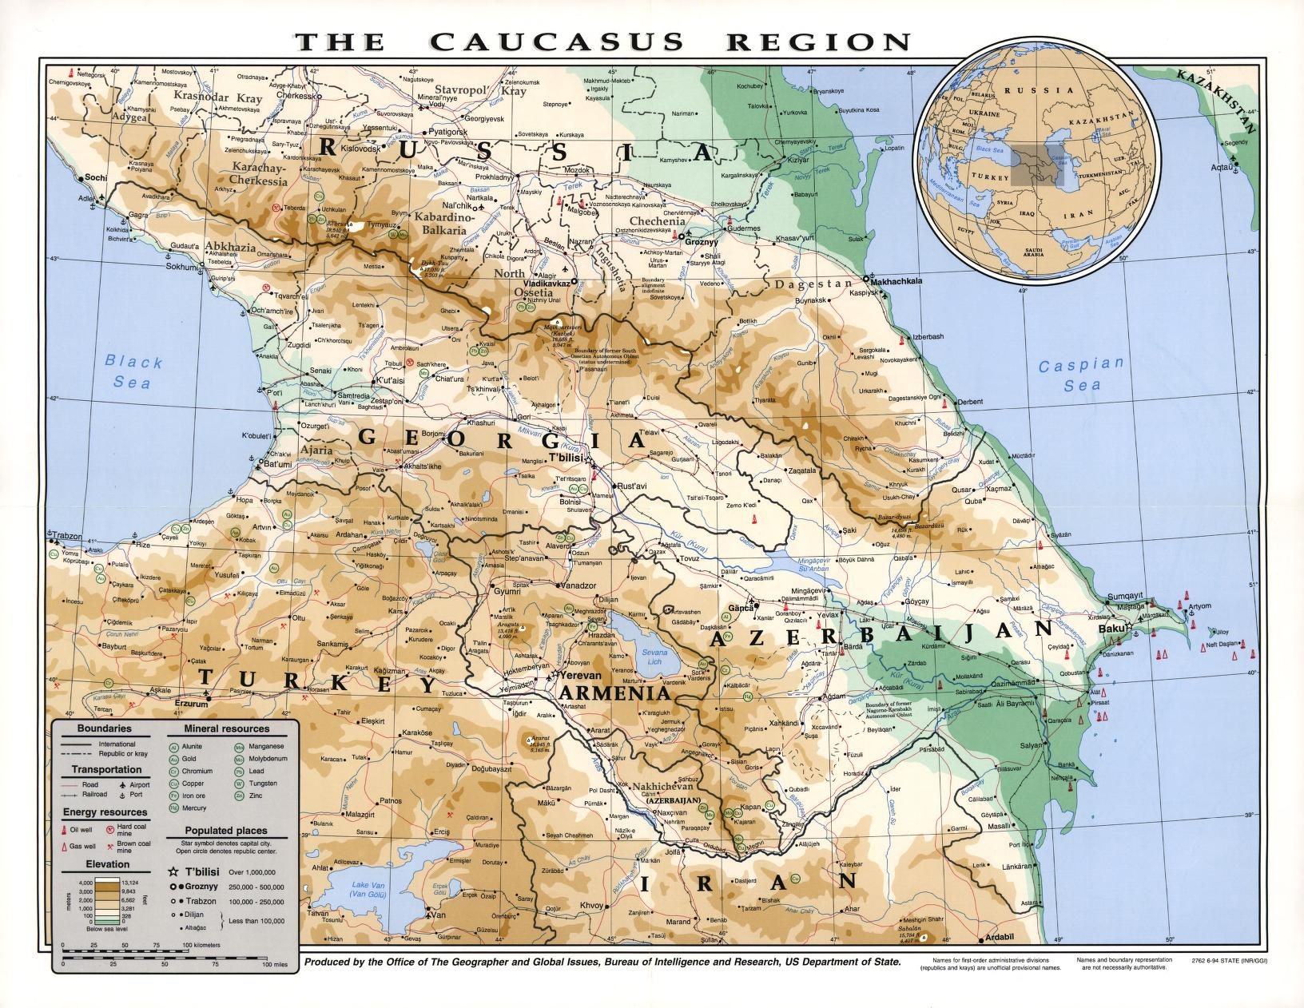
Introduction
Study area
© Library of Congress

Slide 22
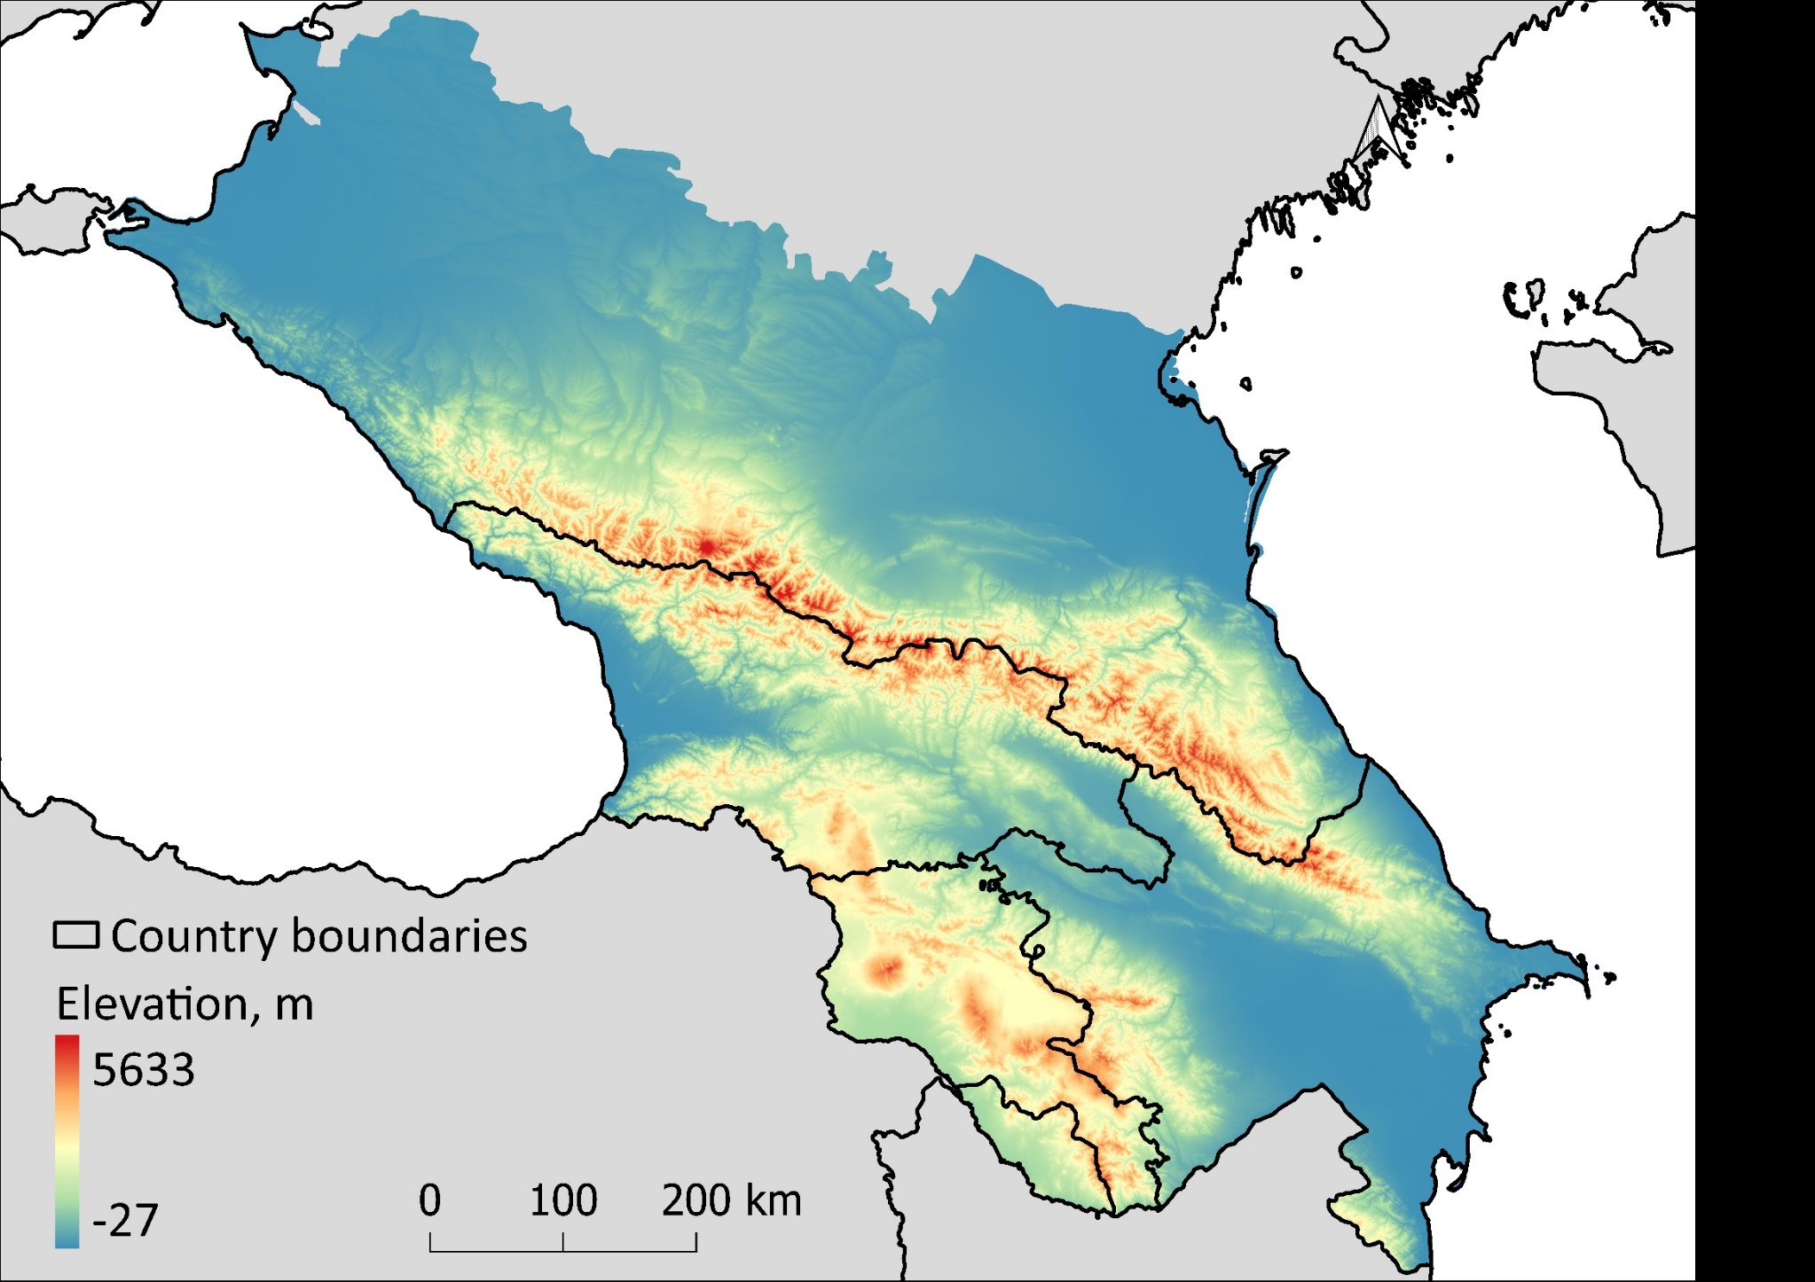
Introduction
Study area
5,633

Slide 23
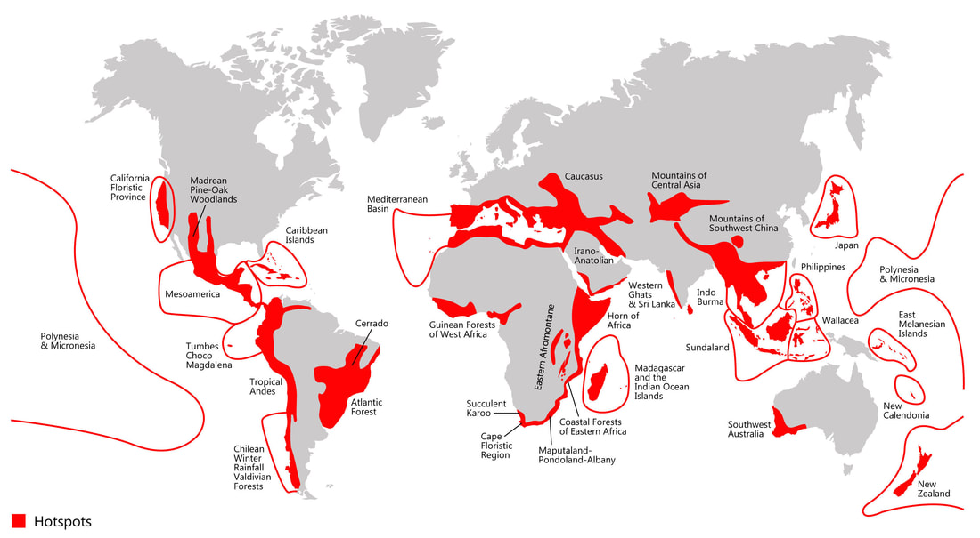
Introduction
Study area
Hotspots
Biodiversity hotspots across the globe (Myers et al., 2000)

Slide 24
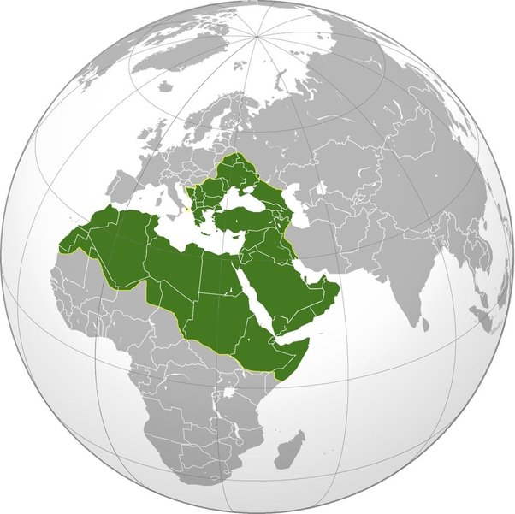
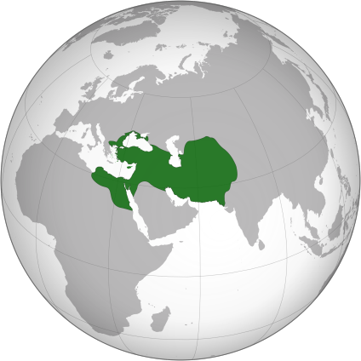
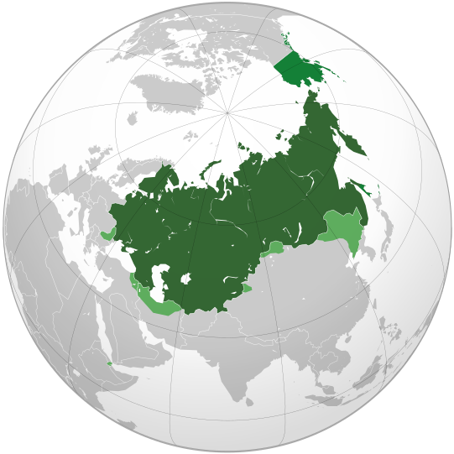
Introduction
Study area
Ottoman Empire, c. 1600
Persian Empire, c. 1800
Russian Empire, c. 1914

Slide 25
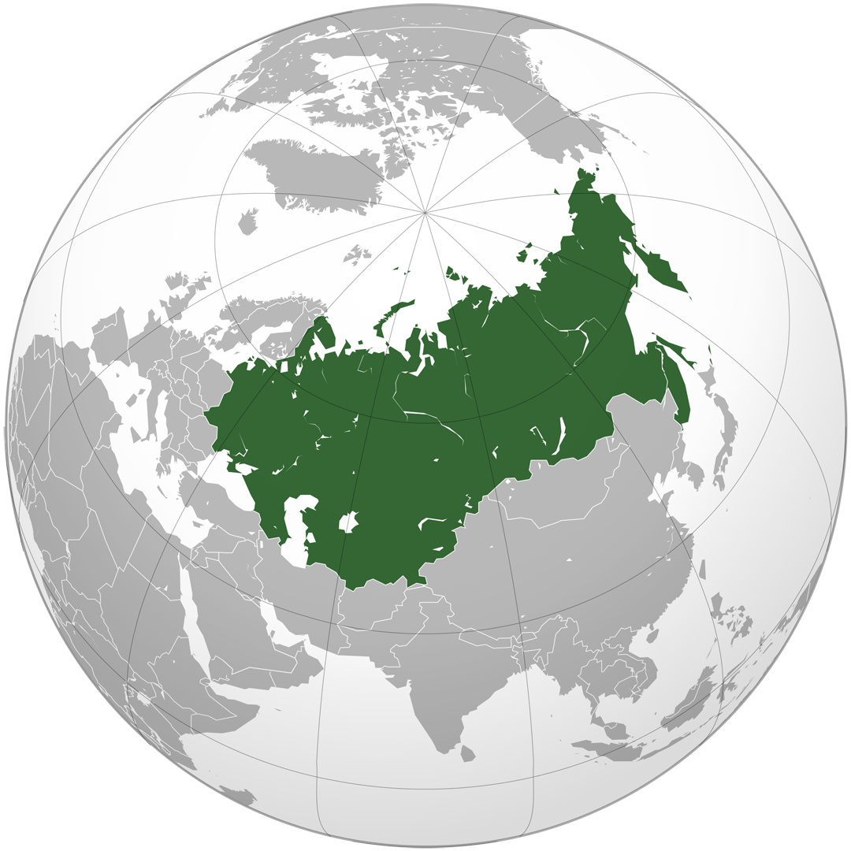
Introduction
Study area
Soviet Union, 1920-1991

Slide 26
Introduction
Outline
How to automatically map the land cover using high-resolution panchromatic historical spy satellite imagery?
How to quantify long-term land cover changes using multi-resolution satellite images?
How to assess habitat changes of wild ungulates, and evaluate how successful the protected areas were using Corona satellite data?

Slide 27
Introduction
Remote sensing - Introduction
How to automatically map the land cover using high-resolution panchromatic historical spy satellite imagery?
- develop an approach to map the land cover using Corona data
How to quantify long-term land cover changes using multi-resolution satellite images?
How to assess habitat changes of wild ungulates, and evaluate how successful the protected areas were using Corona satellite data?

Slide 28
Introduction
Remote sensing - Introduction
Previous Corona studies
?
a
b
c
h
e
g
f
d
k
j
i

Slide 29
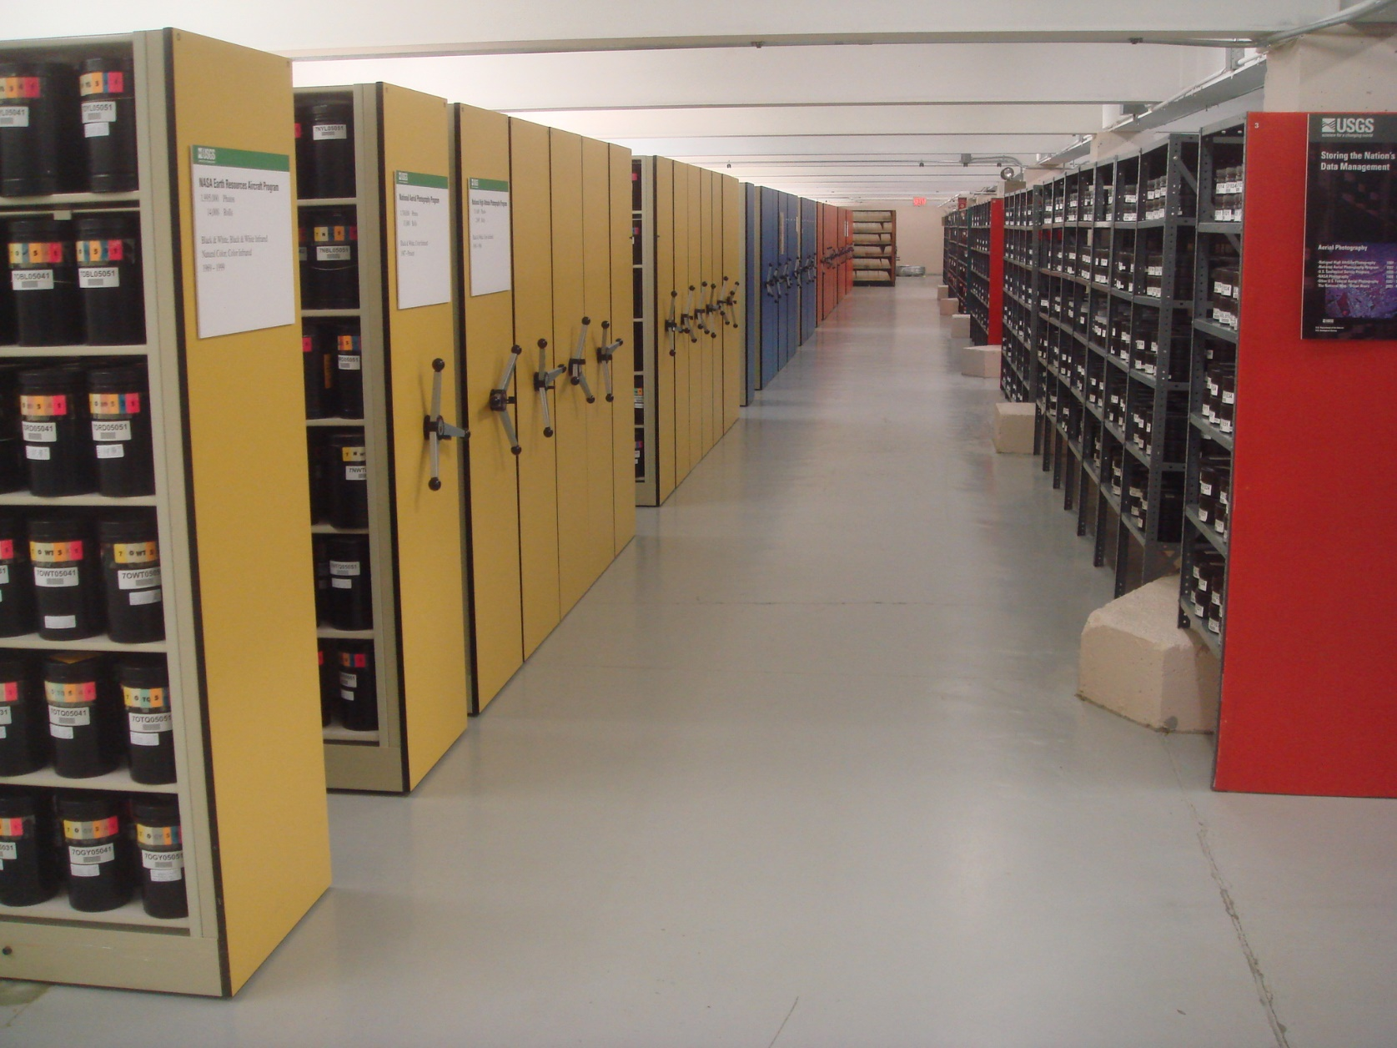
Introduction
Remote sensing - Introduction
USGS Earth Resources Observation and Science (EROS) Center archives in Sioux Falls, SD

Slide 30
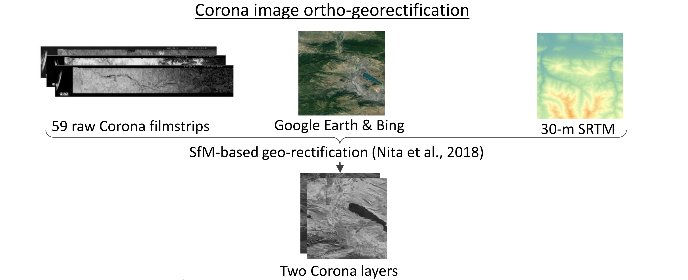
Introduction
Remote sensing - Methods
Nita et al., 2018

Slide 31
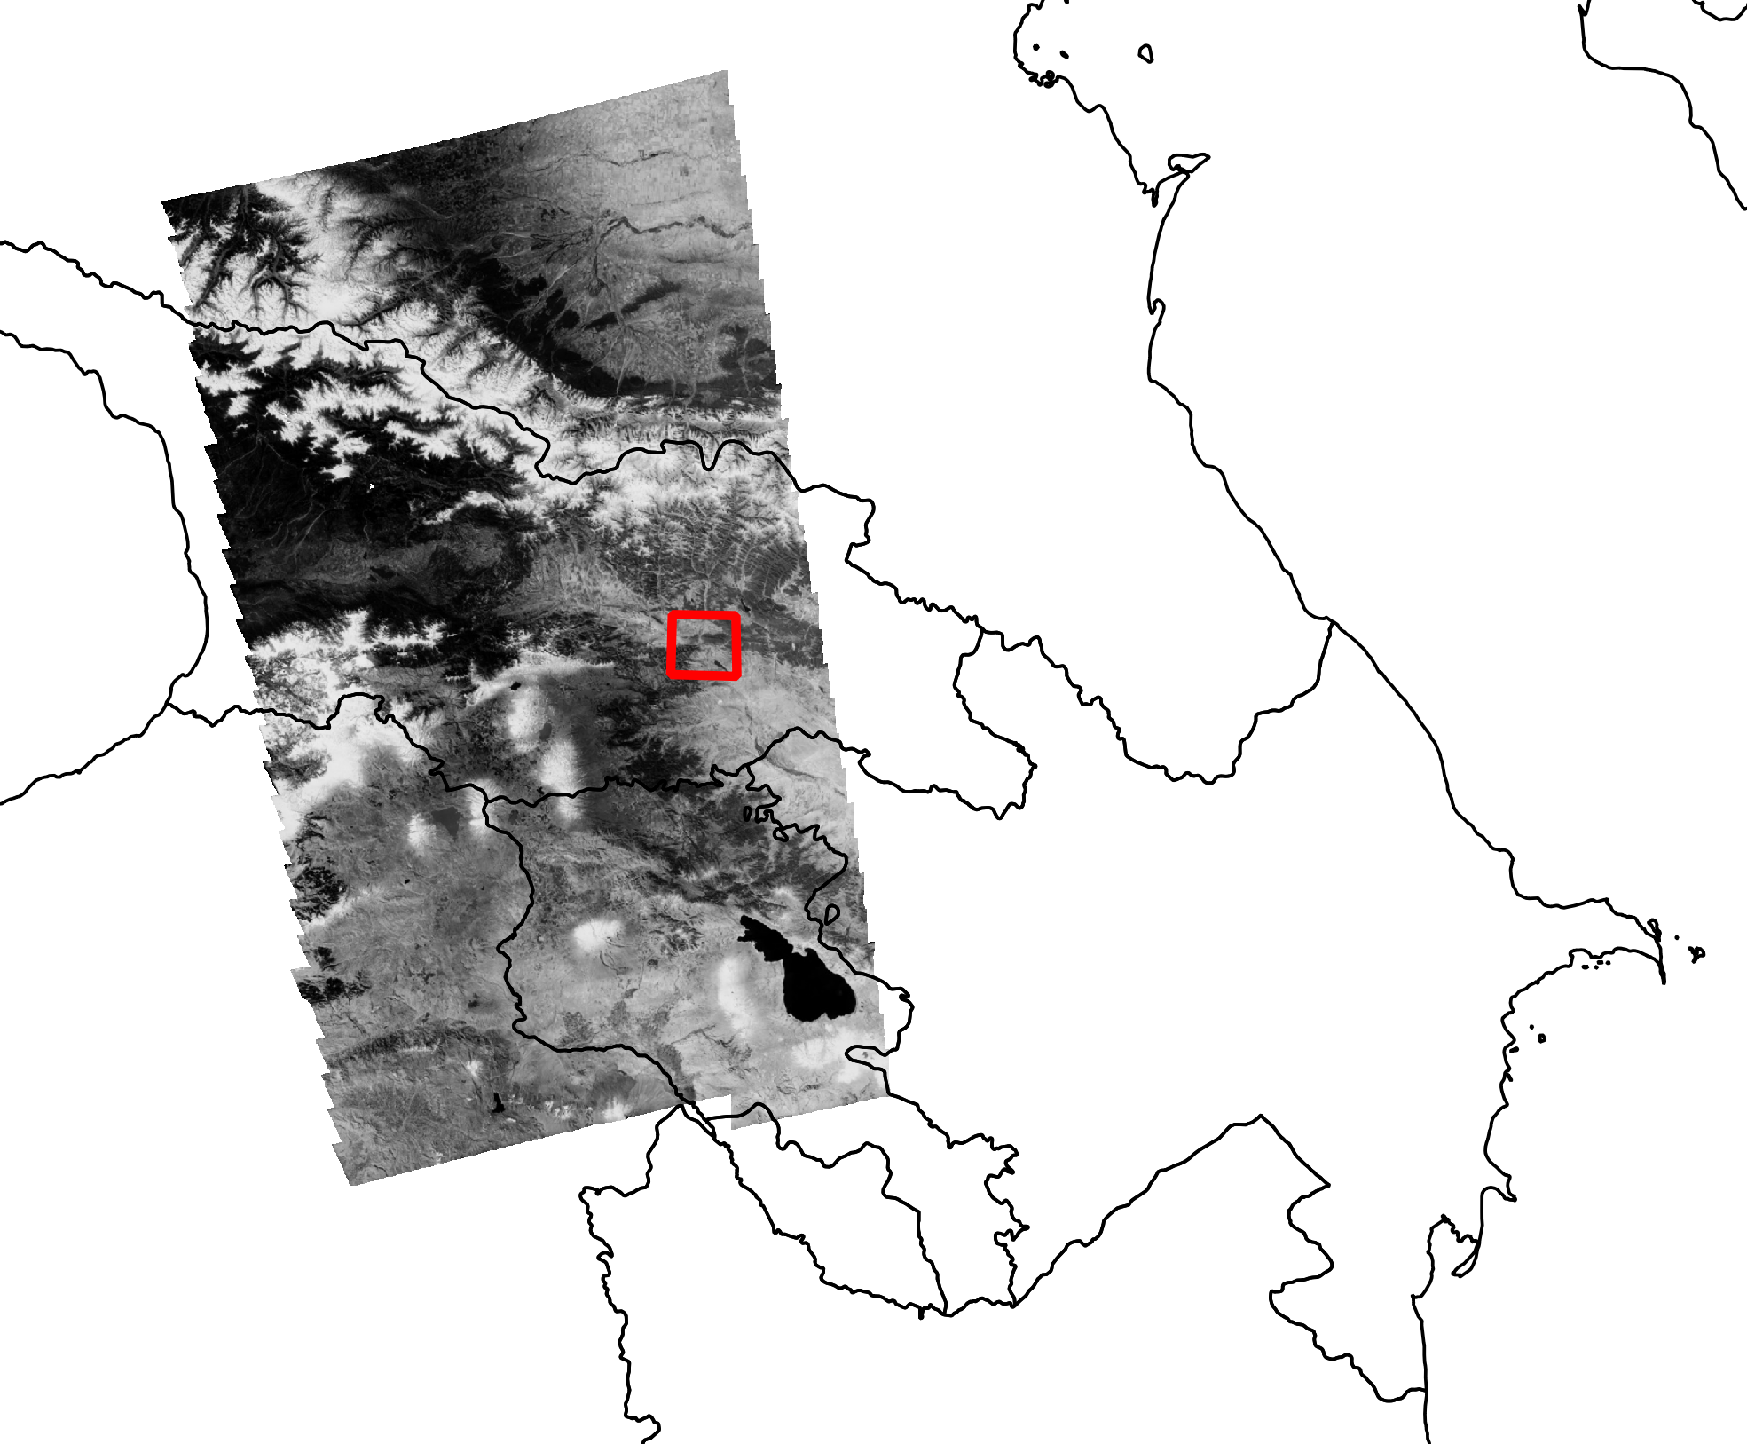
Introduction
Remote sensing – Study area
160,000 km²
2.5-m spatial resolution
Russia
Georgia
Armenia
Azerbaijan
Türkiye
0 5 km
0 100 200 km
October 8, 1964

Slide 32
Introduction
Remote sensing - Methods
GEE

Slide 33
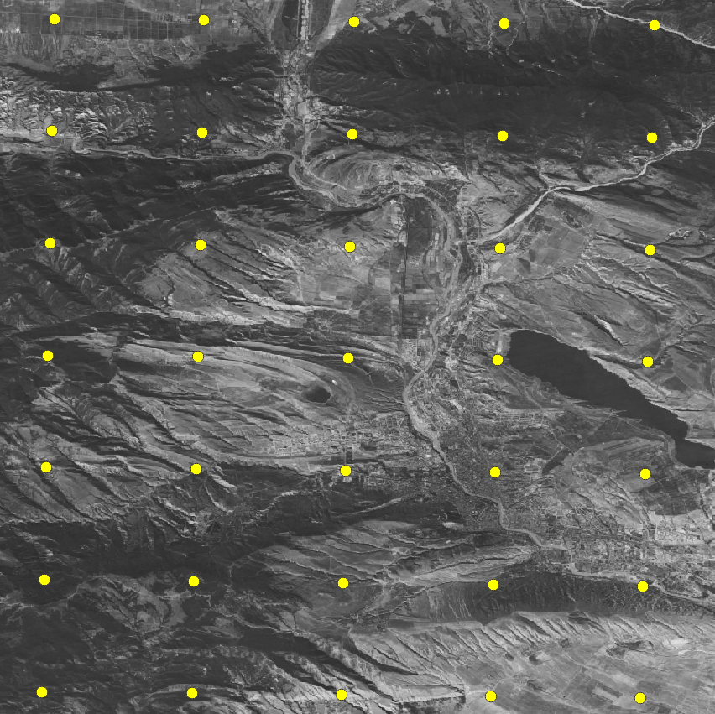
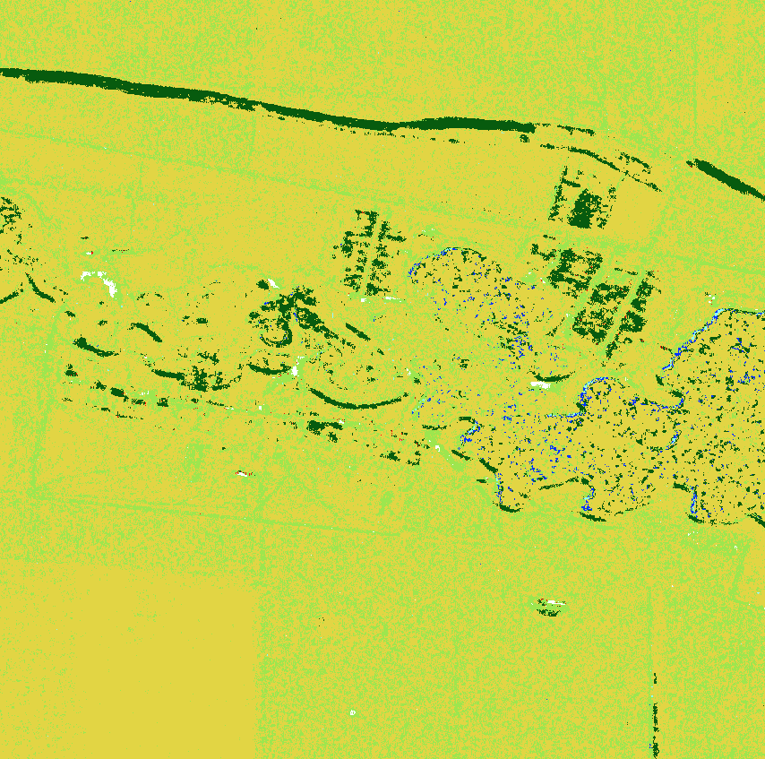
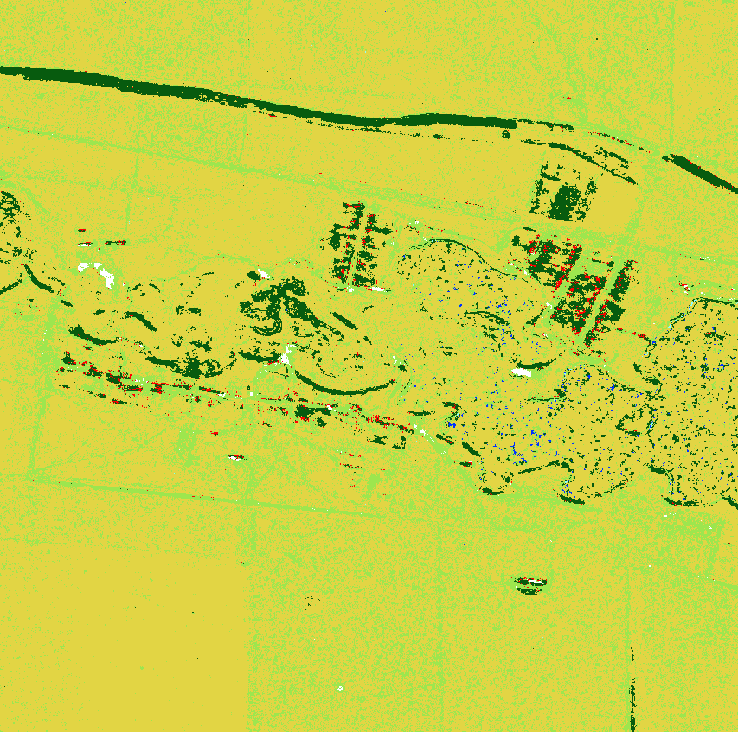
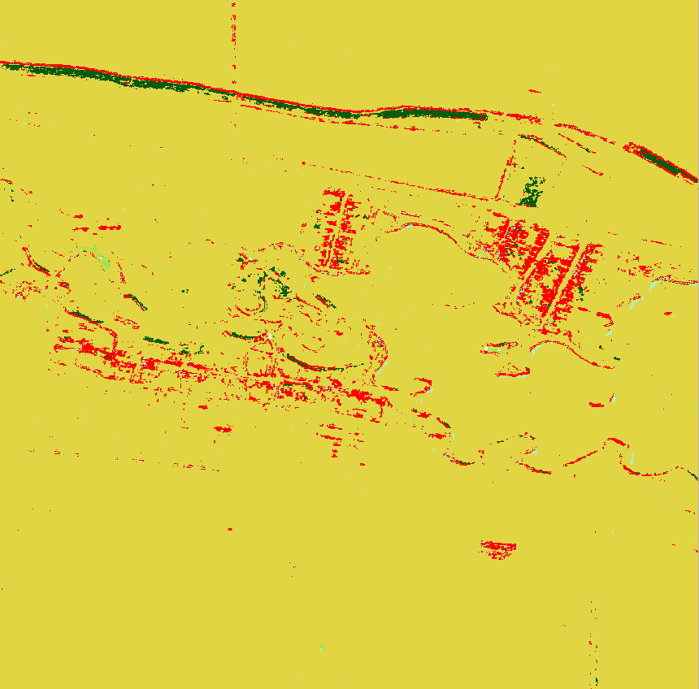
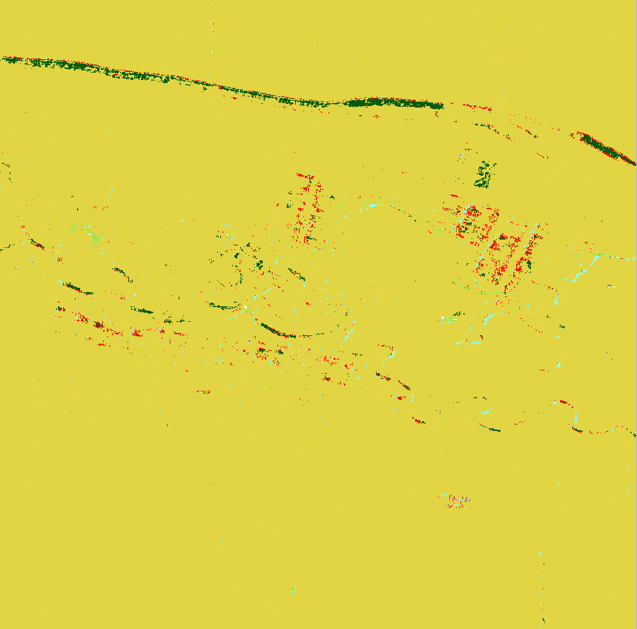
Introduction
Remote sensing - Methods
Pixel-based analysis
GEE
Training data collection
elevation
slope
aspect
mean
standard deviation
ang. second moment
entropy
homogeneity
correlation
dissimilarity
variance
Terrain
Pixel-based texture
Accuracy assessment

Slide 34
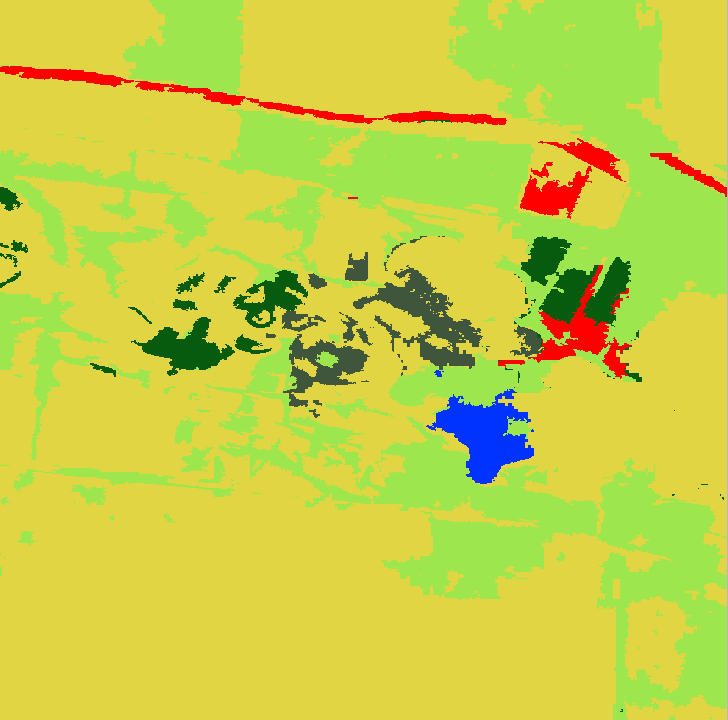
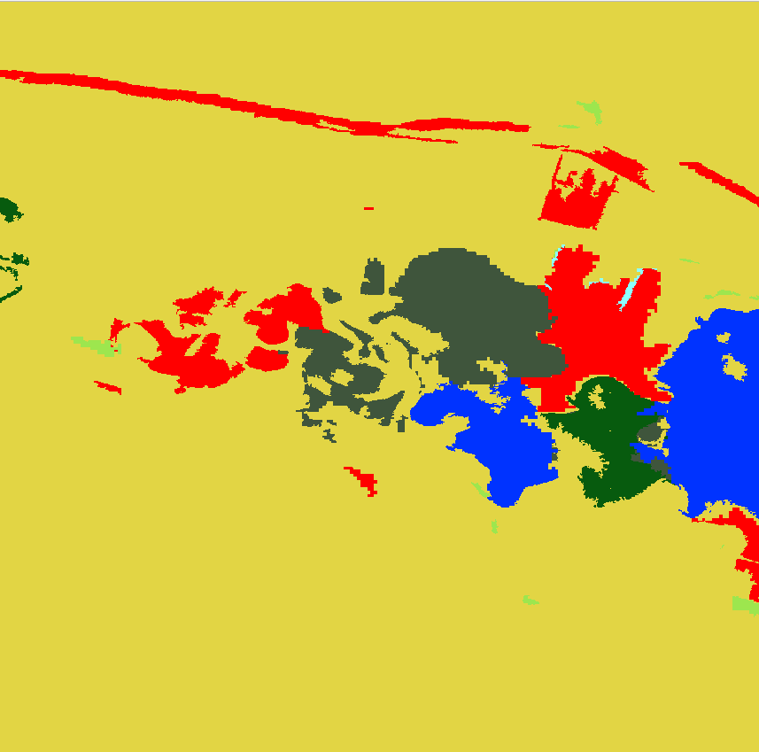
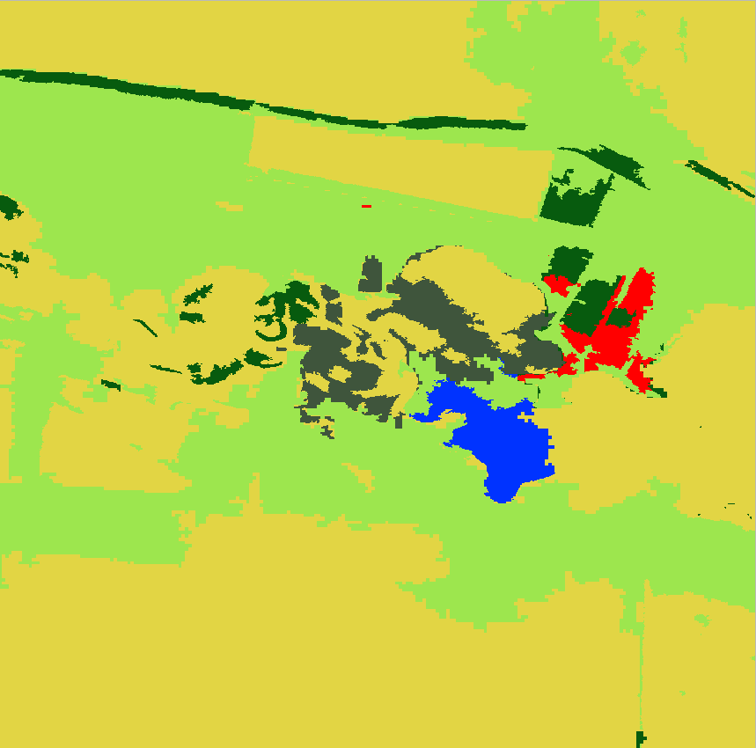
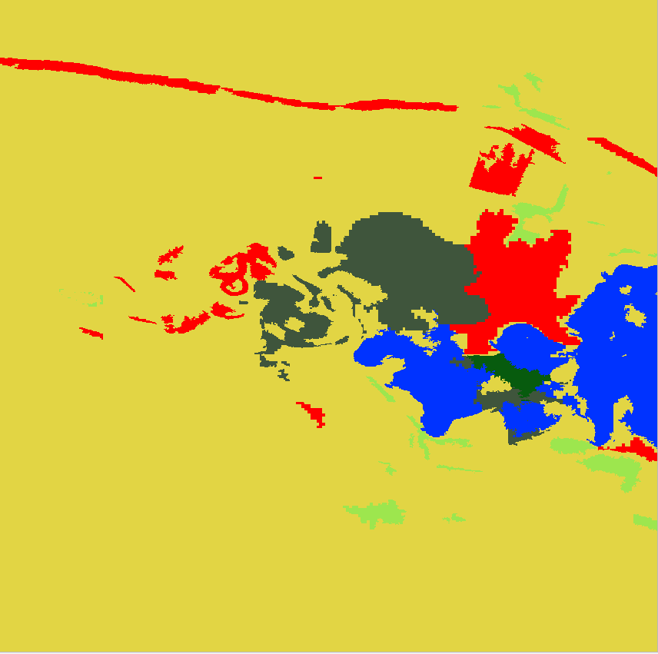
Introduction
Remote sensing - Methods
Pixel-based analysis
Object-oriented analysis
GEE
Training data collection
Segmentation (.snic)
elevation
slope
aspect
mean
standard deviation
ang. second moment
entropy
homogeneity
correlation
dissimilarity
variance
elevation
slope
aspect
mean
standard deviation
ang. second moment
entropy
homogeneity
area
height
width
perimeter
shape
Terrain
Pixel-based texture
Object-based terrain
Object-oriented texture
Object geometry
Accuracy assessment
Accuracy assessment

Slide 35
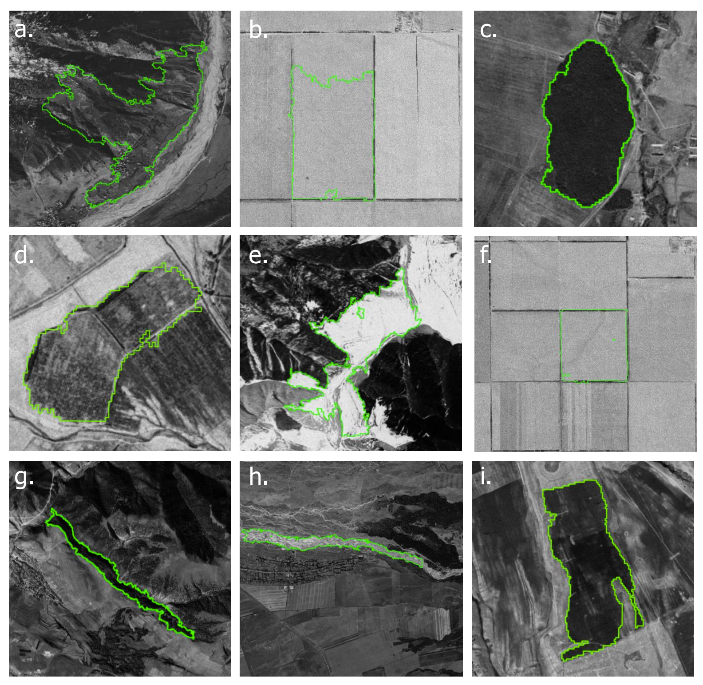
Introduction
Remote sensing - Methods
Pixel-based analysis
Object-oriented analysis
GEE
Training data collection
Segmentation
elevation
slope
aspect
mean
standard deviation
ang. second moment
entropy
homogeneity
correlation
dissimilarity
variance
elevation
slope
aspect
mean
standard deviation
ang. second moment
entropy
homogeneity
area
height
width
perimeter
shape
Terrain
Pixel-based texture
Object-based terrain
Object-oriented texture
Object geometry
Accuracy assessment
Accuracy assessment

Slide 36
Introduction
Remote sensing - Methods
Pixel-based analysis
Object-oriented analysis
GEE
Training data collection
Segmentation
elevation
slope
aspect
mean
standard deviation
ang. second moment
entropy
homogeneity
correlation
dissimilarity
variance
elevation
slope
aspect
mean
standard deviation
ang. second moment
entropy
homogeneity
area
height
width
perimeter
shape
Farwell et al., 2021
Terrain
Pixel-based texture
Object-based terrain
Object-oriented texture
Object geometry
Accuracy assessment
Accuracy assessment

Slide 37
Introduction
Remote sensing - Methods
Pixel-based analysis
Object-oriented analysis
GEE
Training data collection
Segmentation
elevation
slope
aspect
mean
standard deviation
ang. second moment
entropy
homogeneity
correlation
dissimilarity
variance
elevation
slope
aspect
mean
standard deviation
ang. second moment
entropy
homogeneity
area
height
width
perimeter
shape
Farwell et al., 2021
Terrain
Pixel-based texture
Object-based terrain
Object-oriented texture
Object geometry
62.8 % - 75.3 %
67.3 % - 78.7 %

Slide 38
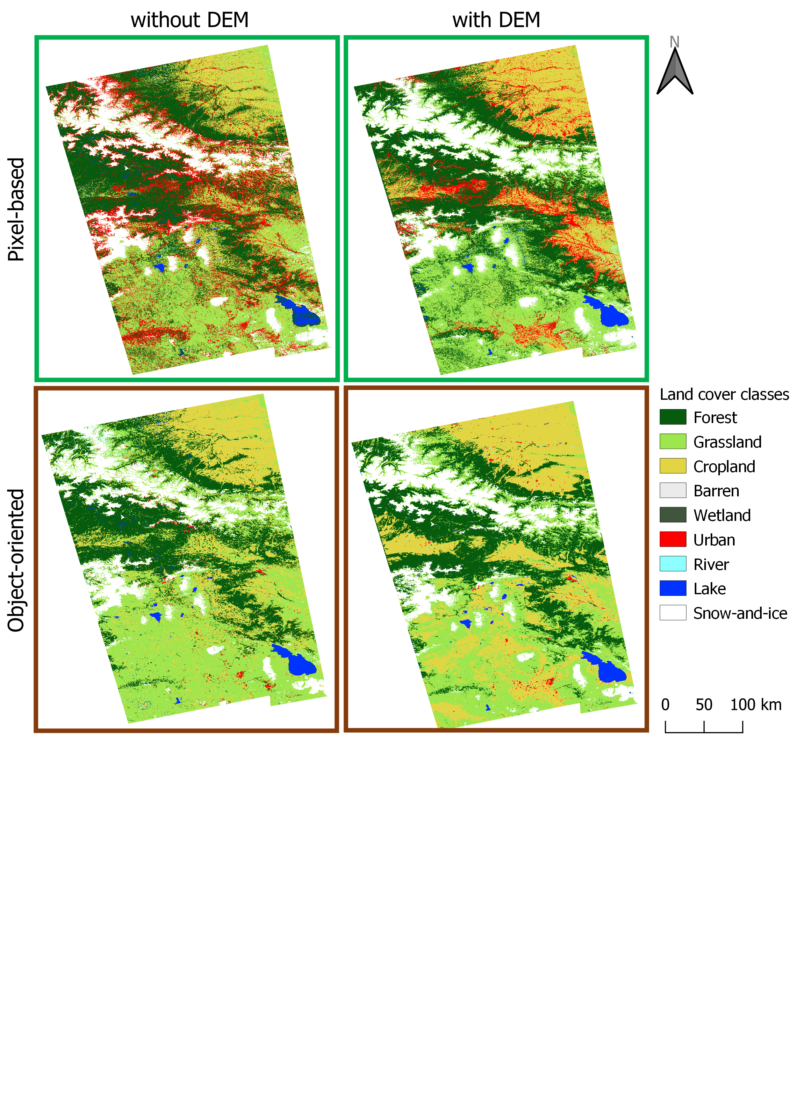
Introduction
Remote sensing - Results
texture 8x / geometry
texture 8x / geometry, DEM
texture 5x
texture 5x, DEM

Slide 39
Introduction
Remote sensing - Results
texture x5
texture x8
texture x5, DEM
texture x8, DEM
texture x5
texture x5, geometry
texture x5, DEM
texture x5, geometry, DEM

Slide 40
Introduction
Remote sensing - Conclusions
- texture
- geometry
- DEM

Slide 41
Introduction
Remote sensing - Conclusions
How to automatically map the land cover using high-resolution panchromatic historical spy satellite imagery?
How to quantify long-term land cover changes using multi-resolution satellite images?
How to assess habitat changes of wild ungulates, and evaluate how successful the protected areas were using Corona satellite data?

Slide 42
Introduction
Remote sensing - Conclusions
How to automatically map the land cover using high-resolution panchromatic historical spy satellite imagery?
- 2.5-m land cover map for 1960s, 160,000 km²
- broad land cover types
- pixel- vs. object-based for Corona
- set of codes on GEE

Slide 43
Introduction
Outline
How to automatically map the land cover using high-resolution panchromatic historical spy satellite imagery?
How to quantify long-term land cover changes using multi-resolution satellite images?
How to assess habitat changes of wild ungulates, and evaluate how successful the protected areas were using Corona satellite data?

Slide 44
Introduction
Land change - Introduction
© Ali Rza

Slide 45
Introduction
Land change - Introduction
How to quantify long-term land cover changes using multi-resolution satellite images?
- quantify long-term land cover changes
- apply Corona data for regions with socio-political changes since the 1960s

Slide 46
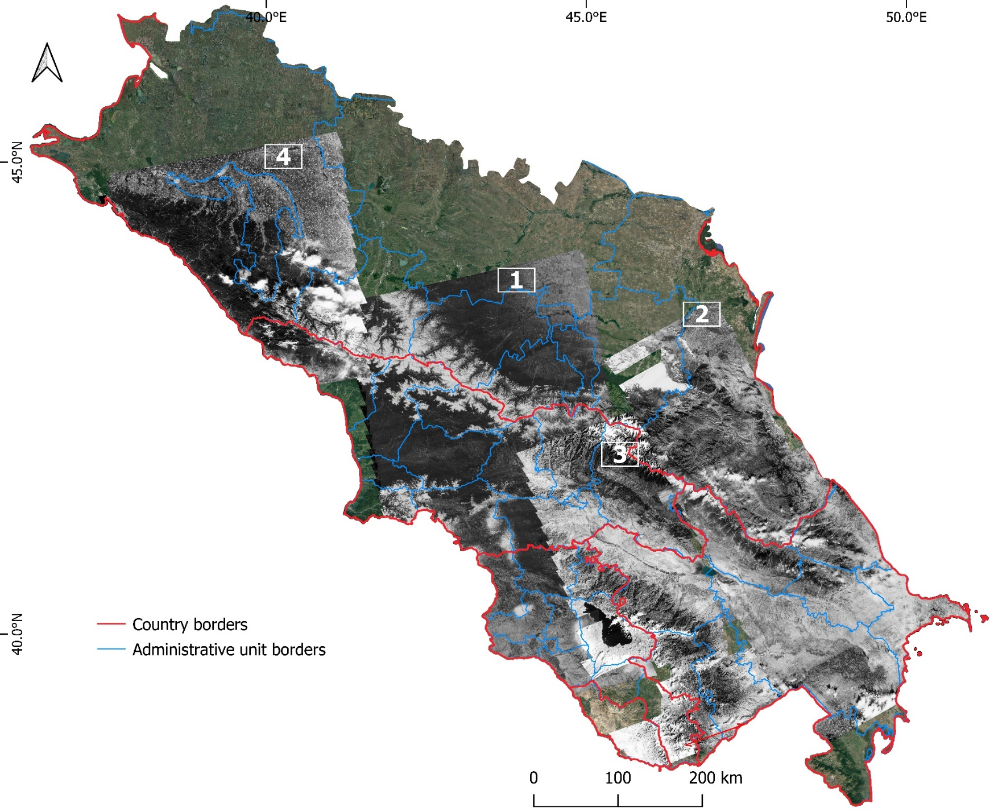
Introduction
Land change - Study area
 | Date | Rectification accuracy, m
1 | October 1964 | 16.3 ± 10.4
2 | August 1965 | 15.0 ± 11.1
3 | September 1965 | 8.1 ± 5.7
4 | October 1965 | 11.9 ± 8.0
240,000 km²
Russia
Georgia
Armenia
Azerbaijan
Country borders
Administrative unit borders

Slide 47
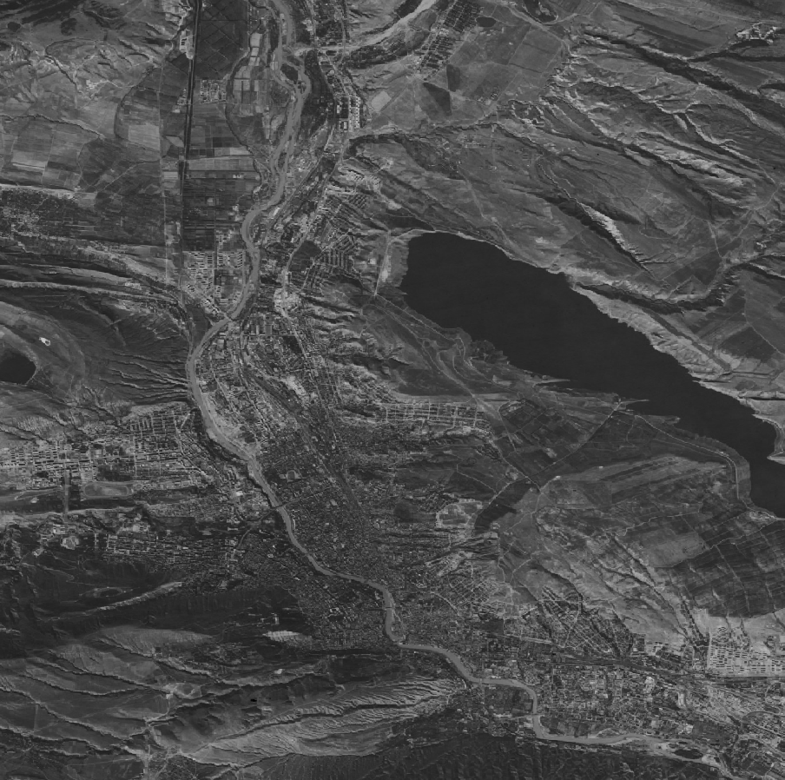
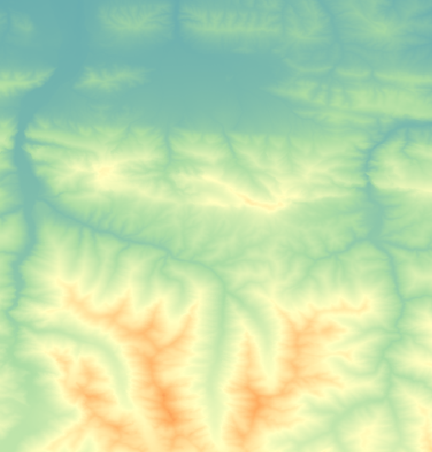
Introduction
Land change - Methods
Corona ortho-georectification
Object-oriented analysis
Post-classification comparison
SfM-based geo-rectification
(Nita et al., 2018)
198 filmstrips
30-m 1965 Corona, resampled
Soviet era
changes
Segmentation
Two Corona layers
2.5-m 1965 Corona
30-m 1987 Landsat (Buchner et al., 2020)
Post-Soviet
changes
Google, Bing Earth & Bing
Texture
Elevation, SRTM
(Farr et al., 2007)
30-m 2015 Landsat (Buchner et al., 2020)
50-year
changes
Elevation, SRTM
(Farr et al., 2007)

Slide 48
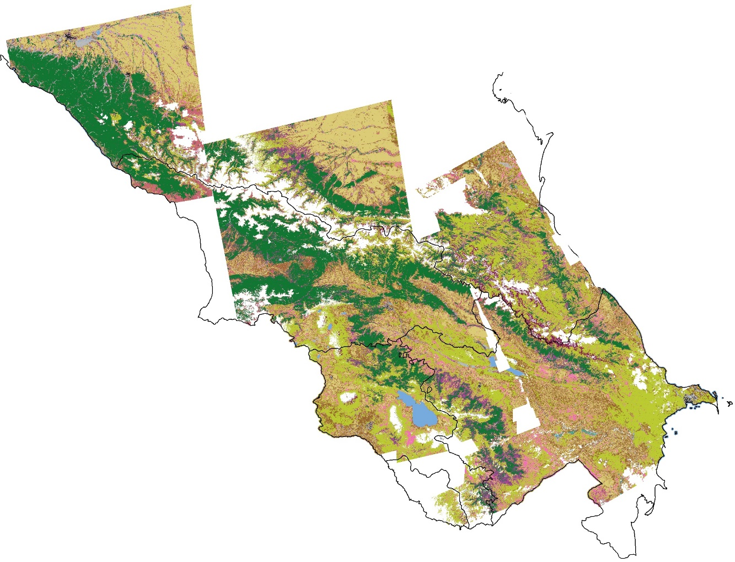
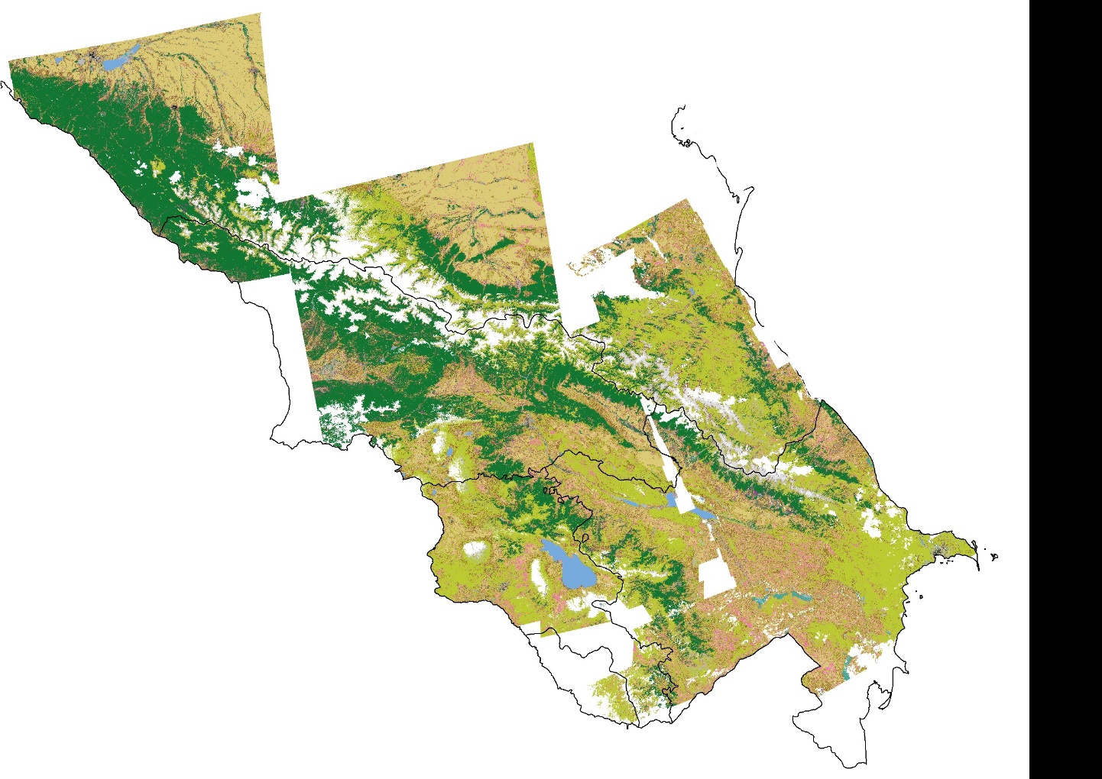
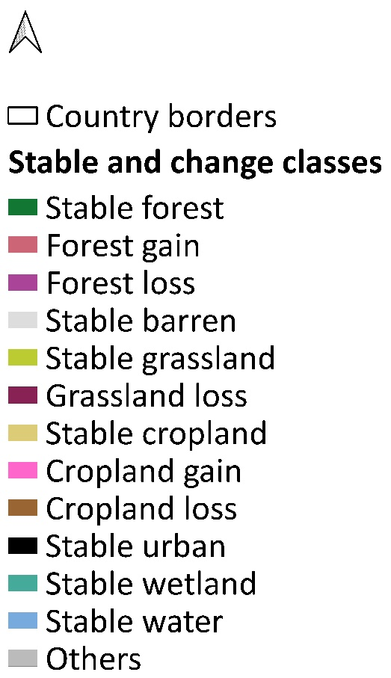
Introduction
Land change - Results
1965-2015
1965-1987
1987-2015
1965-1987
1987-2015
0 100 200 km
Olofsson et al., 2014

Slide 49
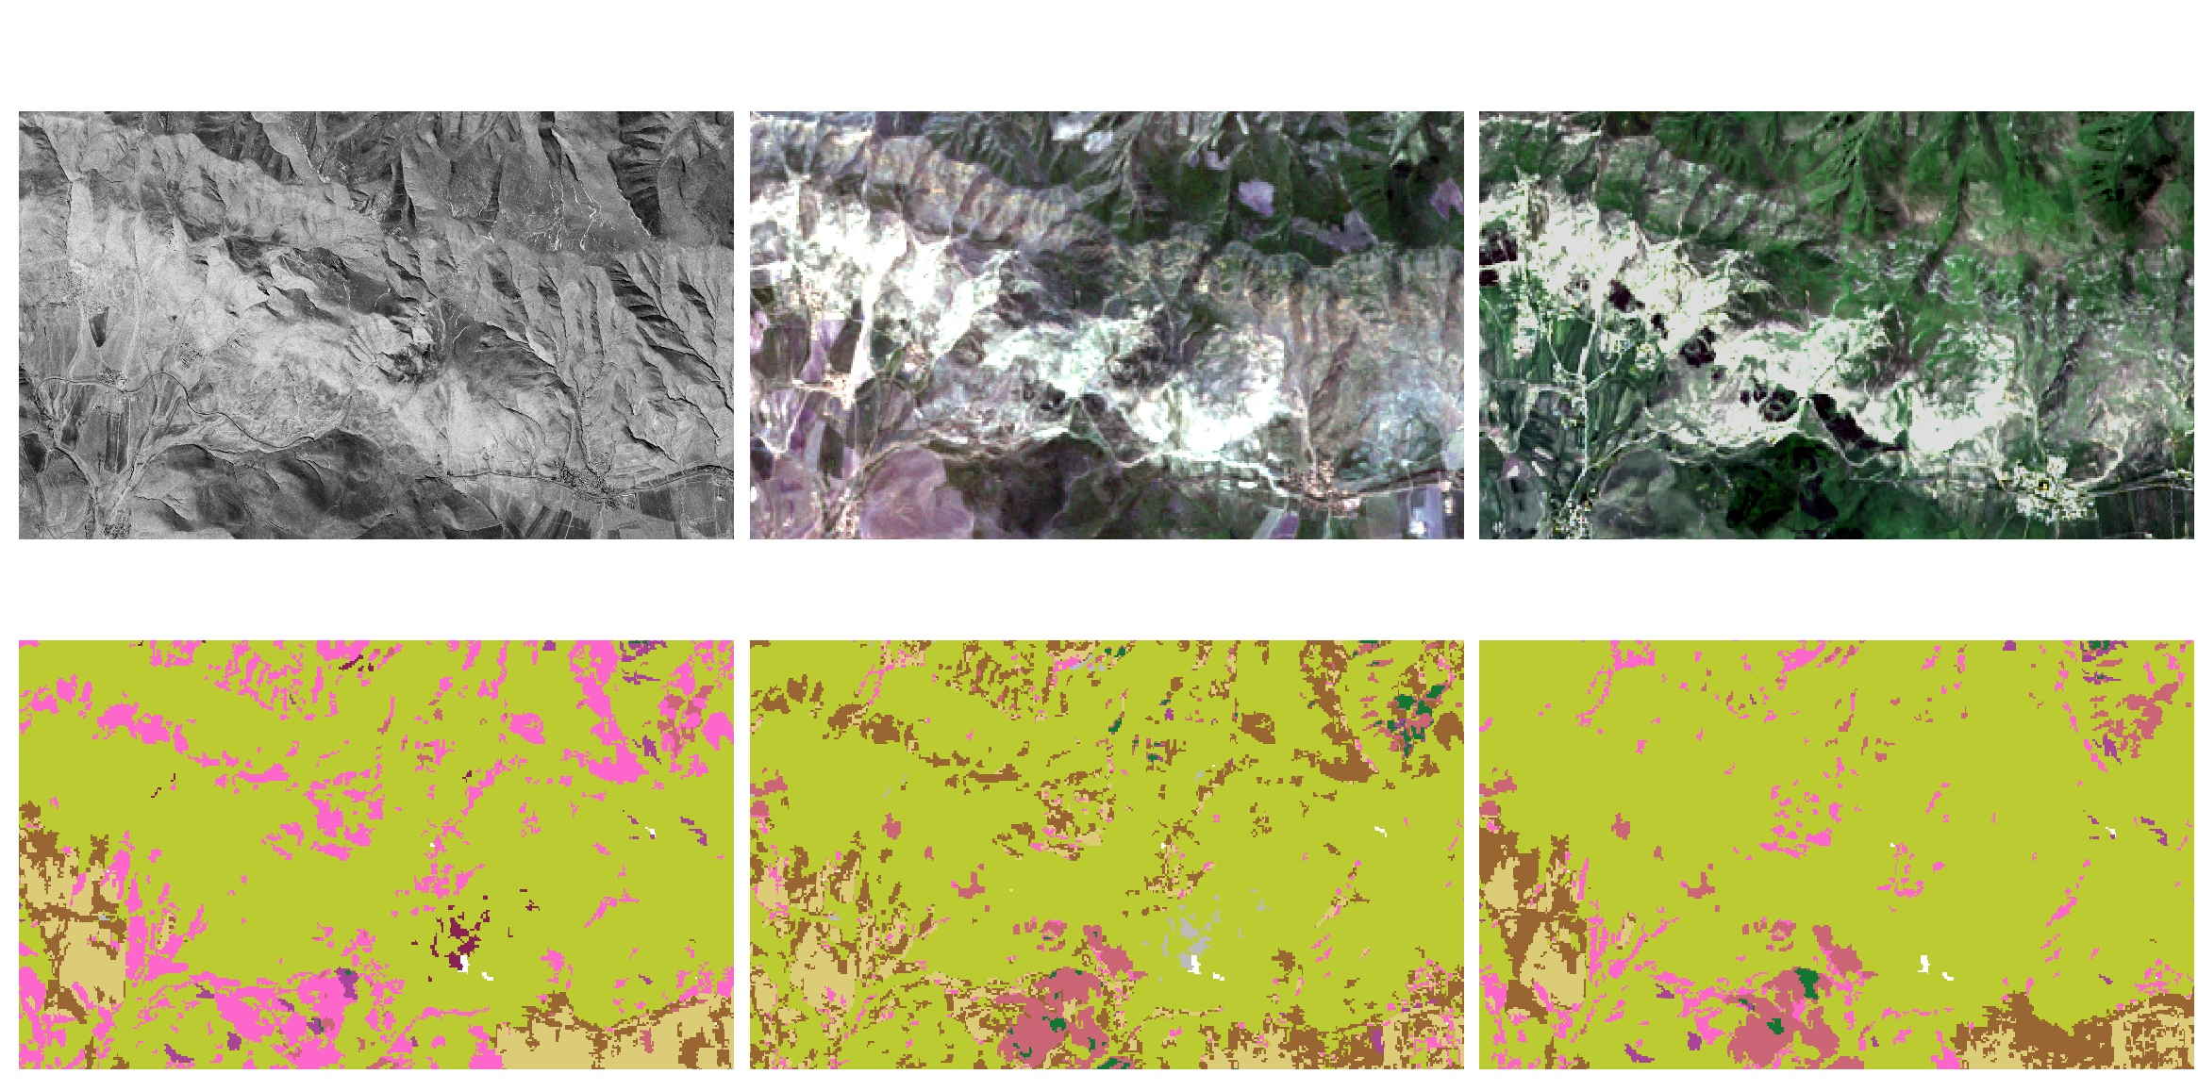
Introduction
Land change - Results
1965-2015
1965
1987
2015
1965-1987
1987-2015
1965-2015
0 100 200 km
0
2
4 km

Slide 50
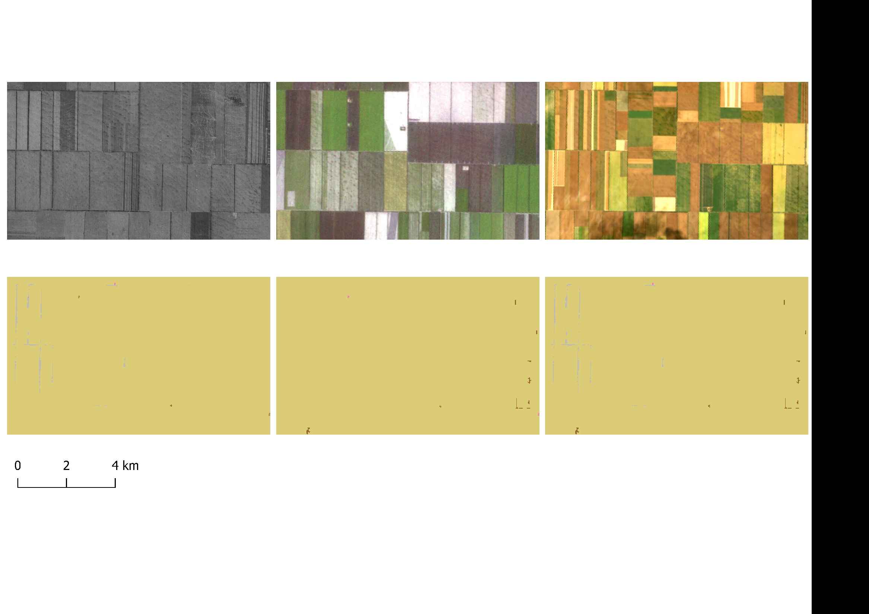
Introduction
Land change - Results
1965-2015
1965
1987
2015
1965-1987
1987-2015
1965-2015
0 100 200 km
0
2
4 km

Slide 51
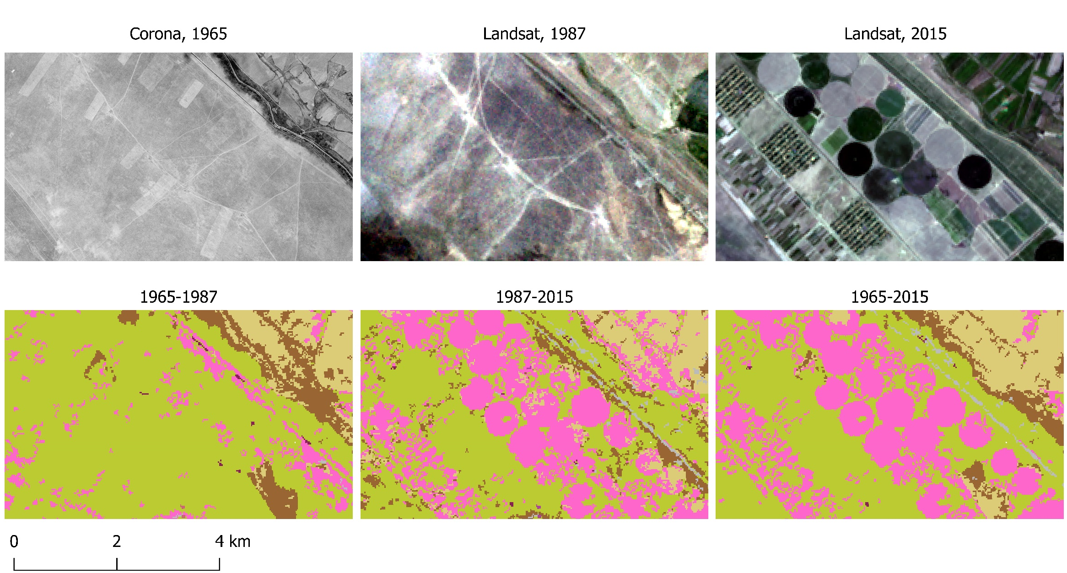
Introduction
Land change - Results
1965-2015
1965
1987
2015
1965-1987
1987-2015
1965-2015
0 100 200 km
0
2
4 km

Slide 52
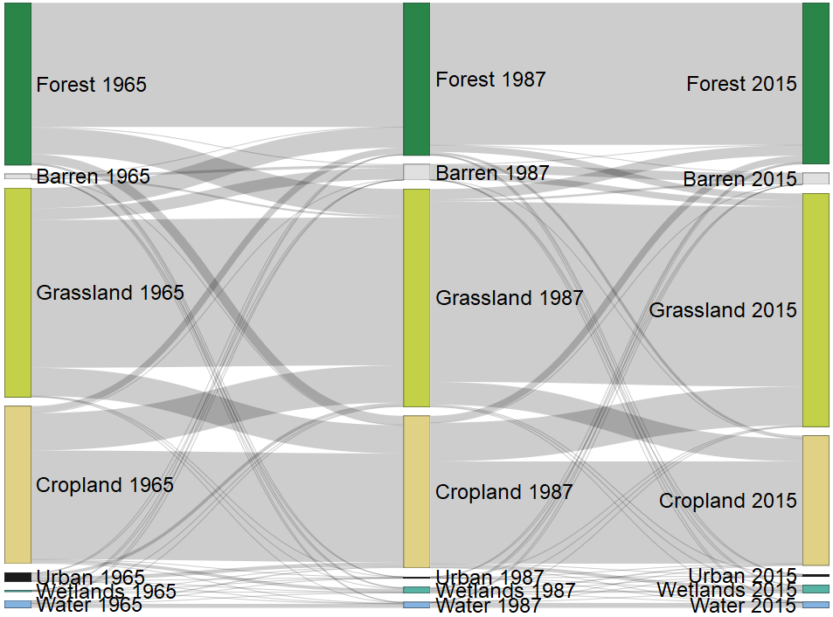
Introduction
Land Land change - Results

Slide 53
Introduction
Land change - Conclusions
How to automatically map the land cover using high-resolution panchromatic historical spy satellite imagery?
How to quantify long-term land cover changes using multi-resolution satellite images?
How to assess habitat changes of wild ungulates, and evaluate how successful the protected areas were using Corona satellite data?

Slide 54
Introduction
Land change - Conclusions
How to quantify long-term land cover changes using multi-resolution satellite images?
- detect land cover changes with multi-resolution satellite imagery
- extend the time series to the 1960s
- emphasize importance of Corona data for regions with substantial changes during that time frame

Slide 55
Introduction
Outline
How to automatically map the land cover using high-resolution panchromatic historical spy satellite imagery?
How to quantify long-term land cover changes using multi-resolution satellite images?
How to assess habitat changes of wild ungulates, and evaluate how successful the protected areas were using Corona satellite data?

Slide 56
Introduction
Habitat change - Introduction
How to assess habitat changes of wild ungulates, and evaluate how successful the protected areas were using Corona satellite data?
- asses wild ungulates habitat changes
- evaluate how successful were the protected areas in preserving and restoring habitats

Slide 57
Introduction
Habitat change - Introduction
© Ali Rza

Slide 58
Introduction
Habitat change - Introduction

Slide 59
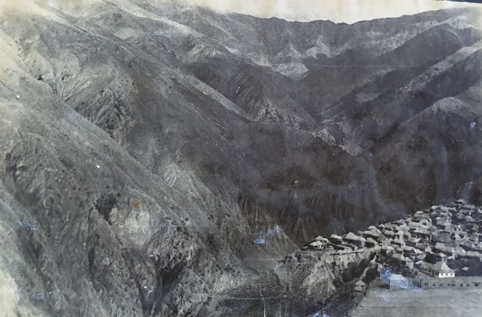
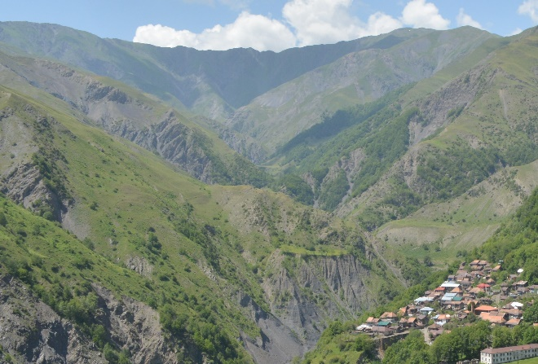
Introduction
Habitat change - Introduction
1958
2019
© National Archive Department of Azerbaijan
© A. Muradov
Sarybash village, Gakh, Azerbaijan

Slide 60
Introduction
Habitat change - Introduction

Slide 61
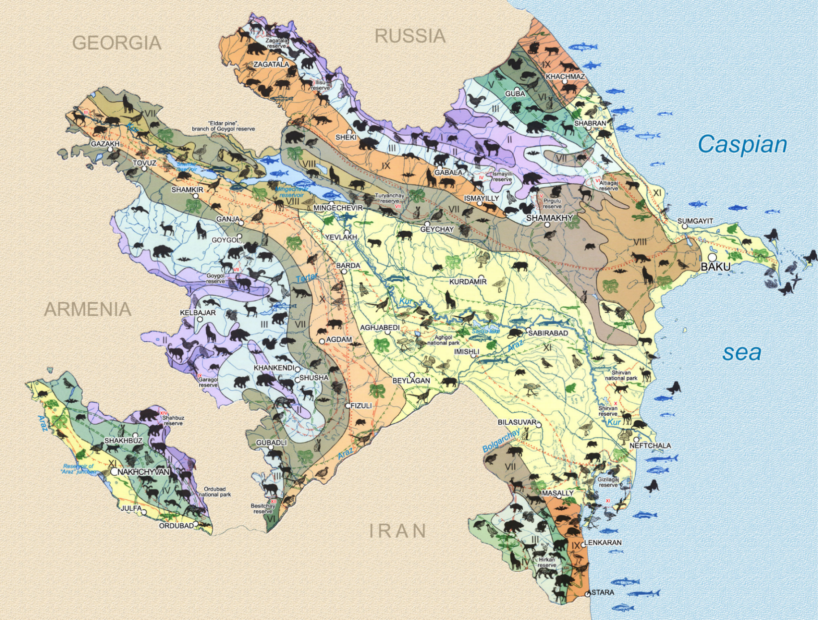
Introduction
Habitat change - Study area
407 bird species
126 mammal species
123 fish species
64 reptile species
11 amphibian species
Biomes
I II III IV
High mountains
Forests
Low mountains, steppes and semi-deserts
Plains and lowlands, meadow-forest,
dry steppe and semi-deserts
V VI
VII VIII
IX X XI
© boundtoazerbaijan.com

Slide 62
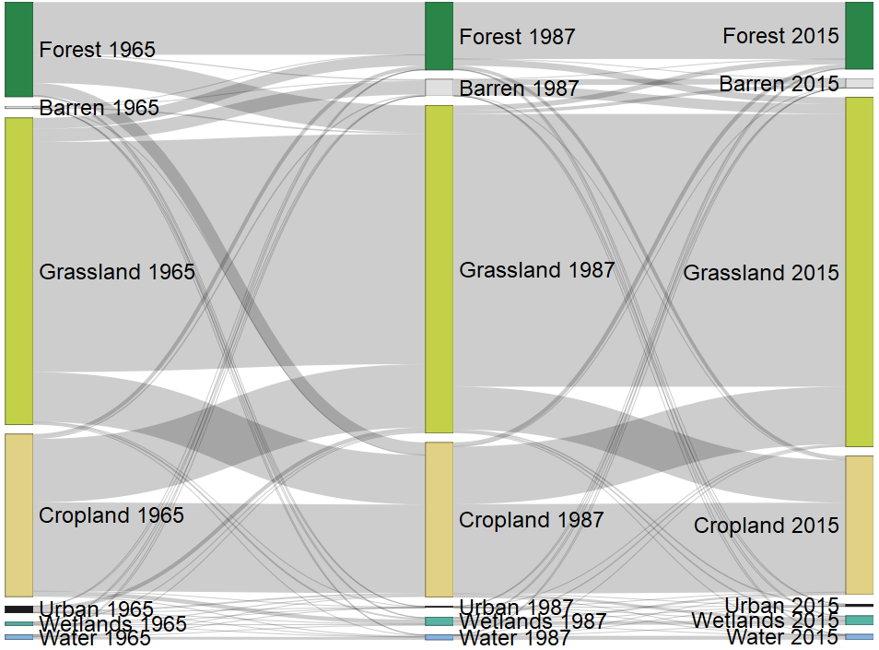
Introduction
Habitat change - Study area

Slide 63
Introduction
Habitat change - Study area
90,000 km²
Corona availability
within study area
Elevation, m
4,466
-27

Slide 64
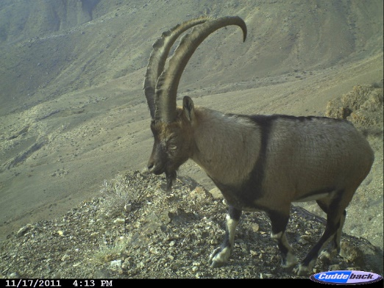
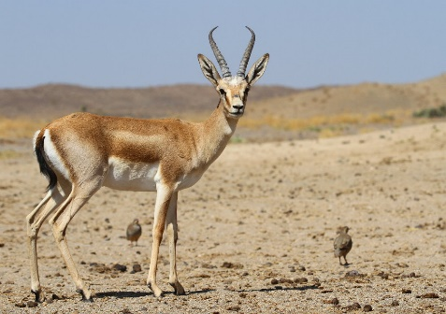
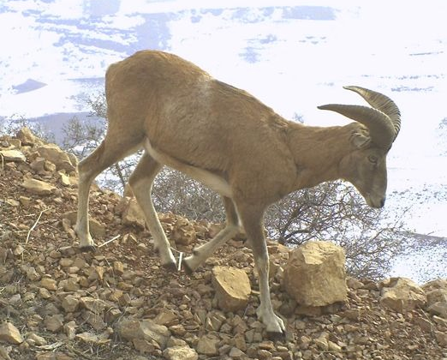
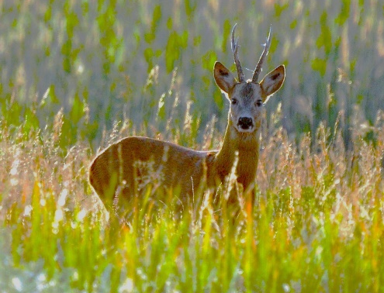
Introduction
Habitat change - Methods
WWF Azerbaijan
A. Muradov
B. Ghorbani
Bezoar goat
(Capra aegagrus)
Chamois
(Rupicapra rupicapra)
Goitered gazelle
(Gazella subgutturosa)
WWF Azerbaijan
A. Muradov
A. Lipkovich
A. Muradov
Mouflon
(Ovis gmelini)
Red deer
(Cervus elaphus)
Roe deer
(Capreolus capreolus)
East Caucasian tur
(Capra cylindricornis)

Slide 65
Introduction
Habitat change - Methods
bezoar - Capra aegagrus
chamois - Rupicapra rupicapra
gazelle - Gazella subgutturosa
mouflon - Ovis gmelinii
red deer - Cervus elaphus
roe deer - Capreolus capreolus
tur - Capra cylindricornis

Slide 66
Introduction
Habitat change - Methods
Continuous maps
Categorical maps
Current presence data
Pseudo-absence data
Biomod2, Ensemble models from:
GLM
GBM
CTA
MARS
RF
Maxent
ANN
1965
1965
Change detection
Predictor variables:
Land cover
Climate
Terrain
Proximity
2021
2021

Slide 67
Introduction
Habitat change - Results

Slide 68
Introduction
Habitat change - Methods
Continuous maps
Categorical maps
Current presence data
Pseudo-absence data
Biomod2, Ensemble models from:
GLM
GBM
CTA
MARS
RF
Maxent
ANN
1965
1965
Change detection
Predictor variables:
Land cover
Climate
Terrain
Proximity
2021
2021

Slide 69
Continuous maps, tur (Capra cylindricornis)
1965
0-10 % - non-habitat
10-30 % - least-suitable habitat
30-55 % - moderately-suitable habitat
55-100 % - highly-suitable habitat
2021

Slide 70
Categorical maps, tur (Capra cylindricornis)
1965
0-10 % - non-habitat
10-30 % - least-suitable habitat
30-55 % - moderately-suitable habitat
55-100 % - highly-suitable habitat
Change detection
2021

Slide 71
Introduction
Habitat change - Results
A. Muradov
A. Muradov
A. Muradov
A. Lipkovich
B. Ghorbani
Biomes
Azerbaijan shrub desert and steppe
Caspian Hyrcanian mixed forests
Caucasus mixed forests
Eastern Anatolian montane steppe
Elburz Range forest steppe
WWF Azerbaijan
WWF Azerbaijan
Olson et al., 2001

Slide 72
Introduction
Habitat change - Results
Azerbaijan shrub desert and steppe
Caucasus mixed forests
highly-suitable habitat
moderately-suitable habitat
least-suitable habitat
non-habitat

Slide 73
Introduction
Habitat change - Results
Azerbaijan shrub desert and steppe
Caucasus mixed forests
highly-suitable habitat
moderately-suitable habitat
least-suitable habitat
non-habitat

Slide 74
Introduction
Habitat change - Results

Slide 75
Introduction
Habitat change - Results
Azerbaijan shrub desert and steppe
Caucasus mixed forests
highly-suitable habitat
moderately-suitable habitat
least-suitable habitat
non-habitat

Slide 76
Introduction
Habitat change - Results

Slide 77
Introduction
Habitat change - Results
Change study area
Protected area by IUCN category:
I-II
III-VI
WDPA, 2023

Slide 78
Introduction
Habitat change - Results
after 1990
1970-1990
IUCN category I-II
before 1970
highly-suitable habitat
moderately-suitable habitat
least-suitable habitat
non-habitat

Slide 79
Introduction
Habitat change - Results
Red deer habitat in Goygol National park
1961
2021
A. Muradov
highly-suitable habitat
moderately-suitable habitat
least-suitable habitat
non-habitat

Slide 80
Introduction
Habitat change - Conclusions
How to automatically map the land cover using high-resolution panchromatic historical spy satellite imagery?
How to quantify long-term land cover changes using multi-resolution satellite images?
How to assess habitat changes of wild ungulates, and evaluate how successful the protected areas were using Corona satellite data?

Slide 81
Introduction
Habitat change - Conclusions
How to assess habitat changes of wild ungulates, and evaluate how successful the protected areas were using Corona satellite data?
- extend understanding of past habitat conditions to the 1960s
- reduce the shifting baseline syndrome
- highlight success of the protected areas in preserving and restoring habitats
- emphasize the close relationship between land use and habitat changes

Slide 82
Introduction
Overall conclusions & implications
Scientific advancements
Methodological advancements
Management implications

Slide 83
Introduction
Scientific contribution
Scientific advancements
advance the understanding of landscape dynamics and habitat changes
quantify long-term land cover trends in the former Soviet states
uncover how past land use decisions dictate current land cover
revisit a period when major global events took place
uncover important historical patterns of land cover changes

Slide 84
Introduction
Methodological advancements
Methodological advancements
apply and optimize approaches for processing high-resolution historical imagery
present a novel workflow for 2.5-m Corona spy satellite imagery
map for the first time large-area land cover (240,000 km²) for broad land cover types

Slide 85
Introduction
Management implications
In the Caucasus:
support cross-border conservation and management
inform plans to create new protected areas
deliver results to local and international conservation organizations
Globally:
provide informed decision-making in land use planning
use 1960s data for management today
help increase ecosystem resilience
reduce shifting baseline syndrome
prevent species’ extinction

Slide 86
© Ali Rza

Slide 87
Introduction
Thank you!

Slide 88
Introduction
Thank you!
Volker
Radeloff
Annemarie
Schneider
Benjamin
Zuckerberg
Holly
Gibbs
Mihai D.
Nita

Slide 89
Introduction
Thank you!

Slide 90
Introduction
Thank you!

Slide 91
Introduction
Thank you!

Slide 92
Introduction
References
Song, D. X., Huang, C., Sexton, J. O., Channan, S., Feng, M., & Townshend, J. R. (2015). Use of Landsat and Corona data for mapping forest cover change from the mid-1960s to 2000s: Case studies from the Eastern United States and Central Brazil. ISPRS Journal of Photogrammetry and Remote Sensing, 103, 81-92.
Myers, N., Mittermeier, R. A., Mittermeier, C. G., Da Fonseca, G. A., & Kent, J. (2000). Biodiversity hotspots for conservation priorities. Nature, 403(6772), 853-858.
Nita, M. D., Munteanu, C., Gutman, G., Abrudan, I. V., & Radeloff, V. C. (2018). Widespread forest cutting in the aftermath of World War II captured by broad-scale historical Corona spy satellite photography. Remote Sensing of Environment, 204, 322-332.
Farwell, L. S., Gudex-Cross, D., Anise, I. E., Bosch, M. J., Olah, A. M., Radeloff, V. C., ... & Pidgeon, A. M. (2021). Satellite image texture captures vegetation heterogeneity and explains patterns of bird richness. Remote sensing of Environment, 253, 112175.
Rizayeva, A., Nita, M. D., & Radeloff, V. C. (2023). Large-area, 1964 land cover classifications of Corona spy satellite imagery for the Caucasus Mountains. Remote Sensing of Environment, 284, 113343.
Olofsson, P., Foody, G. M., Herold, M., Stehman, S. V., Woodcock, C. E., & Wulder, M. A. (2014). Good practices for estimating area and assessing accuracy of land change. Remote sensing of Environment, 148, 42-57.
Olson, D. M., Dinerstein, E., Wikramanayake, E. D., Burgess, N. D., Powell, G. V., Underwood, E. C., ... & Kassem, K. R. (2001). Terrestrial Ecoregions of the World: A New Map of Life on Earth: A new global map of terrestrial ecoregions provides an innovative tool for conserving biodiversity. BioScience, 51(11), 933-938.

Slide 93
Thank you for your attention!
© A. Abbasov

