Slide 1
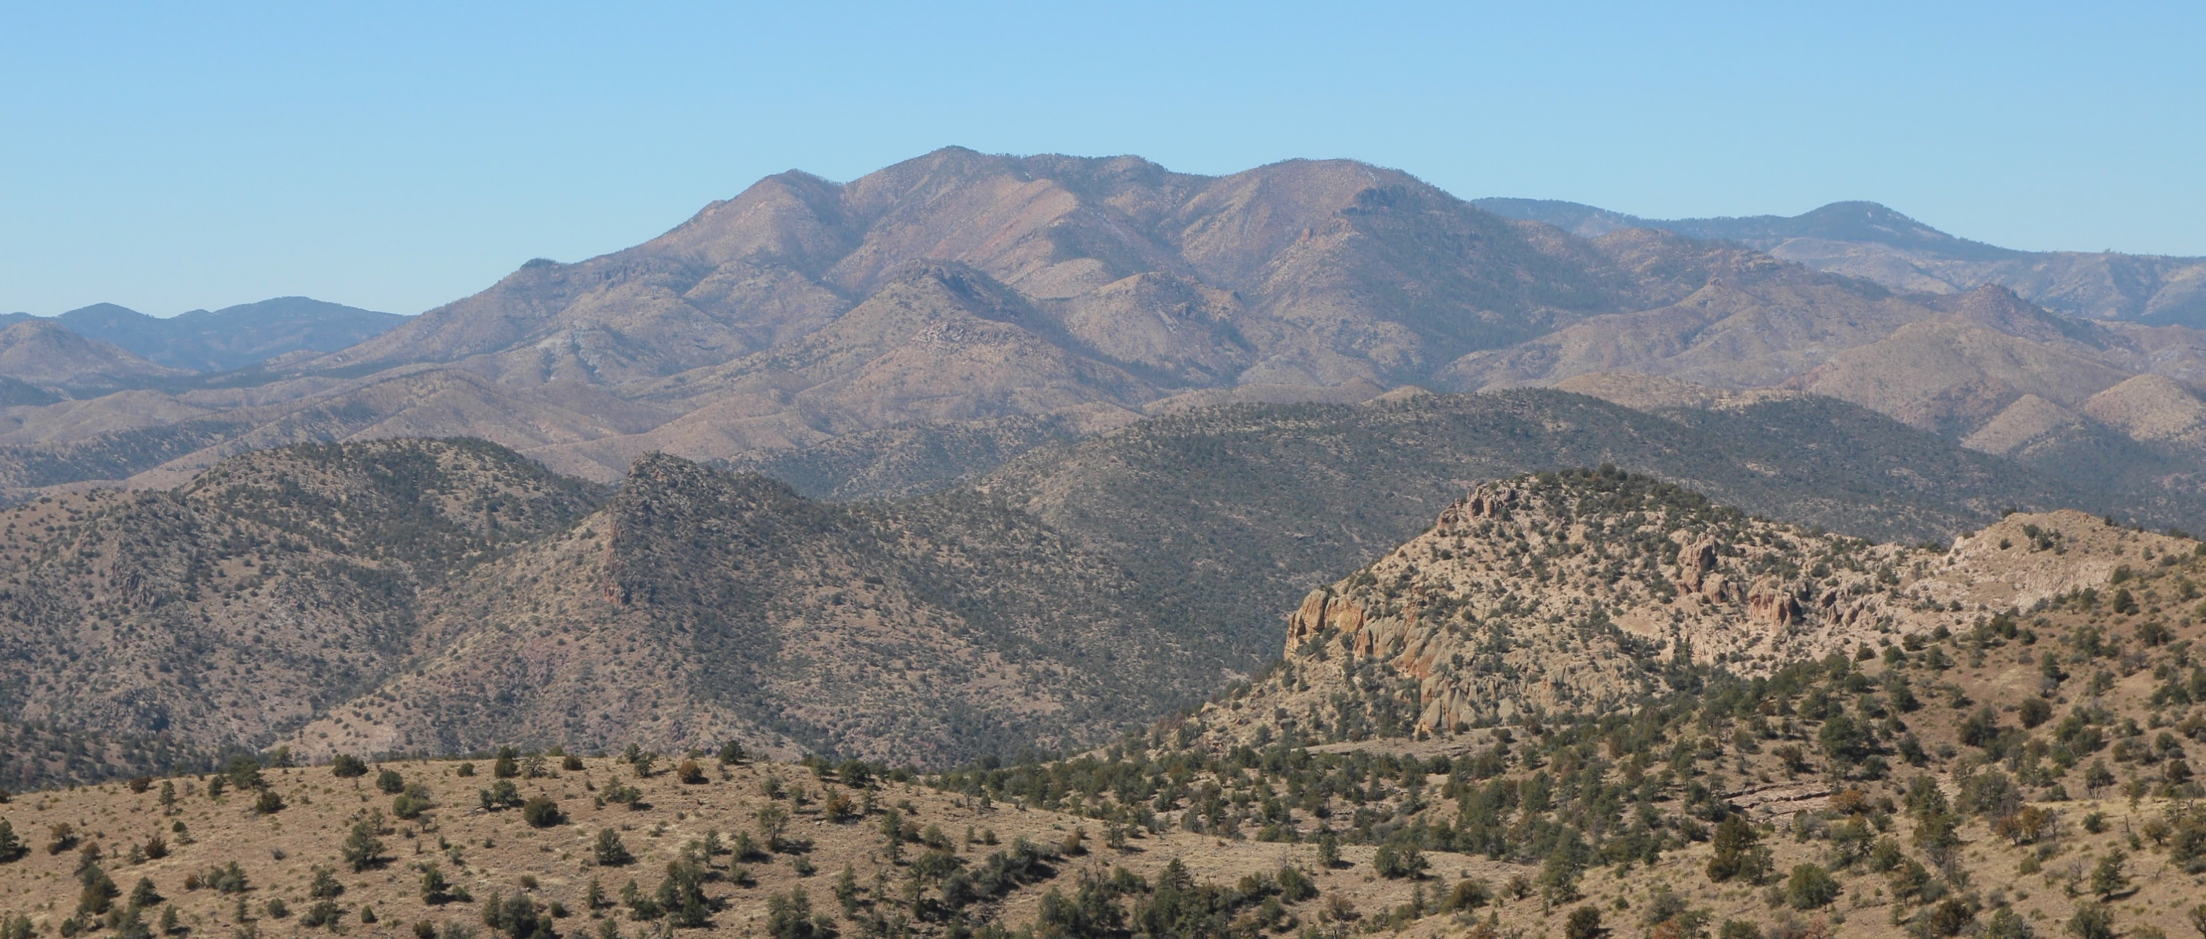
WUI growth, fire activity, and vegetation types across Mediterranean-type landscapes
Kira A. Pfoch
Advisor: Volker Radeloff
Committee: Phil Townsend, Min Chen, Anthony Ives, Amy Trowbridge, Patrick Hostert

Slide 2
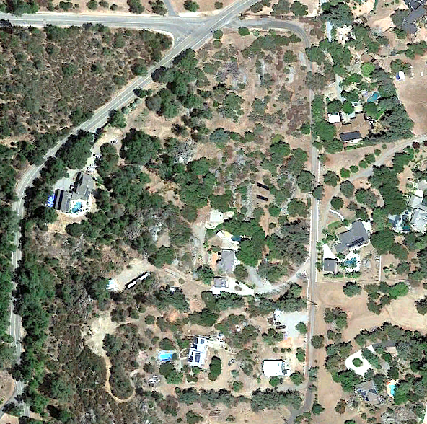


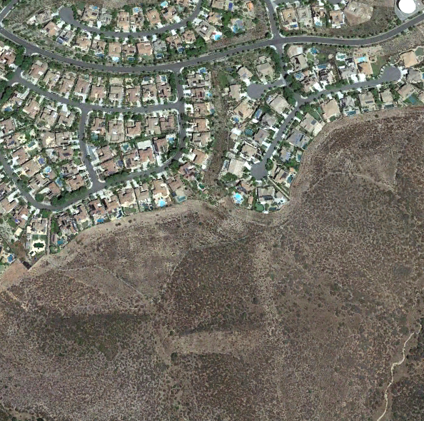
The Wildland-Urban Interface (WUI)
Intermix WUI
settlements intermingle with wildland vegetation
Google Earth TM
Interface WUI
settlements near wildland vegetation
Google Earth TM
(USDI & USDA 2001)

Slide 3
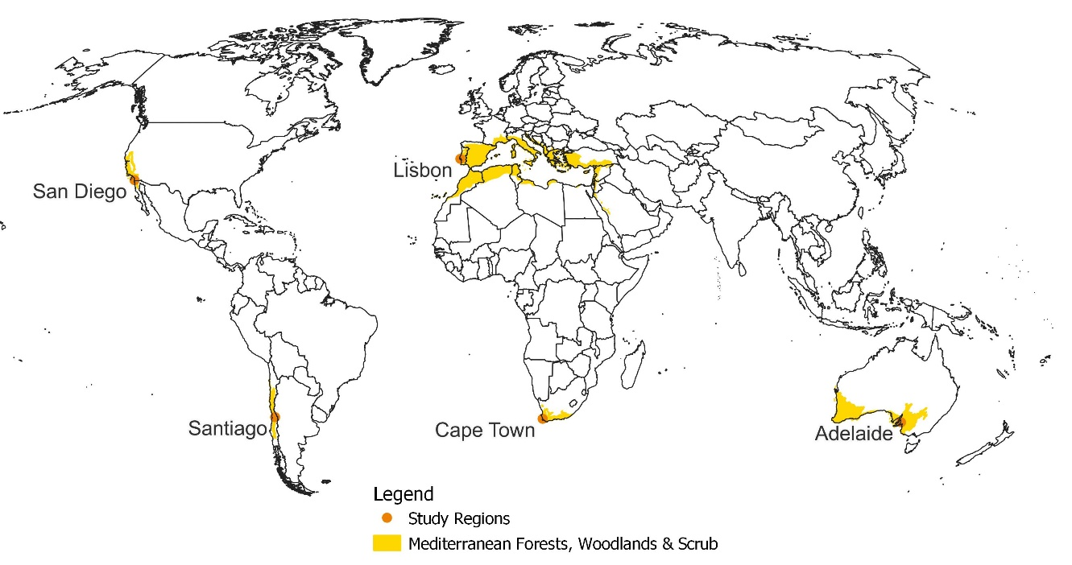
Mediterranean Environments
Characteristics:
  hot/ dry summer
  cool/ wet winter
  disturbance-prone
Study Areas:
  San Diego (USA)
  Santiago (Chile)
  Lisbon (Portugal)
  Cape Town (South Africa)
  Adelaide (Australia)
The Mediterranean-type landscapes,
Olson et al (2001) Terrestrial ecoregions of the world: a new map of life on Earth

Slide 4
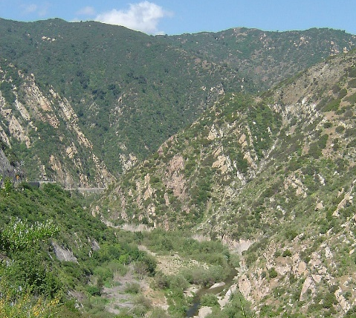
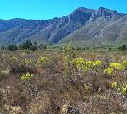
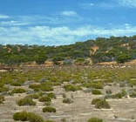
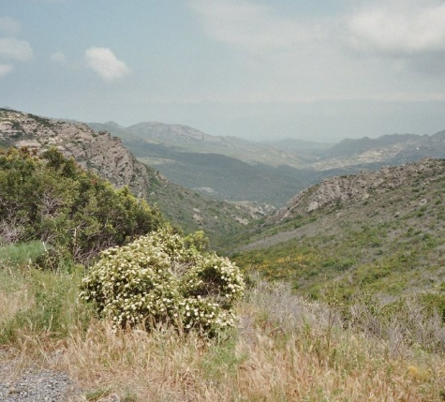
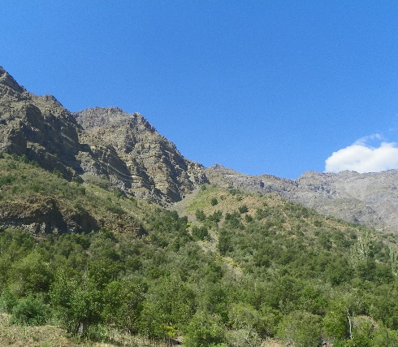
Mediterranean Vegetation Communities
1
2
3
4
5
Chaparral
California
Fynbos
South Africa
Mallee
South Australia
Maquis
Portugal
Matorral
Chile
  Composed of sclerophyllous-leaved, evergreen shrublands, semi-deciduous scrubs, woodlands, grasses
  Fire return interval ~10-60 years
(Keeley, 2012; Medail, 2008)

Slide 5






Major research questions
How to map the WUI with Landsat and Sentinel-2 imagery?
How did WUI change from 1990 to 2022?
What drives WUI change?
Did fire frequency, fire season length, and burned area increase?
Does WUI growth lead vegetation type conversion?
Notes:
Symbology

Slide 6
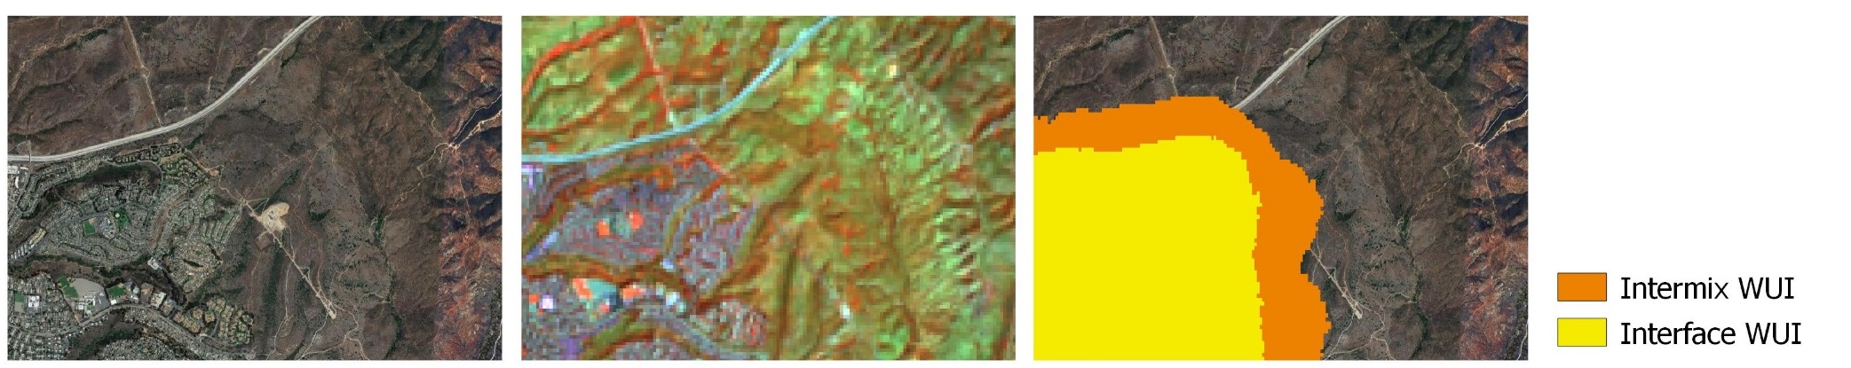
Chapter 1: Mapping the WUI
How to map the WUI using Landsat and Sentinel-2 imagery?
  Novel WUI mapping approach
  spectral unmixing of satellite imagery
  assess vegetation cover and housing density via land cover fractions
Google Earth
Landsat
WUI Map

Slide 7
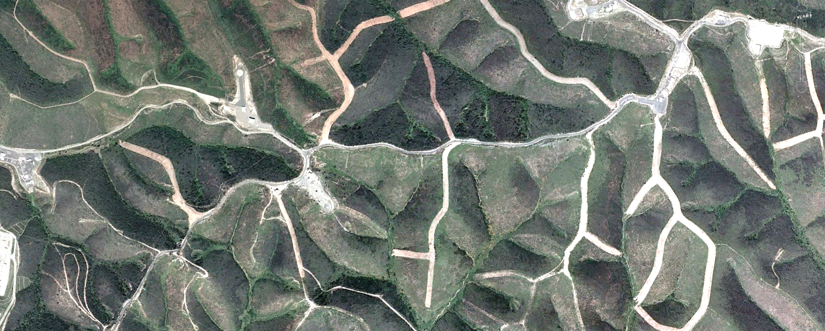
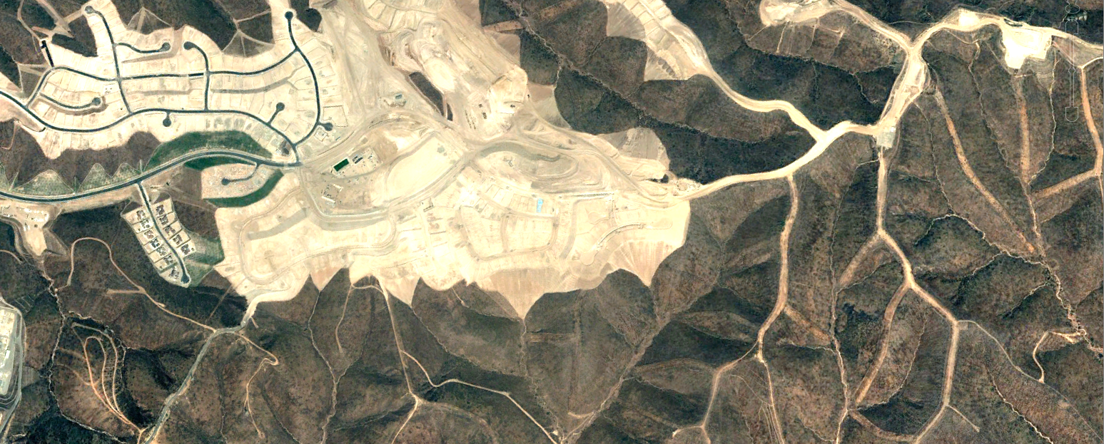
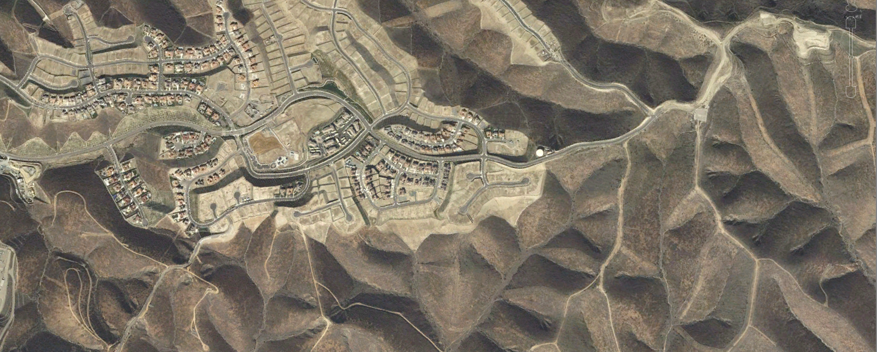
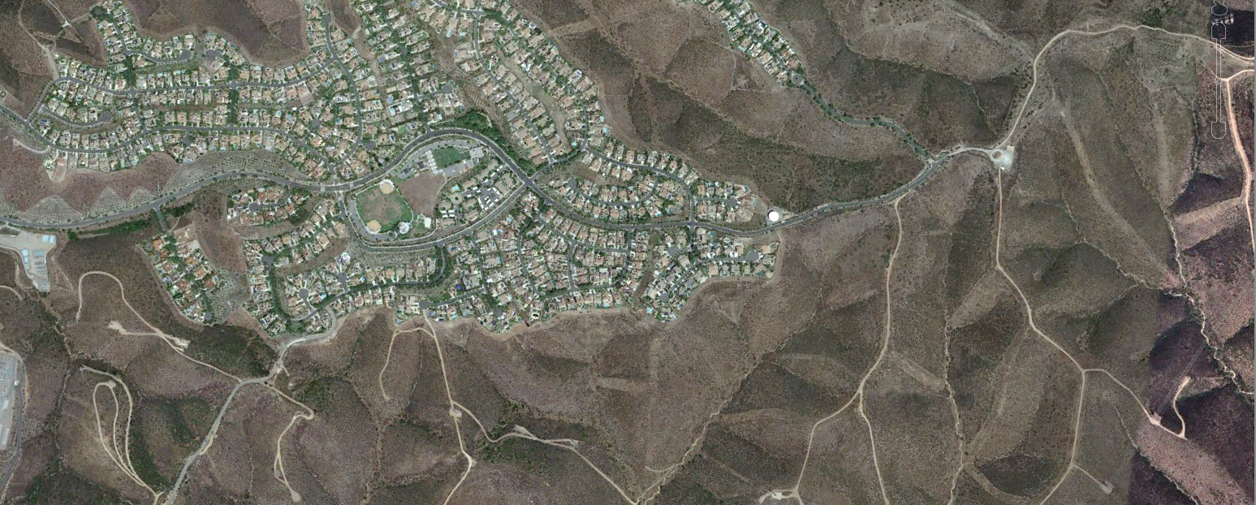
Chapter 2: Quantifying WUI change
How much did WUI grow from 1990 to 2022?
2003
2004
2008
2021
Image Source: Google Earth Pro

Slide 8

Chapter 3: Quantifying WUI drivers
What is the main driver of WUI growth (vegetation or buildings)?
How did land cover change within newly created vs. stable WUI areas?
Increasing houses:
Increasing vegetation:

Slide 9

Chapter 4: Changing fire activity in the WUI
Increased fire frequency
climate
Ignition
WUI growth
Increased fire ignition
Fire
Regime
Increased area burned
Lengthen fire season
Vegetation

Slide 10


Chapter 5: Vegetation Type Conversion
Did shifts from woody to non-woody vegetation occur?
Does WUI growth lead vegetation type conversion?
WUI growth
Increased ignition
Increased fire frequency, area burned, fire season
Vegetation
Type Conversion

Slide 11
Overall Significance
Scientific contributions:
    Assess WUI growth across the Mediterranean biome
    Investigate drivers of WUI change
    Trends in fire activity and vegetation communities
Methodological contributions:
    Novel WUI mapping approach with Landsat & Sentinel-2
    WUI maps to assess human-environmental conflicts
Conservation and management implications:
    Feedbacks between WUI growth, fire activity, and type conversion
    Woody to non-woody transition as proxy for biodiversity loss

Slide 12
Timeline

Slide 13
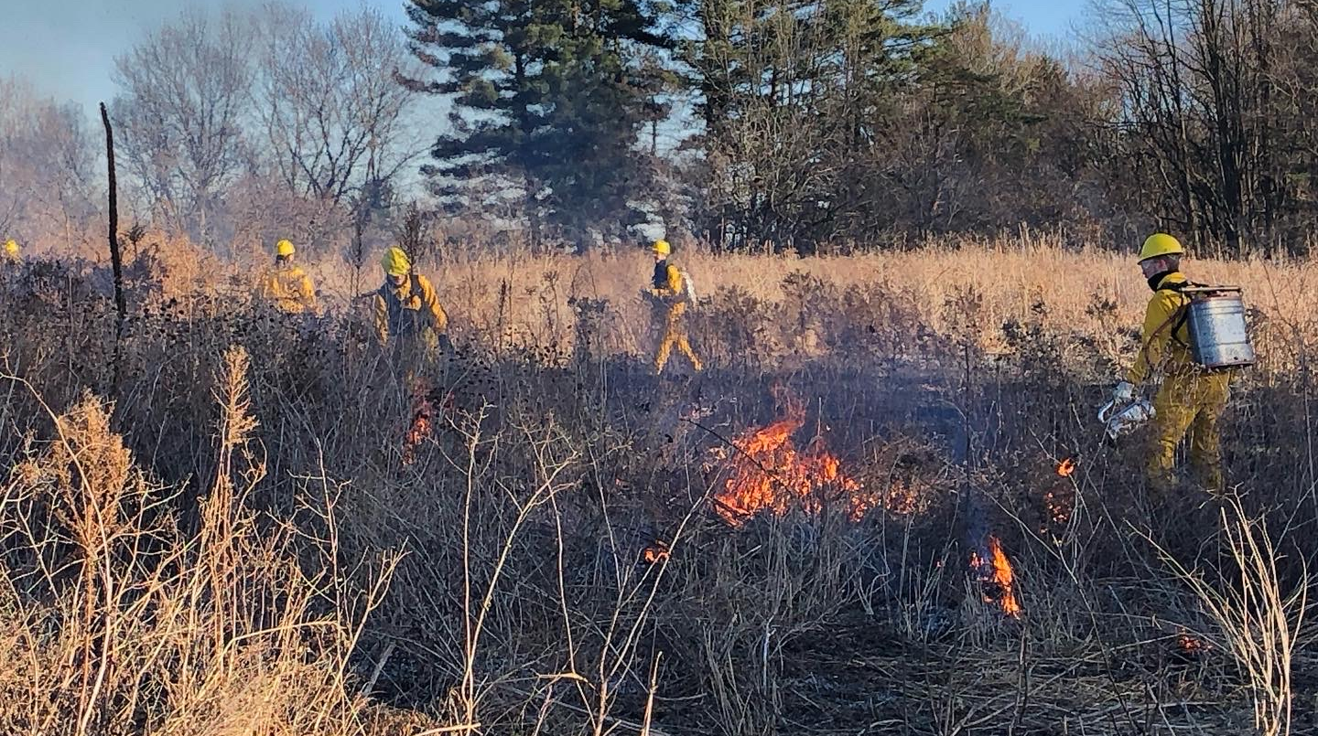
Thank you for your attention!
Thank you for your attention!

