Slide 1
Developing remote sensing indices
for biodiversity studies across the conterminous US
Advisors: Volker Radeloff
Anna Pidgeon
Committee members:
Benjamin Zuckerberg
Patrick Hostert
Anthony Ives
Preliminary exam- July 10, 2020
Elena Razenkova

Slide 2
Introduction
Background:
Biodiversity is declining.
RS is useful for assessing biodiversity at broad scales.
Goals:
Develop Landsat DHIs.
Landsat vs. MODIS DHIs predicting bird richness.
Landsat DHIs for bird abundance.
Introduction | Chapter 1 |Chapter 2|Chapter 3

Slide 3
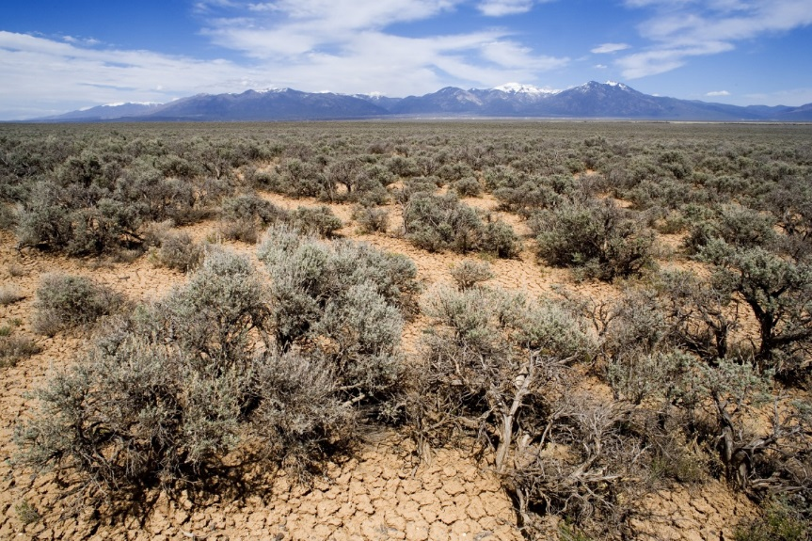
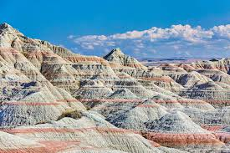
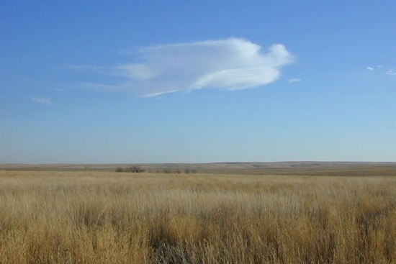
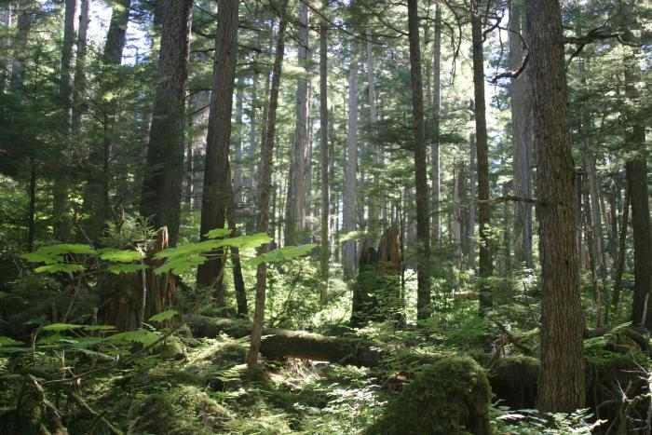
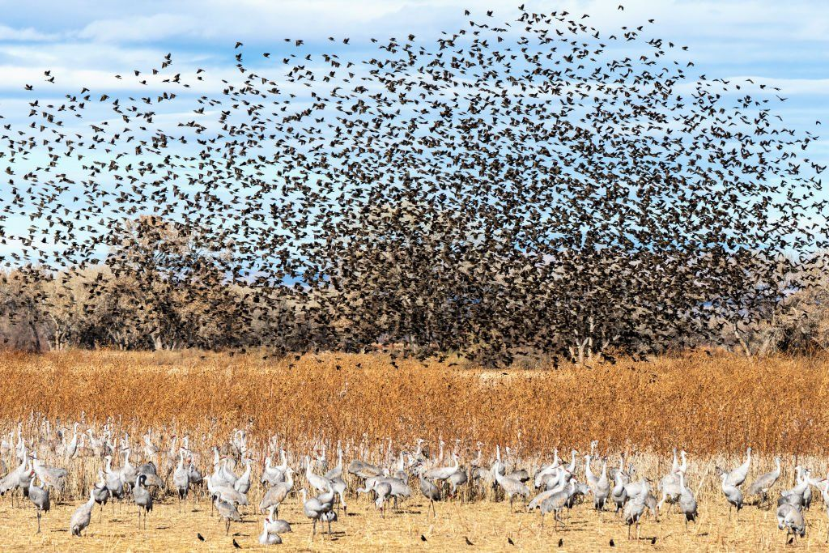
Study area –conterminous US
Introduction | Chapter 1 |Chapter 2|Chapter 3

Slide 4
Study area–conterminous US
The conterminous United States:
Large area
Many vegetation types
Complex topography
Diverse climatic zones
Bird data
Introduction | Chapter 1 |Chapter 2|Chapter 3

Slide 5
Chapter I – Remote sensing
Chapter 1. Comparison of DHIS from MODIS and Landsat
Goals:
1.1 Identify the time period required for DHIs calculation.
1.2 Assess uncertainties of the DHIs.
1.3 Compare DHIs at different scales.
1.4 Assess the ability of Landsat DHIs capture heterogeneity.
Introduction | Chapter 1 |Chapter 2|Chapter 3

Slide 6
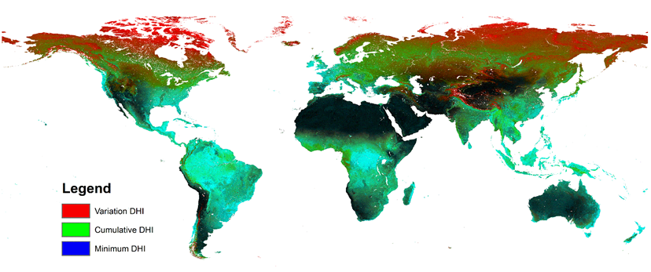
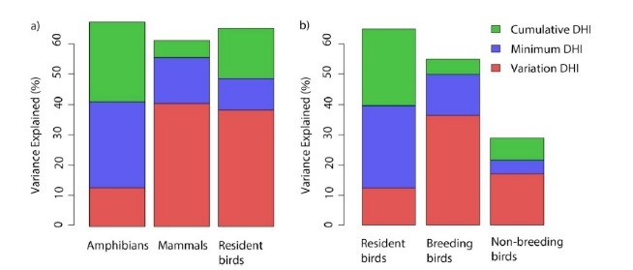
Chapter I – Remote sensing
MODIS DHI
Radeloff et al.,2019
Introduction | Chapter 1 |Chapter 2|Chapter 3

Slide 7
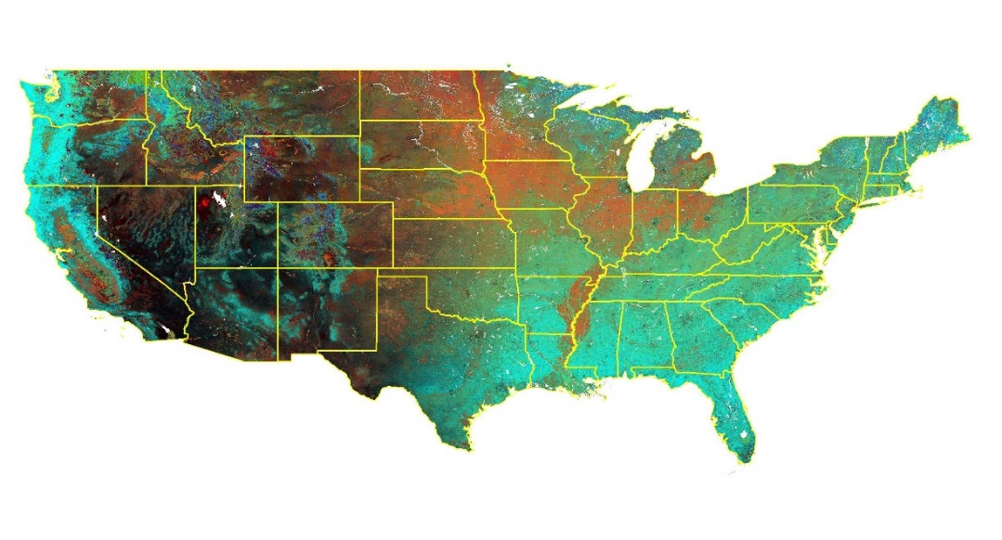
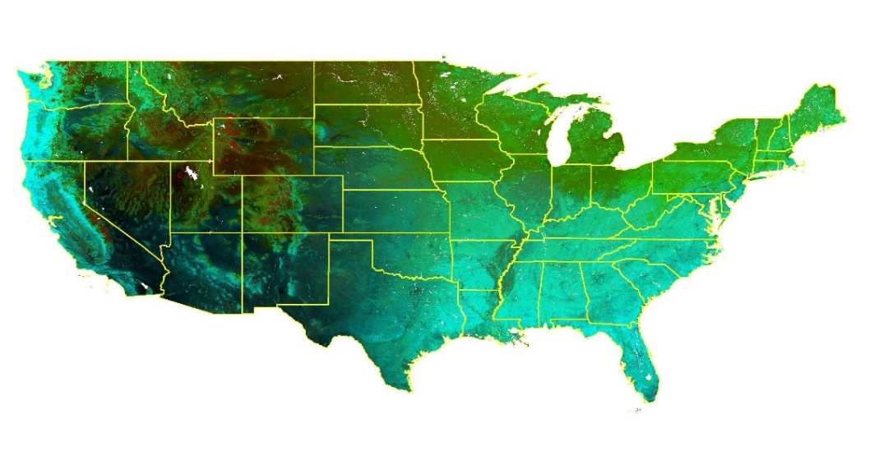
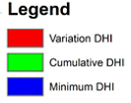
Chapter I – Remote sensing
Landsat
16 days return interval
30-m resolution
MODIS
1-2 days return interval
1-km resolution
Introduction | Chapter 1 |Chapter 2|Chapter 3

Slide 8
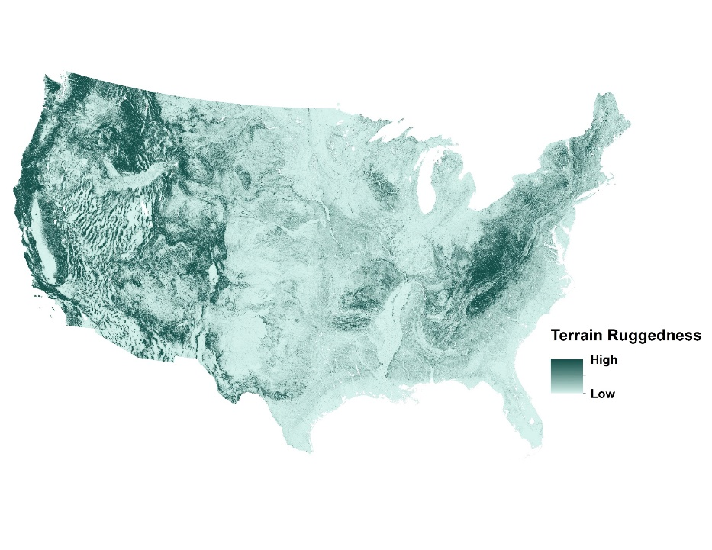
Chapter I – Remote sensing
Global model
Elevation
Terrain ruggedness
Land cover
Percent of core and edge areas:
forest,
shrubland,
grassland.
Introduction | Chapter 1 |Chapter 2|Chapter 3

Slide 9
Chapter I – Remote sensing
Expected results and significance:
1.1 The required time period for DHIs much shorter for MODIS DHIs.
1.2 Landsat DHIs will have more uncertainties.
1.3 Pattern for both DHIs will be comparable.
1.4 Landsat DHIs will capture heterogeneity better.
Introduction | Chapter 1 |Chapter 2|Chapter 3

Slide 10
Chapter II - Conservation
Chapter 2. Explaining bird richness with Landsat vs. MODIS DHIs
Goals:
2.1 Predictive power of Landsat vs. MODSI DHIs for bird richness.
2.2 Importance of DHIs for different guilds.
2.3 Relative importance of the DHIs vs. other environmental variables.
Introduction | Chapter 1 |Chapter 2|Chapter 3

Slide 11
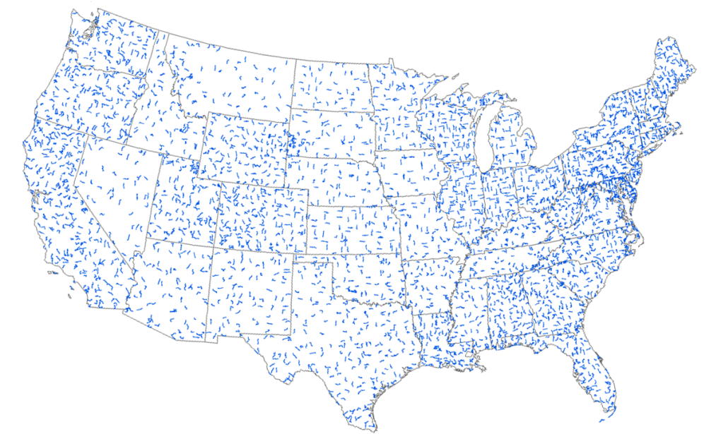
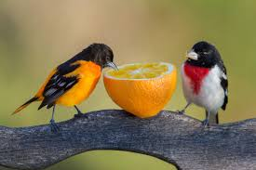
Chapter II - Conservation
Species 1
Species 2
Guilds
Species 3
Habitat association
Migratory behavior
Based on body size
Species n
Introduction | Chapter 1 |Chapter 2|Chapter 3

Slide 12
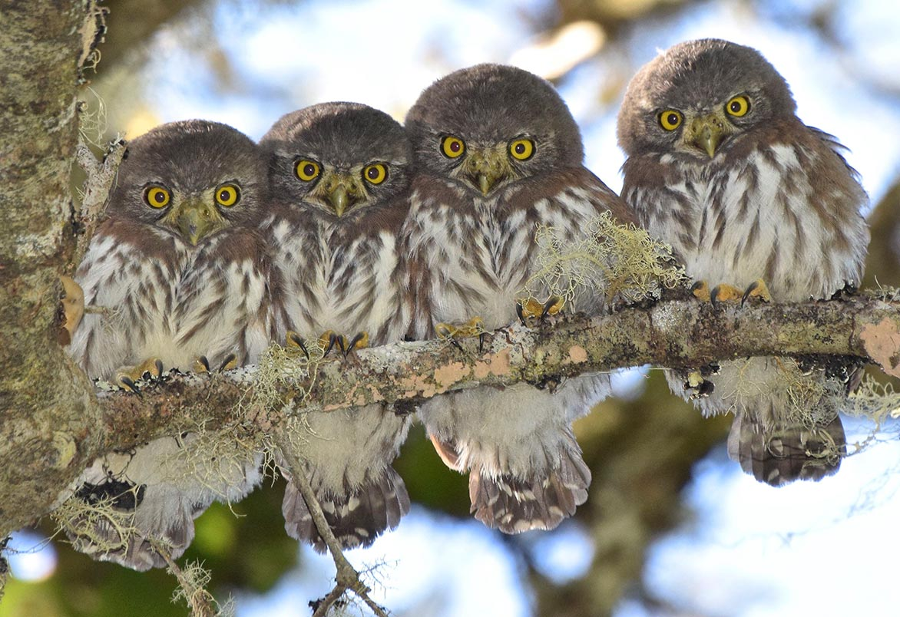
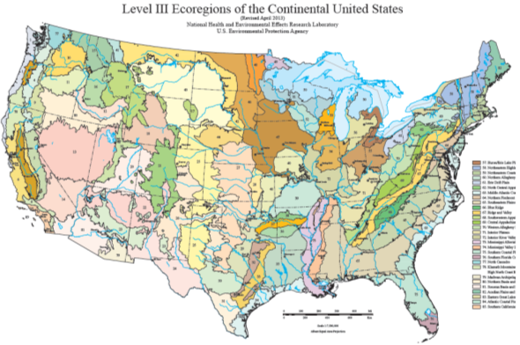
Chapter II - Conservation
Method:
Linear regression
Dependent variables: BBS bird richness
Explanatory variables: the DHIs
Three scales:
Broad
Medium
Point
Introduction | Chapter 1 |Chapter 2|Chapter 3

Slide 13
Chapter II - Conservation
Global model
Elevation
Land cover map
The proportion of
forest,
shrubland,
grassland
Only for BBS routes
Introduction | Chapter 1 |Chapter 2|Chapter 3

Slide 14
Chapter II - Conservation
Expected results and significance:
2.1 The Landsat DHIs will outperform the MODIS DHIs.
2.2 Landsat DHIs will be more important for all bird guilds .
2.3 The DHIs will complement other environmental variables.
Introduction | Chapter 1 |Chapter 2|Chapter 3

Slide 15
Chapter III – Conservation
Chapter 3. Explaining bird abundance with the DHIs
Goals:
3.1 Do Landsat DHIs predict bird species abundance?
3.2 Is the more individuals hypothesis more relevant for rare than for common species?
3.3 Is abundance of resident birds and long-distance migrants correlated with different DHIs
Introduction | Chapter 1 |Chapter 2|Chapter 3

Slide 16
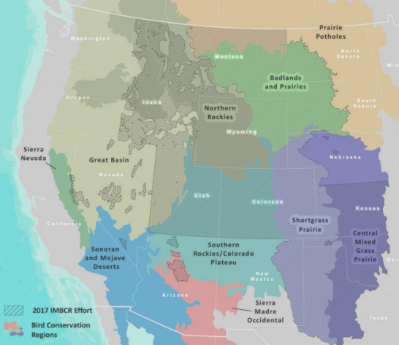
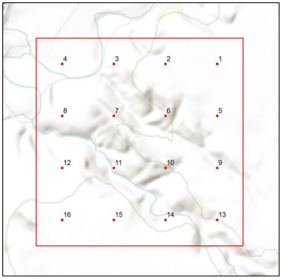
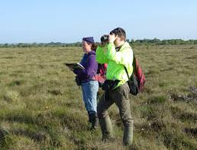
Chapter III – Conservation
From IMBCR data:
Common and rare bird species
Residents and long-distance migrants
Model linear regression
Introduction | Chapter 1 |Chapter 2|Chapter 3

Slide 17
Chapter III – Conservation
Global model
Elevation
BIOCLIM
Elevation
Annual precipitation
Introduction | Chapter 1 |Chapter 2|Chapter 3

Slide 18
Chapter III – Conservation
Expected results and significance:
3.1 Bird abundance will be higher in more productive areas.
3.2 The DHIs will be more important for common species.
3.3 Minimum DHI most important for Resident birds, variation DHI for long-distance migrants.
3.4 The DHIs complement environmental variables.
Introduction | Chapter 1 |Chapter 2|Chapter 3

Slide 19
Significance
Methodological contribution:
Develop the methodology for Landsat DHIs.
Determine at what scale Landsat DHIs outperform MODIS DHIs.
Assess how Landsat DHIs capture heterogeneity in mountains and fragmented landscapes.

Slide 20
Significance
Ecology contribution:
Identifying the factors shaping broad-scale species richness.
Demonstrate the value of Landsat DHIs for explaining bird richness.
Understanding the importance of the DHIs versus climate and elevation.

Slide 21
Significance
Land management and conservation:
Assess the application of Landsat DHIs for monitoring bird abundance.
Assess the ability of Landsat DHIs capture the important characteristics of suitable habitat of common and rare species.
Identify critical habitat for species of high concern.

Slide 22
Time line
Task | 2018 |  | 2019 |  |  |  | 2020 |  |  |  | 2021 |  |  |  | 2022
 | III | IV | I | II | III | IV | I | II | III | IV | I | II | III | IV | I | II | III | IV
Classes
Preliminary analysis
Dissertation proposal
Analysis Chapter I
Writing Chapter I
Analysis Chapter II
Writing Chapter II
Analysis Chapter III
Writing Chapter III
Writing Dissertation/Papers
1st committee meeting
Prelim
Defense
Introduction | Chapter 1 |Chapter 2|Chapter 3

Slide 23
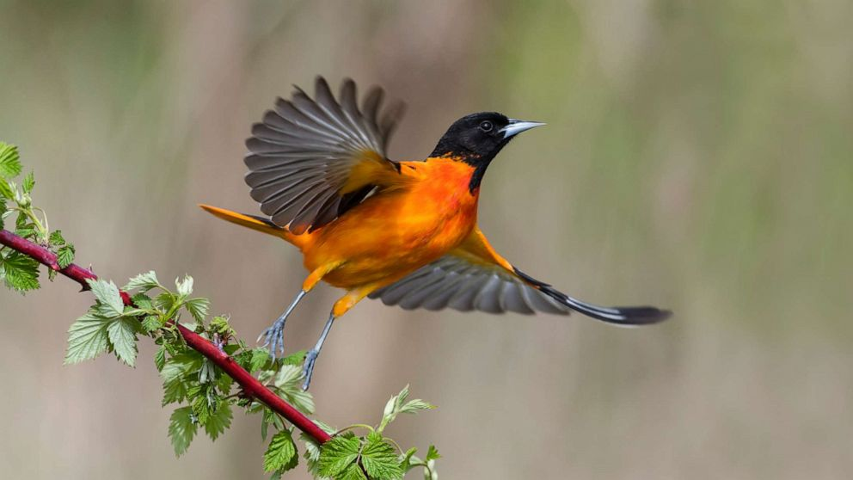
Thank you for your attention!

