Slide 1
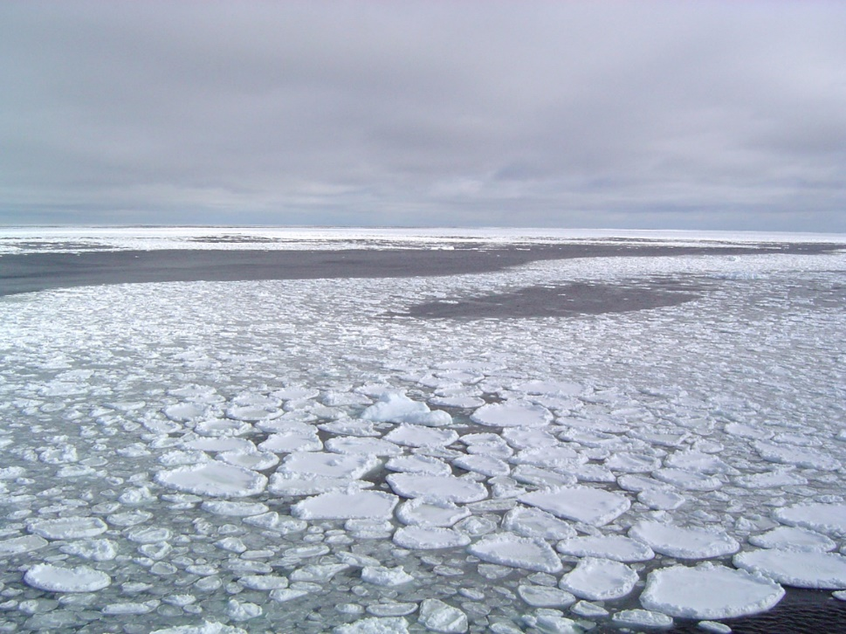
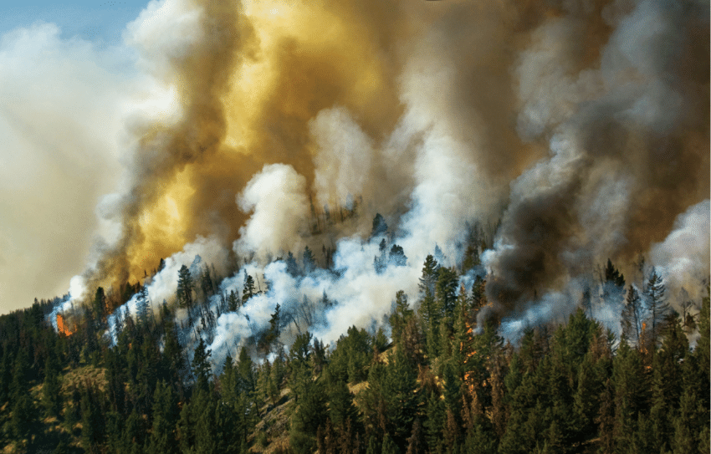
Preliminary Exam Presentation
Fire and Ice: Unhappy Bedfellows?
C. W. Stephens
Credit: NSIDC, C. Rumpel 2019

Slide 2
Outline
Background
A Changing Arctic
Proposed Chapters
Significance
Acknowledgments

Slide 3
Outline
Background
A Changing Arctic
Proposed Chapters
Significance
Acknowledgments

Slide 4
Overview
Fire
Ice

Slide 5
Background
Fire
Ice
Connection?

Slide 6
Outline
Background
A Changing Arctic
Proposed Chapters
Implications
Acknowledgments

Slide 7
A Changing Arctic
Minimum Arctic Sea Ice extent has declined by 45% over the last 40 years. (Onarheim et al. 2018)

Slide 8
A Changing Arctic
Minimum Arctic Sea Ice extent has declined by 45% over the last 40 years. (Onarheim et al. 2018)
Circumboreal burnt area has increased over last several decades. (Walker et al. 2019)

Slide 9
A Changing Arctic
Minimum Arctic Sea Ice extent has declined by 45% over the last 40 years. (Onarheim et al. 2018)
Circumboreal burnt area has increased over last several decades. (Walker et al. 2019)
Boreal and Arctic wildfires are a major producer of black carbon. (Kang et al. 2019)

Slide 10
A Changing Arctic
Minimum Arctic Sea Ice extent has declined by 45% over the last 40 years. (Onarheim et al. 2018)
Circumboreal burnt area has increased over last several decades. (Walker et al. 2019)
Boreal and Arctic wildfires are a major producer of black carbon. (Kang et al. 2019)
Black carbon is carbon containing soot which is heavily absorbent in visible spectrum. (Winiger et al. 2019)

Slide 11
Overview
Climate Warming Catalyst
Sea Ice Recedes
Ash Deposits on Sea Ice Reducing Albedo
Boreal Forest Warm
Wildfire Extent Increases
Hypothetical Smoke – Ice Albedo Feedback

Slide 12
Outline
Background
A Changing Arctic
Proposed Chapters
Significance
Acknowledgments

Slide 13
Chapters
Chapter 1: Do the fundamental drivers of Arctic sea ice presence vary in importance across Arctic sub-regions?
Chapter 2: Do trends in Arctic sea ice extent effect wildfire occurrence in Arctic boreal forests?
Chapter 3: Does wildfire activity in Arctic boreal forests impact Arctic sea ice extent via smoke – ice albedo effects?

Slide 14
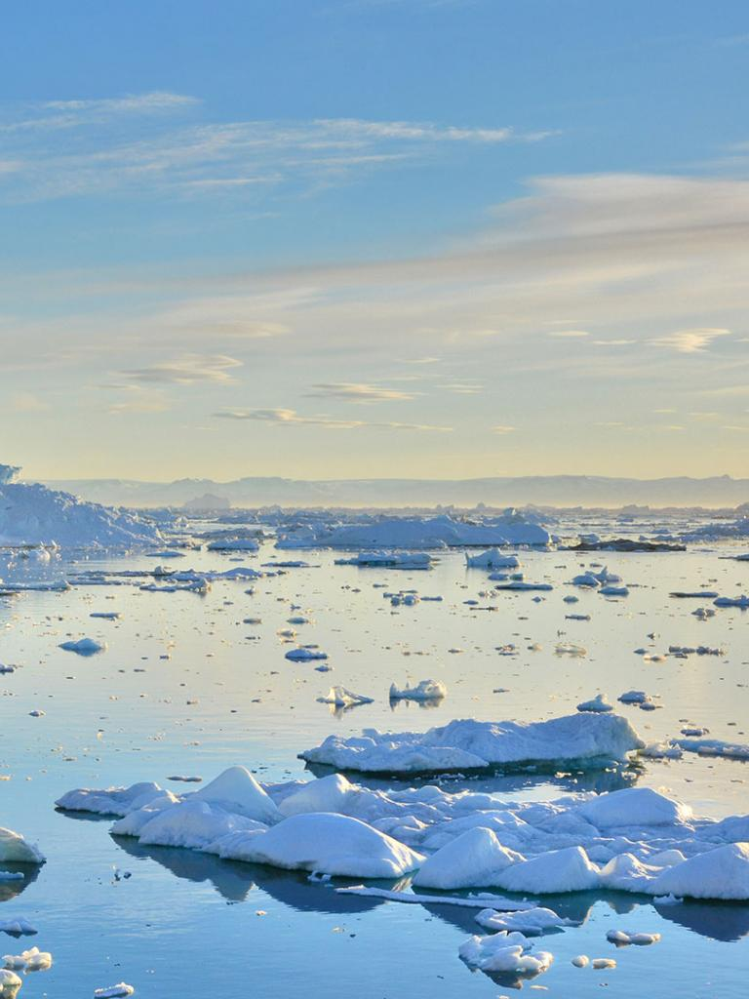
Chapter 1
Chapter 1: Do the fundamental drivers of Arctic sea ice presence vary in importance across Arctic sub-regions?
Credit: EUMETSAT

Slide 15
Rationale
Arctic sea ice has declined unevenly. (Onarheim et al. 2018)

Slide 16
Rationale
Arctic sea ice has declined unevenly. (Onarheim et al. 2018)
Arctic sea ice presence drives regional climate feedbacks. (Perovich et al. 2018)

Slide 17
Rationale
Arctic sea ice has declined unevenly. (Onarheim et al. 2018)
Arctic sea ice presence drives regional climate feedbacks. (Perovich et al. 2018)
Arctic sea ice presence modifies climate at the mid-latitudes. (Blackport and Screen 2020)

Slide 18
Rationale
Arctic sea ice has declined unevenly. (Onarheim et al. 2018)
Arctic sea ice presence drives regional climate feedbacks. (Perovich et al. 2018)
Arctic sea ice presence modifies climate at the mid-latitudes. (Blackport and Screen 2020)
Drivers of Arctic sea ice loss have changed in prevalence over time (e.g. clouds). (Kopec et al. 2016)

Slide 19
Overview
Climate Warming Catalyst
Sea Ice Recedes
Ash Deposits on Sea Ice Reducing Albedo
Boreal Forest Warm
Wildfire Extent Increases
Hypothetical Smoke – Ice Albedo Feedback

Slide 20
Chapter 1: Drivers of Ice Loss
Question: Do the fundamental drivers of Arctic sea ice presence vary in importance across Arctic sub-regions?
Methodology:
Use remotePARTS to evaluate for drives of ice persistence
Drivers used include:
Ice Albedo time trends
Surface Temperature time trends
Cloud Coverage time trends
Primary Interest: Does the importance of these drivers change based on the Arctic sub region examined?

Slide 21
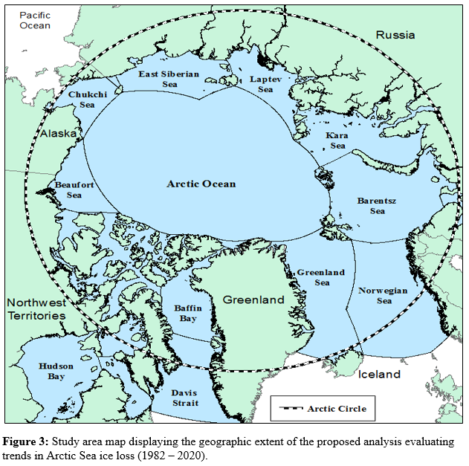
Study Area

Slide 22
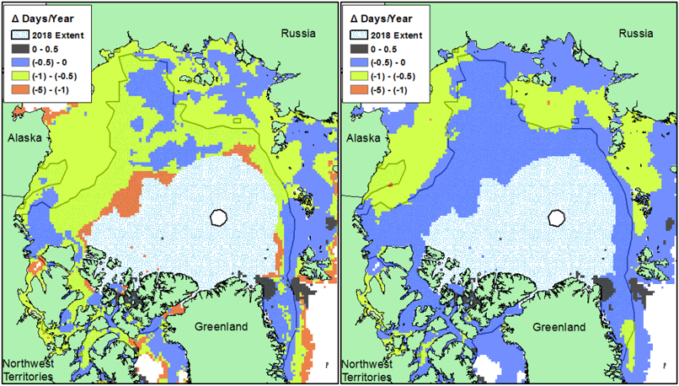
Chapter 1: Preliminary Results
Traditional OLS Analysis
AR(1) CLS Analysis
Trends in Monthly (September) Days of Arctic Sea Ice Coverage

Slide 23
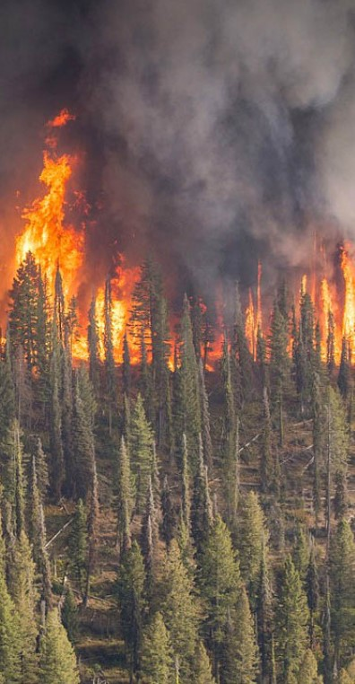
Chapter 2
Chapter 2: Do trends in Arctic sea ice extent effect wildfire occurrence in Arctic boreal forests?
(Credit: The Moscow Times, 2019.)

Slide 24
Chapter 2: Ice – Fire Relationship
Question: Do trends in Arctic sea ice extent effect wildfire occurrence in Arctic boreal forests?
Methodology:
Relate Sea ice extent to temperature (Teleconnection Analysis)
Relate temperature to annual burnt area
Relate Sea ice extent to annual burnt area (Teleconnection Analysis)
Primary Interest: Is there a detectable relationship between Arctic sea ice extent and wildfire conditions in polar Boreal forests? Does this relationship influence burnt area extent?

Slide 25
Overview
Climate Warming Catalyst
Sea Ice Recedes
Ash Deposits on Sea Ice Reducing Albedo
Boreal Forest Warm
Wildfire Extent Increases
Hypothetical Smoke – Ice Albedo Feedback

Slide 26
Rationale
Fall season warming contributes to drought stress in water limited ecosystems. (Buchwal et al. 2020)

Slide 27
Rationale
Fall season warming contributes to drought stress in water limited ecosystems. (Buchwal et al. 2020)
Primary control on late-season Boreal wildfire is temperature and fuel moisture. (Kharuk et al. 2017)

Slide 28
Rationale
Fall season warming contributes to drought stress in water limited ecosystems. (Buchwal et al. 2020)
Primary control on late-season Boreal wildfire is temperature and fuel moisture. (Kharuk et al. 2017)
Permafrost produce GhG’s by direct CO2 emission and fertilizing CH4 production. (Lara et al. 2019)

Slide 29
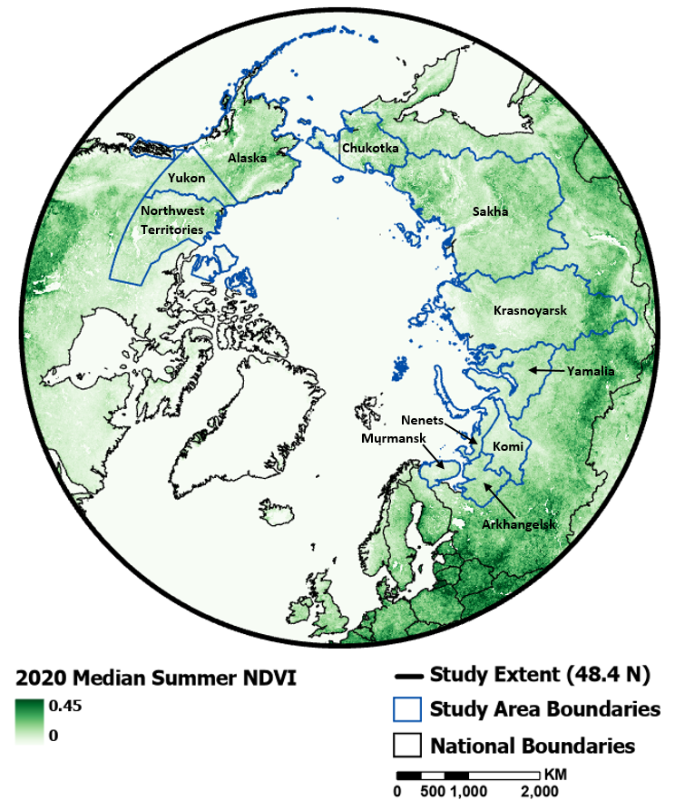
Study Area

Slide 30
Chapter 2 Analysis Flowchart
Step 1
Step 2
Step 3
Land Region B’s minimum monthly surface temperature
Land Region B’s minimum monthly surface temperature
Land Region B’s wildfire season length/burnt area
Significant Relationship?
Yes
Significant Relationship?
Yes
Analyze
Oceanic Region A’s minimum monthly Arctic Sea ice Extent
Land Region B’s wildfire season length/burnt area
Oceanic Region A’s minimum monthly Arctic Sea ice Extent

Slide 31
Chapter 2 Analysis Flowchart
Step 1
Step 2
Step 3
Land Region B’s minimum monthly surface temperature
Land Region B’s minimum monthly surface temperature
Land Region B’s wildfire season length/burnt area
Significant Relationship?
Yes
Significant Relationship?
Yes
Analyze
Oceanic Region A’s minimum monthly Arctic Sea ice Extent
Land Region B’s wildfire season length/burnt area
Oceanic Region A’s minimum monthly Arctic Sea ice Extent

Slide 32
Chapter 2 Analysis Flowchart
Step 1
Step 2
Step 3
Land Region B’s minimum monthly surface temperature
Land Region B’s minimum monthly surface temperature
Land Region B’s wildfire season length/burnt area
Significant Relationship?
Yes
Significant Relationship?
Yes
Analyze
Oceanic Region A’s minimum monthly Arctic Sea ice Extent
Land Region B’s wildfire season length/burnt area
Oceanic Region A’s minimum monthly Arctic Sea ice Extent

Slide 33
Chapter 2 Analysis Flowchart
Step 1
Step 2
Step 3
Land Region B’s minimum monthly surface temperature
Land Region B’s minimum monthly surface temperature
Land Region B’s wildfire season length/burnt area
Significant Relationship?
Yes
Significant Relationship?
Yes
Analyze
Oceanic Region A’s minimum monthly Arctic Sea ice Extent
Land Region B’s wildfire season length/burnt area
Oceanic Region A’s minimum monthly Arctic Sea ice Extent

Slide 34
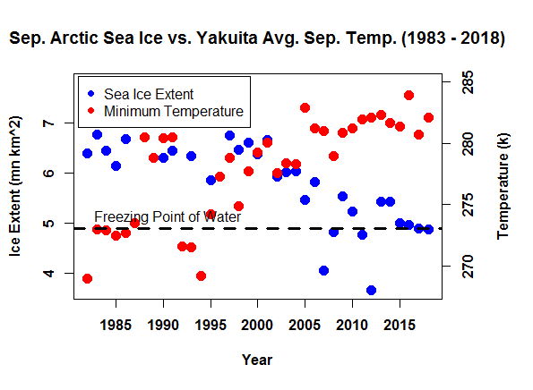
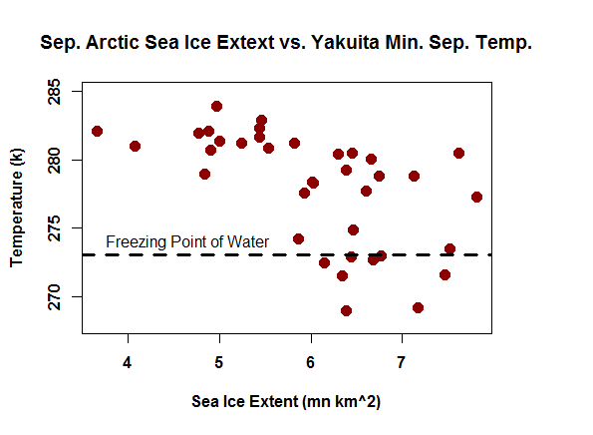
Chapter 2 Preliminary Results
Average Minimum Increasing
Minimum vs. Ice Extent

Slide 35
Chapter 2: Fire Mapping
Selected Dataset: AVHRR 5km Multispectral Archive (1982 – 2020)
Products:
Monthly Maximum NDVI Timeseries
Monthly Maximum 3.7 um Temperature

Slide 36
Chapter 2: Fire Mapping
Selected Dataset: AVHRR 5km Multispectral Archive (1982 – 2020)
Products:
Monthly Maximum NDVI Timeseries
Monthly Maximum 3.7 um Temperature
Model Description:
CLS AR(1) temporal autoregressive model
Apply model to each timeseries, residual test

Slide 37
Chapter 2: Fire Mapping
Selected Dataset: AVHRR 5km Multispectral Archive (1982 – 2020)
Products:
Monthly Maximum NDVI Timeseries
Monthly Maximum 3.7 um Temperature
Model Description:
CLS AR(1) temporal autoregressive model
Apply model to each timeseries, residual test
Criteria for Fire Detection (3 Steps):
Significant decrease in max summertime NDVI
Significant increase in max summertime 3.7 μm brightness temperature
Co-location of significant anomalies required

Slide 38
Overview
Climate Warming Catalyst
Sea Ice Recedes
Ash Deposits on Sea Ice Reducing Albedo
Boreal Forest Warm
Wildfire Extent Increases
Hypothetical Smoke – Ice Albedo Feedback

Slide 39
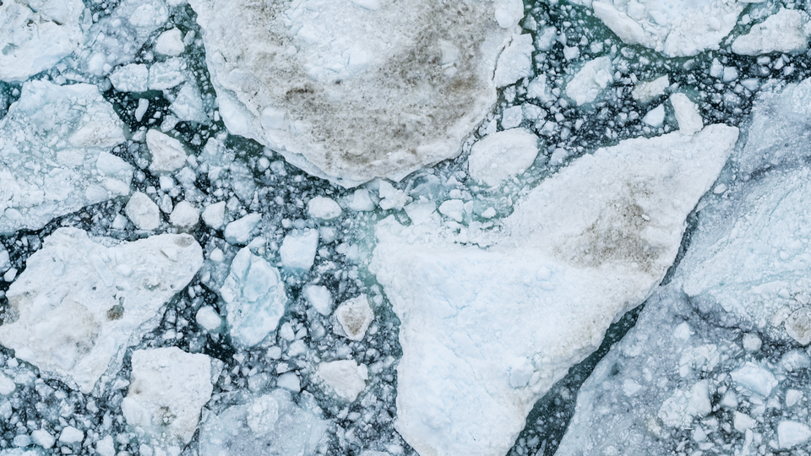
Chapter 3
Chapter 3: Does wildfire activity in Arctic boreal forests impact Arctic sea ice extent via smoke – ice albedo effects?
(Credit: SERI)

Slide 40
Rationale
Arctic sea ice decline contributes to Fall-season warming. (Lang et al. 2017)

Slide 41
Rationale
Arctic sea ice decline contributes to Fall-season warming. (Lang et al. 2017)
90% of variability in Tundra wildfires is explained by variations in temperature and precip. (Hu et al. 2015)

Slide 42
Rationale
Arctic sea ice decline contributes to Fall-season warming. (Lang et al. 2017)
90% of variability in Tundra wildfires is explained by variations in temperature and precip. (Hu et al. 2015)
BC from boreal wildfires caused a 2% increase in ice loss between 1998 and 2001. (Flanner et al. 2007)

Slide 43
Rationale
Arctic sea ice decline contributes to Fall-season warming. (Lang et al. 2017)
90% of variability in Tundra wildfires is explained by variations in temperature and precip. (Hu et al. 2015)
BC from boreal wildfires caused a 2% increase in ice loss between 1998 and 2001. (Flanner et al. 2007)
Black Carbon contribution to the Arctic by wildfire is underestimated by a factor of 3. (Ohata et al. 2021)

Slide 44
Overview
Climate Warming Catalyst
Sea Ice Recedes
Ash Deposits on Sea Ice Reducing Albedo
Boreal Forest Warm
Wildfire Extent Increases
Hypothetical Smoke – Ice Albedo Feedback

Slide 45
Chapter 3: Smoke – Albedo Relationship
Question: Does wildfire activity in Arctic boreal forests impact Arctic sea ice extent via smoke – ice albedo effects?
Methodology:
Relate AOD to sea ice surface Albedo
Relate AOD to burnt area (Teleconnection Analysis)
Relate Sea ice albedo to burnt area (Teleconnection Analysis)
Primary Interest: Is there a detectable relationship between burnt area extent and Arctic sea ice albedo? Does this change with Arctic sub-region, and can contributions be partitioned by land area?

Slide 46
Chapter 3 Analysis Flowchart
Step 1
Step 2
Step 3
Oceanic Region A’s monthly average Aerosol Optical Depth
Oceanic Region A’s monthly average Aerosol Optical Depth
Land Region B’s
Cumulative burnt area
(aggregated to AOD)
Significant Relationship?
Yes
Significant Relationship?
Yes
Analyze
Oceanic Region A’s minimum monthly Arctic Sea ice Albedo
Land Region B’s
Cumulative burnt area
(aggregated to AOD)
Oceanic Region A’s minimum monthly Arctic Sea ice Albedo

Slide 47
Chapter 3 Analysis Flowchart
Step 1
Step 2
Step 3
Oceanic Region A’s monthly average Aerosol Optical Depth
Oceanic Region A’s monthly average Aerosol Optical Depth
Land Region B’s
Cumulative burnt area
(aggregated to AOD)
Significant Relationship?
Yes
Significant Relationship?
Yes
Analyze
Oceanic Region A’s minimum monthly Arctic Sea ice Albedo
Land Region B’s
Cumulative burnt area
(aggregated to AOD)
Oceanic Region A’s minimum monthly Arctic Sea ice Albedo

Slide 48
Chapter 3 Analysis Flowchart
Step 1
Step 2
Step 3
Oceanic Region A’s monthly average Aerosol Optical Depth
Oceanic Region A’s monthly average Aerosol Optical Depth
Land Region B’s
Cumulative burnt area
(aggregated to AOD)
Significant Relationship?
Yes
Significant Relationship?
Yes
Analyze
Oceanic Region A’s minimum monthly Arctic Sea ice Albedo
Land Region B’s
Cumulative burnt area
(aggregated to AOD)
Oceanic Region A’s minimum monthly Arctic Sea ice Albedo

Slide 49
Chapter 3 Analysis Flowchart
Step 1
Step 2
Step 3
Oceanic Region A’s monthly average Aerosol Optical Depth
Oceanic Region A’s monthly average Aerosol Optical Depth
Land Region B’s
Cumulative burnt area
(aggregated to AOD)
Significant Relationship?
Yes
Significant Relationship?
Yes
Analyze
Oceanic Region A’s minimum monthly Arctic Sea ice Albedo
Land Region B’s
Cumulative burnt area
(aggregated to AOD)
Oceanic Region A’s minimum monthly Arctic Sea ice Albedo

Slide 50
Outline
Background
A Changing Arctic
Proposed Chapters
Significance
Acknowledgments

Slide 51
Significance
Chapter 1 provides insight on variability in early season drivers of ice loss.
Chapter 2 tests for a new driver of boreal wildfire and provides new long-term product.
Chapter 3 tests for a relationship between wildfire and sea ice condition using observational data.
If all relationships are significant, the sum is greater than its parts.

Slide 52
Outline
Overview
A Changing Arctic
Proposed Chapters
Significance
Acknowledgments

Slide 53
Acknowledgements
James Anheuser for assistance with APP-x archive.
Dr. Xuanji Wang for assistance with polar projections.
Clay Morrow for assistance with spatial error models.

Slide 54
Sources
Onarheim, I. H., T. Eldevik, L. H. Smedsrud & J. C. Stroeve (2018) Seasonal and Regional Manifestation of Arctic Sea Ice Loss. Journal of Climate, 31, 4917-4932.
Walker, X. J., J. L. Baltzer, S. G. Cumming, N. J. Day, C. Ebert, S. Goetz, J. F. Johnstone, S. Potter, B. M. Rogers, E. A. G. Schuur, M. R. Turetsky & M. C. Mack (2019) Increasing wildfires threaten historic carbon sink of boreal forest soils. Nature, 572, 520-+
Kang, S. C., Y. L. Zhang, Y. Qian & H. L. Wang (2020) A review of black carbon in snow and ice and its impact on the cryosphere. Earth-Science Reviews, 210.
Flanner, M. G., C. S. Zender, J. T. Randerson & P. J. Rasch (2007) Present-day climate forcing and response from black carbon in snow. Journal of Geophysical Research-Atmospheres, 112.
Kang, S. C., Y. L. Zhang, Y. Qian & H. L. Wang (2020) A review of black carbon in snow and ice and its impact on the cryosphere. Earth-Science Reviews, 210.
Perovich, D. K., S. V. Nghiem, T. Markus & A. Schweiger (2007) Seasonal evolution and interannual variability of the local solar energy absorbed by the Arctic sea ice-ocean.
Blackport, R. & J. A. Screen (2020) Weakened evidence for mid-latitude impacts of Arctic warming. Nature Climate Change, 10, 1065-1066.
Kopec, B. G., X. H. Feng, F. A. Michel & E. S. Posmentier (2016) Influence of sea ice on Arctic precipitation. Proceedings of the National Academy of Sciences of the United States of America, 113, 46-51.
Buchwal, A., P. F. Sullivan, M. Macias-Fauria, E. Post, I. H. Myers-Smith, J. C. Stroeve, D. Blok, K. D. Tape, B. C. Forbes, P. Ropars, E. Levesque, B. Elberling, S. Angers-Blondin, J. S. Boyle, S. Boudreau, N. Boulanger-Lapointe, C. Gamm, M. Hallinger, G. Rachlewicz, A. Young, P. Zetterberg & J. M. Welker (2020) Divergence of Arctic shrub growth associated with sea ice decline. Proceedings of the National Academy of Sciences of the United States of America, 117, 33334-33344.
Kharuk, V. I. & E. I. Ponomarev (2017) Spatiotemporal characteristics of wildfire frequency and relative area burned in larch-dominated forests of Central Siberia. Russian Journal of Ecology, 48, 507-512.
Lang, A., S. T. Yang & E. Kaas (2017) Sea ice thickness and recent Arctic warming. Geophysical Research Letters, 44, 409-418.
Ohata, S., M. Koike, A. Yoshida, N. Moteki, K. Adachi, N. Oshima, H. Matsui, O. Eppers, H. Bozem, M. Zanatta & A. B. Herber (2021) Arctic black carbon during PAMARCMiP 2018 and previous aircraft experiments in spring. Atmospheric Chemistry and Physics, 21, 15861-15881.

Slide 55
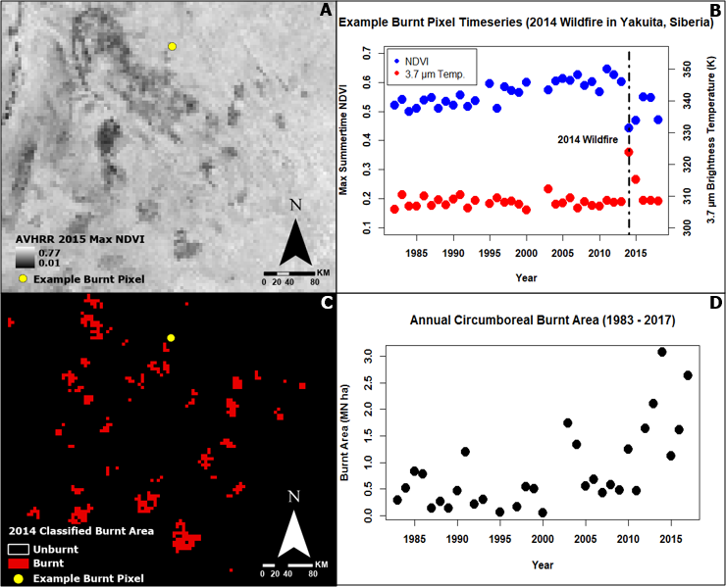
Chapter 2 Preliminary Results

Slide 56
CLS AR(1) Model
$${Equation 1: y}_{i}=a+c\left(y_{i−1}\right)+p(t_{i})+ε_{i}$$
Where $y_{i}$ represents the observed value at time $i$, $a$ represents a fitted intercept, $c$ represents the AR(1) autoregressive relationship between the current and prior observed values, $y_{i−1}$ represents the prior year’s observed value, $p$ represents the relationship between the current observed value and the current year, $t_{i}$ represents the current year, and $ε_{i }\sim N(0, σ^{2})$represents observational error.

Slide 57
Spatial Error Model
$$Equation 2:p_{i}=X_{i}β+(λ_{i}∗W_{i})$$
Where $p_{i}$ represents the fitted time trend for Arctic sea ice extent at pixel $i$ extracted using the CLS analysis (Equation 1), $X_{i}$ represents a vector of inputs for the selected explanatory variables for pixel $i$, $β$ represents a vector of fitted coefficients for the explanatory variable, $λ_{i}$ represents a vector containing pairwise pixel covariance between pixel $i$ and all other pixels, and $W_{i}$ represents a vector containing the geographically weighted relationship between pixel $i$ and all other pixels.

Slide 58
Model With AR(1) Errors
$${Equation 3: y}_{i}=a+β_{1}\left(x_{1,i}\right)+β_{2}\left(x_{2,i}\right)+ε\left(i\right)$$
$$ε\left(i\right)=ρε_{i−1}+u_{i}$$
Where $y_{i}$ represents the response variable at time $i$, $a$ represents a fitted intercept, $β_{1}$ represents the relationship between the response variable value at time $i$ and the value for predictor variable $x_{1}$ at time $i$, $x_{1,i}$ represents the value of predictor variable $x_{1}$ at time $i$, $β_{2}$ represents the relationship between the response variable value at time $i$ and the value for predictor variable $x_{2}$ at time $i$, $x_{2,i}$ represents the value of predictor variable $x_{2}$ at time $i$, $ε(i)$represents AR(1) temporally autocorrelated observational error, $ρ$ represents the AR(1) relationship between the error at time $i$ and the error at time $i−1$, $ε_{i−1}$ represents the error at time$i−1$, and $u_{i}\sim N(0, σ^{2})$ represents auxiliary model error at time $i$.

