Slide 1
Changing fire regimes due to WUI growth in Mediterranean landscapes
Kira A. Pfoch
First Committee Meeting | March 2022

Slide 2
Introduction
Wildland-Urban Interface (WUI)
housing development in/near wildland vegetation
Major LULCC across the world
unique social-ecological
WUI implications
Fragmentation/loss of habitat
biodiversity declines/ invasive species
changing fire regimes
Radeloff et al (2005); Stewart et al (2007); Radeloff et al (2018)

Slide 3
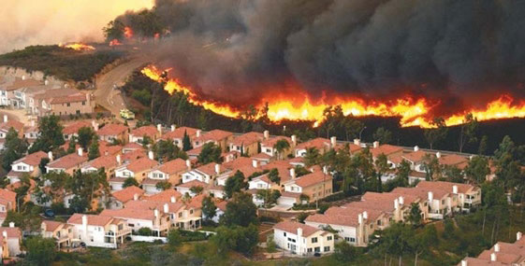
Dissertation Chapters
Landsat-based WUI assessment
Quantification of WUI change
Drivers of WUI growth
Changing fire regimes in WUI areas
Burning Wildland-Urban Interface,
https://texaswildfirerisk.com/the-wildland-urban-interface

Slide 4
Chapter 1: WUI mapping
Title: Mapping the Wildland-Urban Interfaces using spectral unmixing with Landsat imagery in Mediterranean landscapes
Research Questions:
How accurately can Wildland Urban Interface area be quantified using spectral unmixing with Landsat data in Mediterranean landscapes?
How does the Landsat-based WUI area compare to a building location-based WUI map?

Slide 5
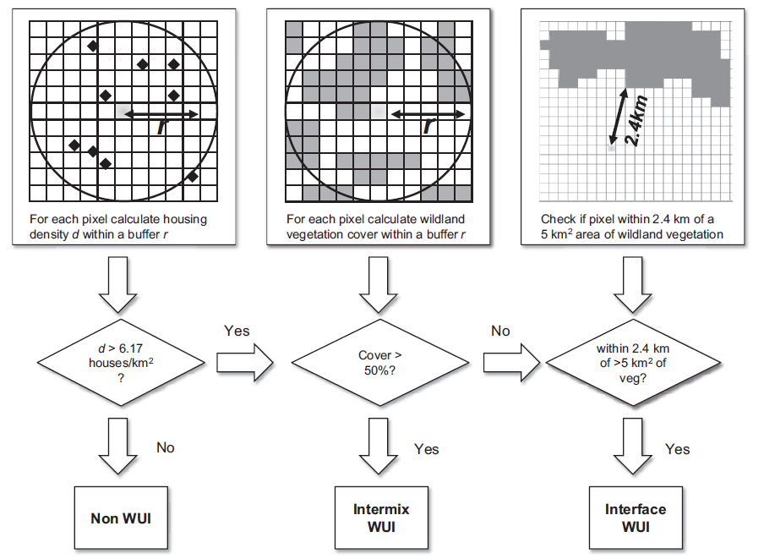
Proposed Analysis
Bar-Massada et al (2013): Using structure location as a basis for mapping the WUI
Landsat-based WUI map
Spectral unmixing of vegetation and impervious
Threshold-based WUI classification
My adaptation of the Method:
Impervious Fractions
Vegetation Fractions
Distance to Vegetation Cluster

Slide 6
Chapter 2: Quantifying WUI change
Title: Mapping Wildland Urban Interface change with spectral unmixing and Landsat time series in Mediterranean landscapes
Research Questions:
How accurately can WUI growth be quantified using spectral unmixing and Landsat time series?
How did WUI grow from 1990 to 2021 in Mediterranean landscapes such as California, western Australia, Chile, South Africa, and Europe?

Slide 7
Chapter 3: Quantifying WUI change drivers
Title: Comparing drivers of vegetation increase and housing growth in causing WUI area expansion across Mediterranean landscapes between 1990 and 2021
Research Questions:
Is the increase in wildland vegetation or buildings the reason for the expansion of WUI areal extent across the Mediterranean landscapes?

Slide 8
Chapter 4: Fire regime change with WUI
Title: Changing Fire Regimes in the Wildland-Urban Interfaces (WUI) in Mediterranean landscapes
Research Questions:
How did the fire regimes in the WUI areas change in Mediterranean landscapes?
Did burn severity and fire frequency increase or decrease as WUI grew?
Did intermix and interface WUI change similarly?

Slide 9
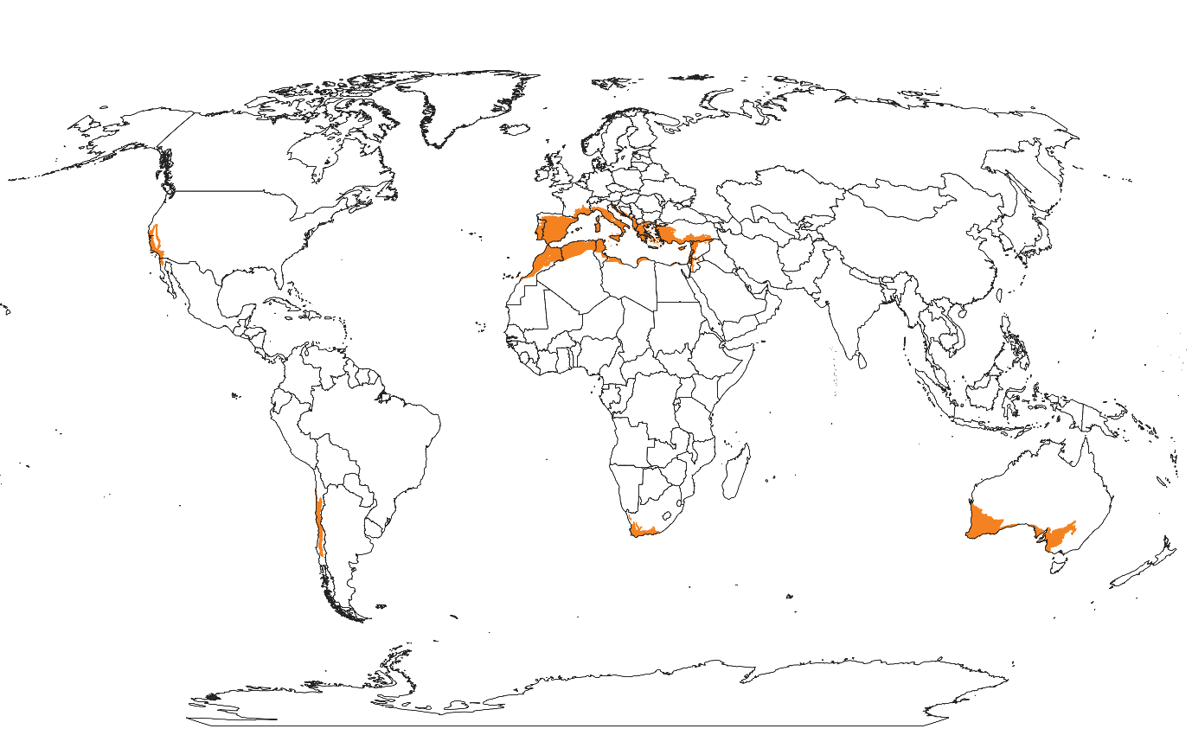
Potential Study Areas
Mediterranean Environment:
hot/ dry summer
cool/ wet winter
Australia, California, Chile, S-W Europe, S & NW Africa
Olson et al (2001): Terrestrial ecoregions of the world: a new map of life on Earth

Slide 10
Significance
Science
Cause of WUI growth & relation to fire regimes
Method
Landsat-based assessment of WUI & trend analysis
Management/ Conservation
Fire regimes within certain areas

Slide 11
Timeline
Year |  | PhD Start | First Meeting | Preliminary | CH1 | CH2 | CH3 | CH4 | Defense
2021 | III | x
2021 | IV
2022 | I |  | x
2022 | II
2022 | III
2022 | IV |  |  | x
2023 | I |  |  |  | Analysis
2023 | II |  |  |  | Analysis
2023 | III |  |  |  | Manuscript
2023 | IV |  |  |  | Manuscript | Analysis
2024 | I |  |  |  |  | Analysis
2024 | II |  |  |  |  | Manuscript
2024 | III |  |  |  |  | Manuscript | Analysis
2024 | IV |  |  |  |  |  | Analysis
2025 | I |  |  |  |  |  | Manuscript | Analysis
2025 | II |  |  |  |  |  | Manuscript | Analysis
2025 | III |  |  |  |  |  |  | Manuscript
2025 | IV |  |  |  |  |  |  | Manuscript | x

Slide 12
Thank you for your attention!
Thank you for your attention!

