Slide 1
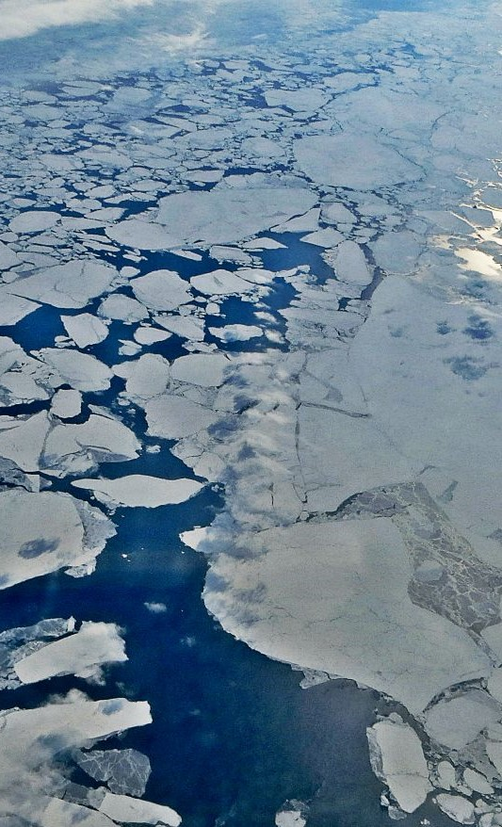
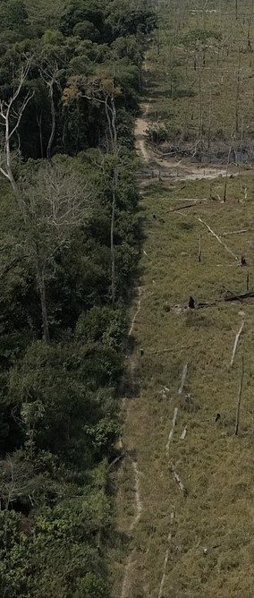
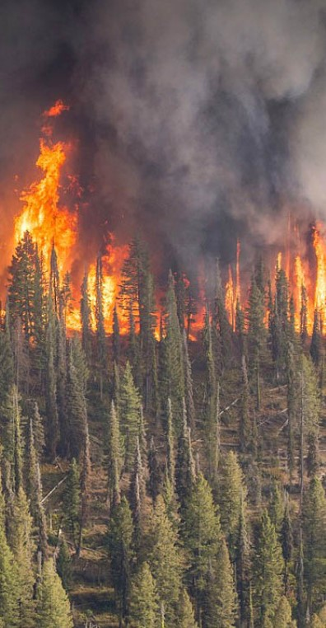
Overview of Proposed Analysis: Chapter 1-3
Connor Stephens
3/12/2021

Slide 2
Introduction
RS data an invaluable tool for quantifying and predicting change.
Data stochasticity and autocorrelation are a challenge.
Common trend analysis methods ignore autocorrelation.
Solution: Partitioned Autoregressive Time-series (PARTS)
Overview │ Methods │ Results

Slide 3
Introduction
Proposed Analyses:
Identify infrequent, abrupt transitions in boreal forest cover caused by wildfire in Sakha, Russia using Landsat 5/7/8 data.
Evaluate long-term, incremental change in Arctic Sea ice extent using the SMM-I/SMMR passive microwave dataset.
Evaluate a combination of abrupt and long-term trends in the Amazonian Drought-Deforestation feedback using the INPE PRODES deforestation dataset.
Overview │ Methods │ Results

Slide 4
Chapter 1: Detecting Wildfire in the Boreal Forests of Siberia
Overview │ Methods │ Results

Slide 5
Introduction
Siberian Taiga are 17% of the world’s forests.
Permafrost carbon stocks a greenhouse gas source if destabilized.
Primary disturbance agent is infrequent wildfire. Climate change reduces reburn interval.
Conventional mapping algorithms (BFAST, LandTrendr) and coarse resolution imagery cause commission errors.
Overview │ Methods │ Results

Slide 6
The Question
Can medium-resolution optical datasets be used to robustly quantify burnt area in Yakutia’s Boreal forests?
Overview │ Methods │ Results

Slide 7
Analysis and Product
Analysis:
Estimate temporal autocorrelation in NDVI.
Calculate spatial autocorrelation in pixel time-trend residuals.
Identify spatially correlated abrupt decreases in NDVI.
Product:
Annual 30m burnt area map for Yakutia (2000 – 2020).
Identified regions of high fire activity.
Overview │ Methods │ Results

Slide 8
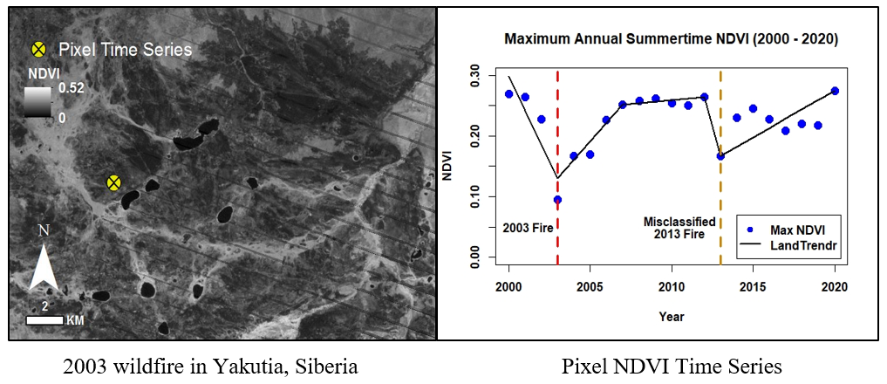
Preliminary Results of CLS Analysis
Point size proportional to fire size
Overview │ Methods │ Results

Slide 9
Chapter 2: Identifying Regions of Consistent Sea Ice Loss in the Arctic
Overview │ Methods │ Results

Slide 10
Introduction
Arctic sea ice is very important for global climate regulation
Excellent long-term remote-sensing observations, making it ideal for trend analysis
High degree of inter-annual variability is a challenge.
Overview │ Methods │ Results

Slide 11
The Question
Can consistent, spatially correlated trends in Arctic sea ice loss be identified given its high degree of inner-annual variability?
Overview │ Methods │ Results

Slide 12
Analysis and Product
Analysis:
Estimate temporal autocorrelation in ice extent.
Calculate spatial autocorrelation in pixel trends.
Identify spatially correlated trends in ice extent.
Product:
Estimate of monthly ice extent trends (1979 – 2018).
Identified regions of consistent decrease.
Overview │ Methods │ Results

Slide 13
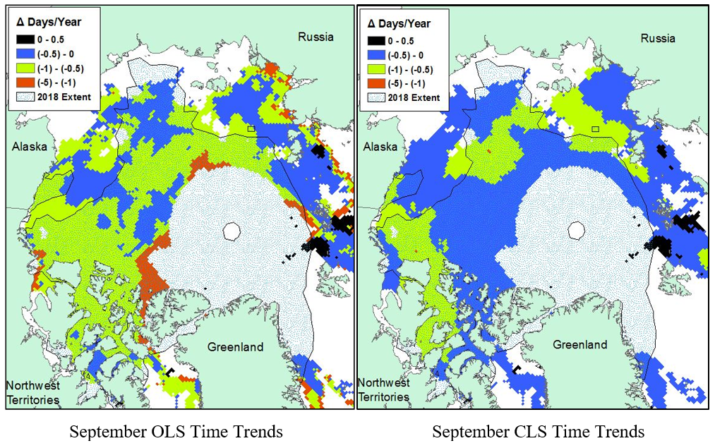
Preliminary Results of CLS Analysis
Point size proportional to fire size
Overview │ Methods │ Results

Slide 14
Chapter 3: Identifying Regions Vulnerable to Drought-Deforestation Feedback in the Brazilian Legal Amazon
Overview │ Methods │ Results

Slide 15
Introduction
Amazon Rainforest provides numerous ecological services.
The region has experienced intense pressure from development.
The drought-deforestation feedback has the potential to destabilize regional climate.
Tracking feedback using spatio-temporal autocorrelation provides new insight.
Overview │ Methods │ Results

Slide 16
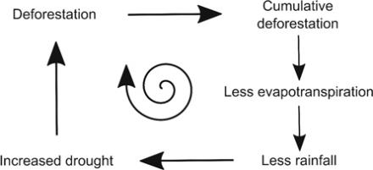
Introduction
Drought – Deforestation Feedback
Cite: Staal et al. 2020
Overview │ Methods │ Results

Slide 17
The Question
What are the drivers of the Drought-Deforestation feedback, and where is the process happening most intensively?
Overview │ Methods │ Results

Slide 18
Analysis and Product
Analysis:
Fit AR polynomial model to PRODES DF data.
Classify distinct trends in deforestation.
Model deforestation rapidity based on established drivers.
Product:
Estimate of deforestation driver relationship to rapidity.
Identified regions at heightened risk of D-D feedback.
Overview │ Methods │ Results

Slide 19
Dissertation Significance
Addressing autocorrelation servers to validate or inform current understanding of long-term human impact on important climatological feedbacks.
Demonstrate the importance of autocorrelation in remotely sensed data.
Validate the utility of a new powerful tool for remotely sensed trend analysis.
Overview │ Methods │ Results

Slide 20
Questions/Comments?
Thank you!

Slide 21
Timeline
Project Timeline
Year | 2021 |  | 2022 |  |  |  | 2023 |  |  |  | 2024
Quarter | III | IV | I | II | III | IV | I | II | III | IV | I | II
Siberia | AN | MP | MP
Arctic |  |  | DC | AN | AN | MP | MP
Amazon |  |  |  |  |  |  | DC | DC | AN | AN | MP | MP
DC – Data calculation, AN – Analysis, MP – Manuscript preparation
Degree Timeline
Step | Date
PhD Start: | September, 2020
Preliminary Exam: | May, 2021
Finish Coursework: | May, 2021
Dissertator Status: | May, 2022
Expected PhD Completion Date: | August, 2024
Overview │ Methods │ Results

Slide 22
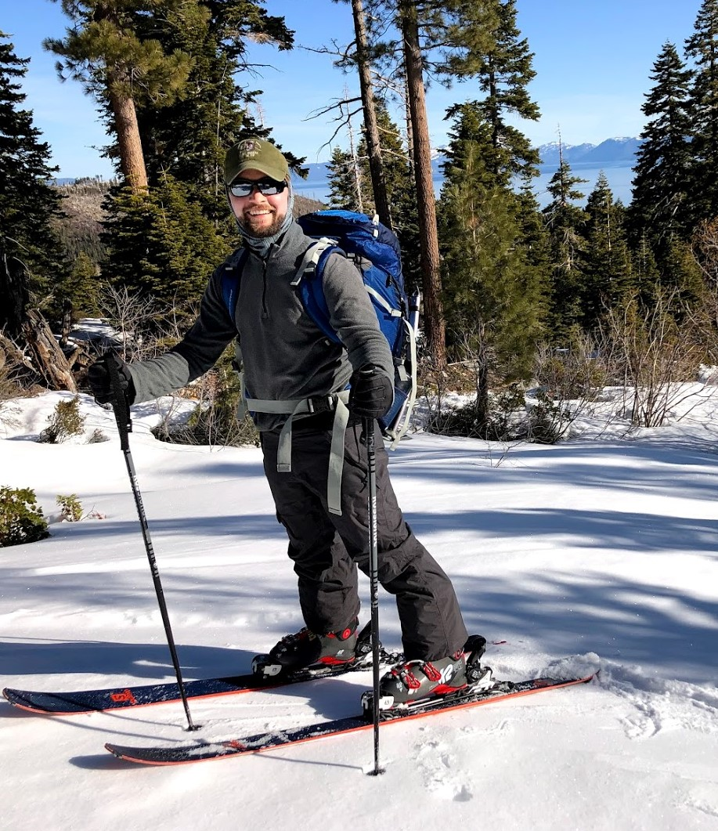
Background
Education:
M.S. GIS/RS, Clark (2019)
B.S. Forestry, UC Berkeley (2016)
Before UW:
RS Analyst for PG&E
Where I’d Like to Go:
Federal Research Scientist or Academic
Hobbies:
I like to be outside!
Mt. Tallac Approach (2021)
Overview │ Methods │ Results

